Slide 1
The Human Visual System
NBAY 6120
March 17, 2020
Prof. Donald P. Greenberg
Lecture 6A

Slide 2
Fundamentals of Human Perception
Retina, Rods & Cones, Physiology
Receptive Fields
Visual Acuity of Resolution
Depth Perception

Slide 3
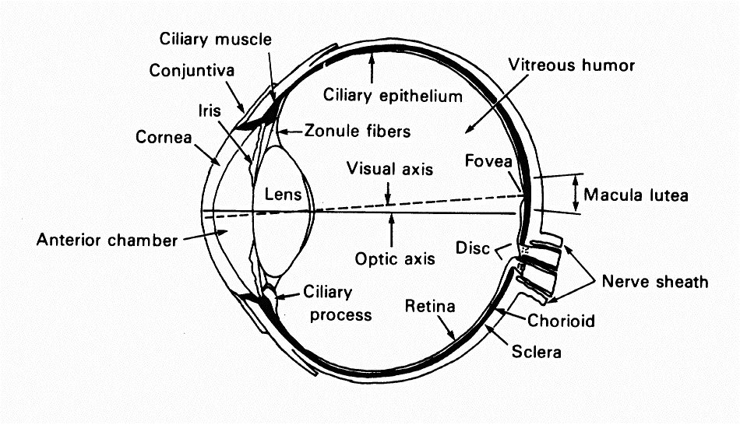
Cross Section of Eye & Retina

Slide 4
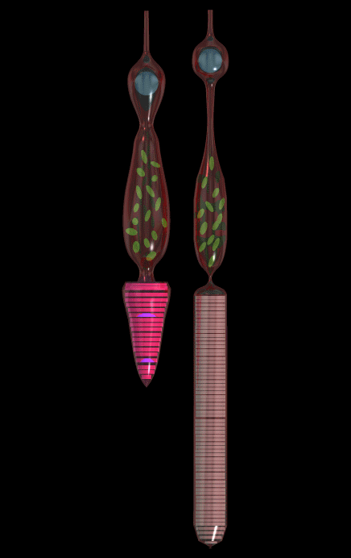
Rods & Cones
Comparison of a rod cell (right) and cone cell (left). This shows how each cell acquired its name from its shape.
120 million rods
7-8 million cones
in each eye
http://www.chemsoc.org/exemplarchem/entries/2002/upton/cones.htm

Slide 5
Rods & Cones

Slide 6
Receptor Distribution

Slide 7
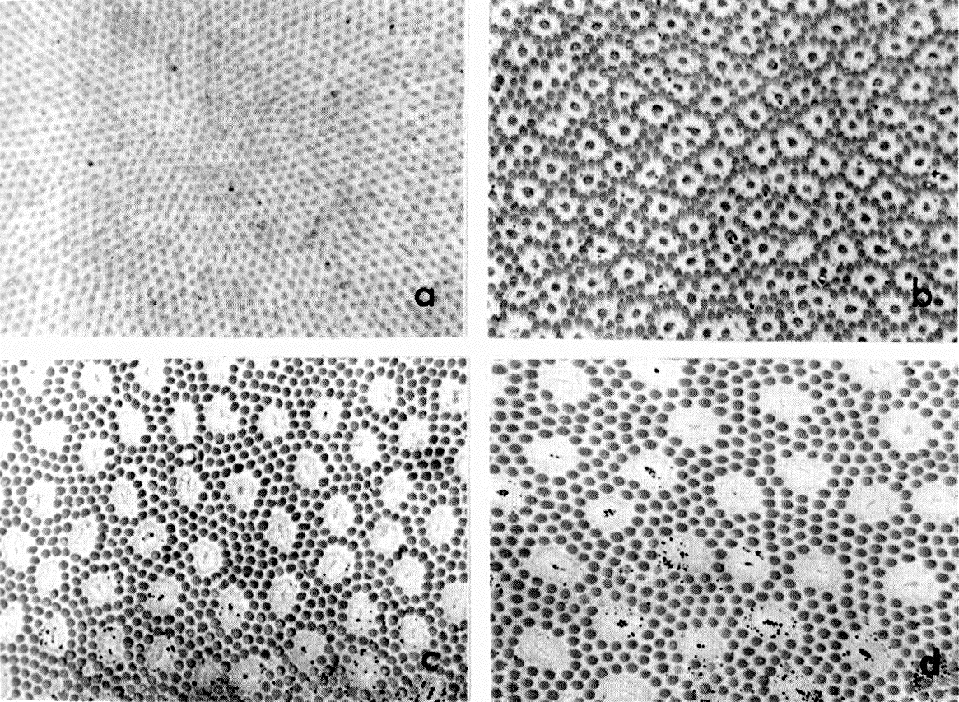
Receptor Distribution
fovea
parafovea
Cone
periphery
far periphery
Rod
Adapted from Levine, Vision in Man and Machine © McGraw-Hill, 1985.

Slide 8
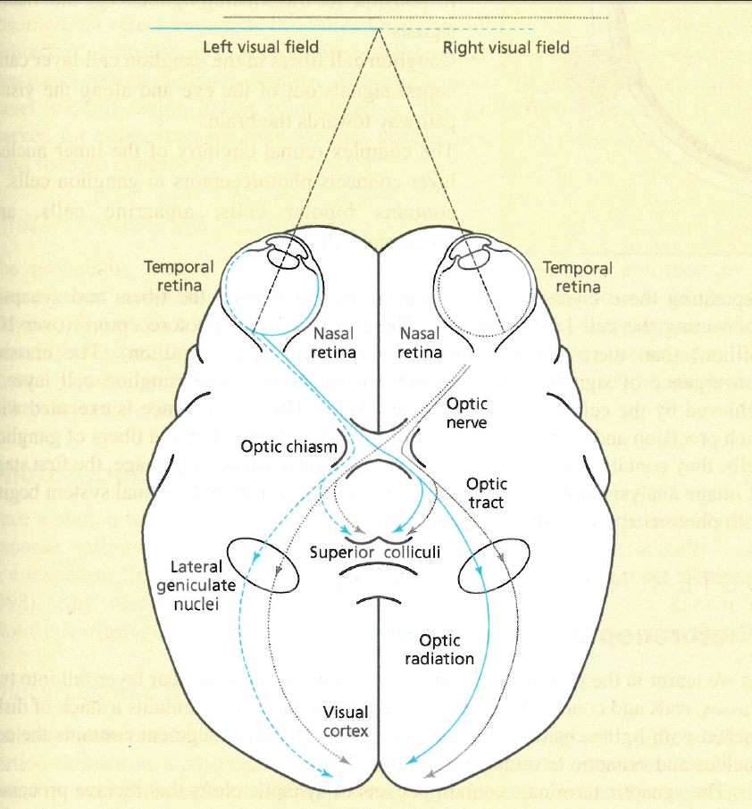
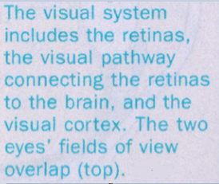
Field of View of the Human Eye
Stereoscopic Vision
Field of View
“Foundations of Sensation and Perception.” Mather, George. 2009.
Notes:
Note only in the region where there is overlap from both eyes do we have binocular vision, the ability to receive depth measurements. The rest is our perception

Slide 9
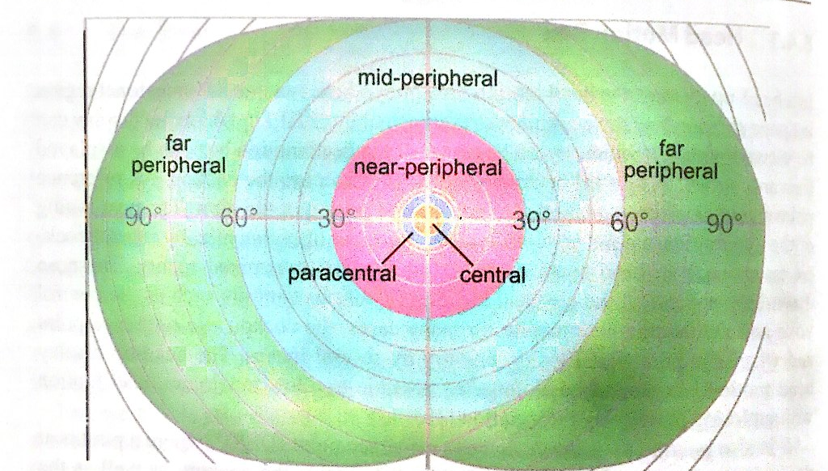
Field of View of the Human Eye
Wikipedia

Slide 10
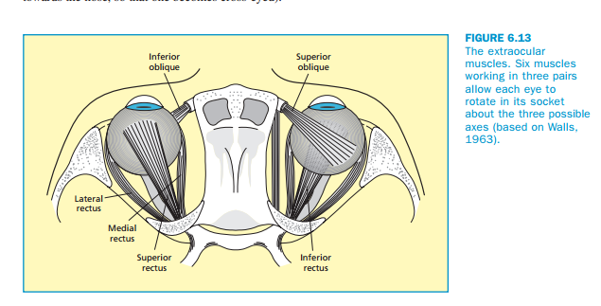
Extraocular Muscles
“Foundations of Sensation and Perception.” Mather, George. 2009.

Slide 11
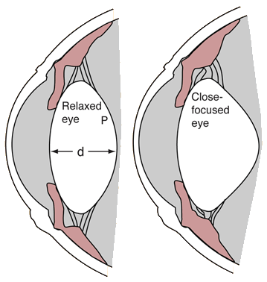
Cilary Muscles
Light and Vision R. Nave

Slide 12

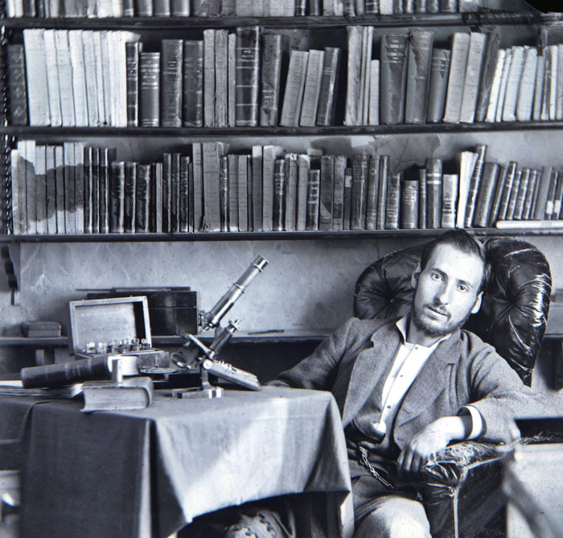
Santiago Ramon y Cajal & Camillo Golgi 1906

Slide 13

Drawings of Santiago Ramon y Cajal

Slide 14
Fundamentals of Human Perception
Retina, Rods & Cones, Physiology
Receptive Fields
Visual Acuity of Resolution
Depth Perception

Slide 15
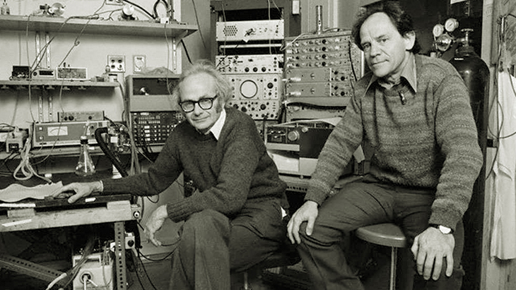
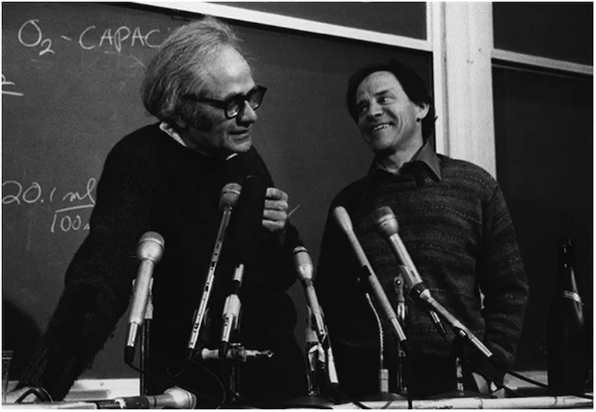
Hubel and Weisel 1981

Slide 16
Receptive Fields
Individual cone signals can either add together or be subtracted from one another.
The ability to resolve fine details depends ultimately on both the spatial mosaic of the receptors and how they interconnect.

Slide 17
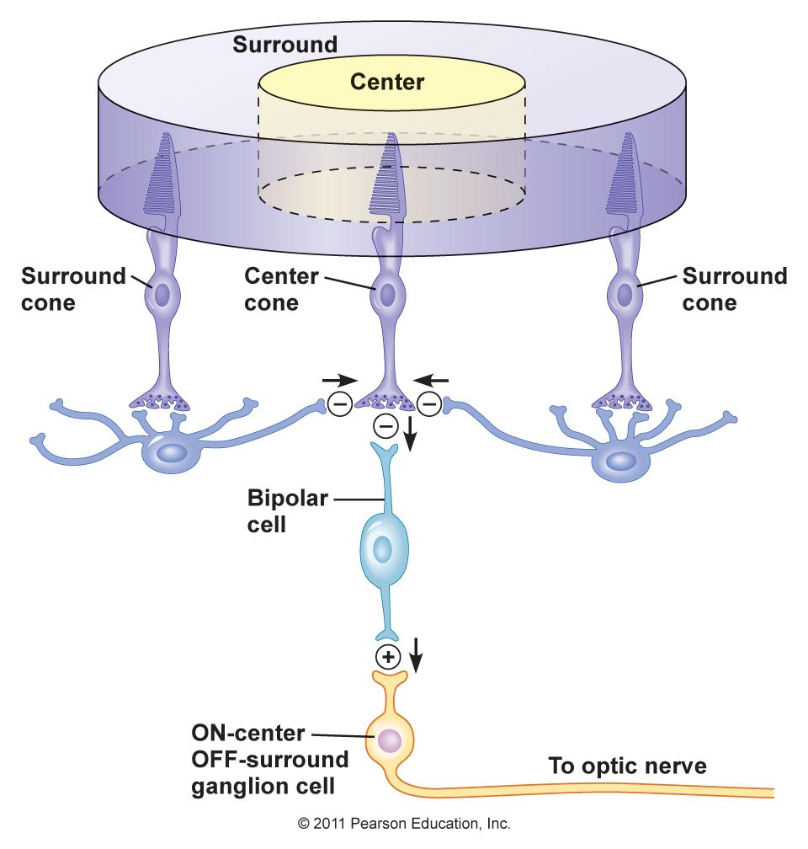
Receptive Fields
http://droualb.faculty.mjc.edu/Course%20Materials/Physiology%20101/Chapter%20Notes/Fall%202007/figure_10_39_labeled.jpg

Slide 18
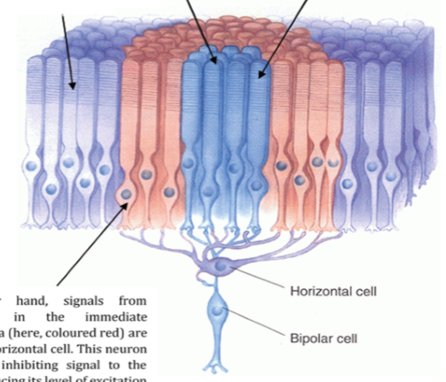
Receptive Fields
S. Deleniv. The Neurosphere. 2016.

Slide 19
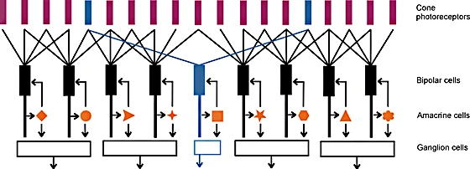
Rods and Cones and Neural Connections
Abstraction
Masland, Richard. “The fundamental connections of the retina.”

Slide 20
Fundamentals of Human Perception
Retina, Rods & Cones, Physiology
Receptive Fields
Visual Acuity of Resolution
Depth Perception

Slide 21


Measures of Acuity
detection
resolution
localization
min. detectable
0.5”
min. resolvable
30”
Snellen letters
30”
vernier
5-7”
Upper figure adapted from Cornsweet. Visual Perception © Academic Press, 1971.
Two rightmost figures from Graham, Vision and Visual Perception © Wiley, 1966.

Slide 22
Visual Acuity
Visual acuity is defined as “1/a where a is the response in arc-minutes”.
This acuity is usually measured by a grating test pattern and thus is
defined using a line pair.
It takes two pixels to generate a line pair (black and white).
Based on a large number of tests, the resolution of the human eye
is approximately 0.3 arc minutes.

Slide 23
How many megapixels are necessary to match the resolution of the human eye?

Slide 24
What is the distance from the surface of the eye to the screen in VR?
How many pixels per inch are necessary at roughly 1.25 inches?

Slide 25
Fundamentals of Human Perception
Retina, Rods & Cones, Physiology
Receptive Fields
Visual Acuity of Resolution
Depth Perception

Slide 26
Human Depth Perception
Depth Perception
Oculomotor
Binocular
Monocular
Visual
Binocular
Monocular
Convergence
Accommodation
Stereopsis
Static Cues
Motion Parallax
Perspective
Occlusion
Texture Gradient
Shading, Shadows, Highlights
Atmospheric Blur
Motion, Position
Familiarity, Relative Size

Slide 27
Monocular Vision
Sixty to seventy degrees have no binocular
vision (because only one eye can see those portions of the
visual field)

Slide 28

Monoscopic Depth Cues
Perspective
Depth from Motion, Relative Size, Position, Familiarity
Occlusion
Texture Gradient
Parallax from Motion
Shadows and Specular Highlights
Atmospheric Blur

Slide 29

Monoscopic Depth Cues
Perspective
Depth from Motion, Relative Size, Position, Familiarity
Occlusion
Texture Gradient
Parallax from Motion
Shadows and Specular Highlights
Atmospheric Blur

Slide 30
Monoscopic Depth Cues
Perspective
Depth from Motion, Relative Size, Position, Familiarity
Occlusion
Texture Gradient
Parallax from Motion
Shadows and Specular Highlights
Atmospheric Blur

Slide 31

Monoscopic Depth Cues
Perspective
Depth from Motion, Relative Size, Position, Familiarity
Occlusion
Texture Gradient
Parallax from Motion
Shadows and Specular Highlights
Atmospheric Blur

Slide 32
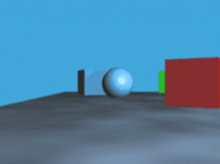
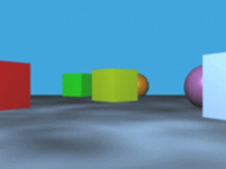
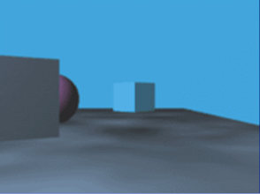
Monoscopic Depth Cues
Perspective
Depth from Motion, Relative Size, Position, Familiarity
Occlusion
Texture Gradient
Parallax from Motion
Shading, Shadows, and Specular Highlights
Atmospheric Blur
Viewpoint A
Viewpoint B
Viewpoint C

Slide 33
Monoscopic Depth Cues
Perspective
Depth from Motion, Relative Size, Position, Familiarity
Occlusion
Texture Gradient
Parallax from Motion
Shading, Shadows, and Specular Highlights
Atmospheric Blur

Slide 34

Monoscopic Depth Cues
Perspective
Depth from Motion, Relative Size, Position, Familiarity
Occlusion
Texture Gradient
Parallax from Motion
Shadows and Specular Highlights
Atmospheric Blur

Slide 35
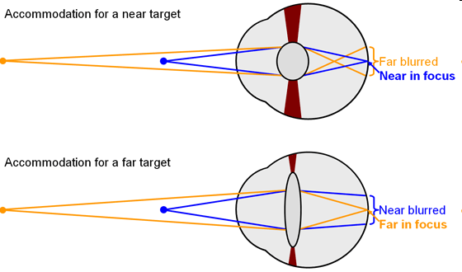
Monoscopic Depth Cues
Perspective
Depth from Motion, Relative Size, Position, Familiarity
Occlusion
Texture Gradient
Parallax from Motion
Shadows and Specular Highlights
Atmospheric Blur
Accommodation
Note change in lens shape

Slide 36
Vergence
The simultaneous movement of the pupils of the eyes toward or away from one another during focusing.
This measure of the convergence or divergence of a pair of light rays is defined as vergence.

Slide 37
Vergence Accommodation Conflict
Computer and projection displays present images on a single surface but have a focal distance (blur on the retina) which may be in front of or behind the screen
The inability to fuse the binocular stimuli causes discomfort and fatigue to the viewer
David M. Hoffman, Ahna R. Girschick, Kurt Akeley, Martin S. Banks. “Vergence-accommodation conflicts hinder visual performance and cause visual fatigue, Journal of Vision, vol. 8, no. 3, article 33, March 28, 2008.

Slide 38
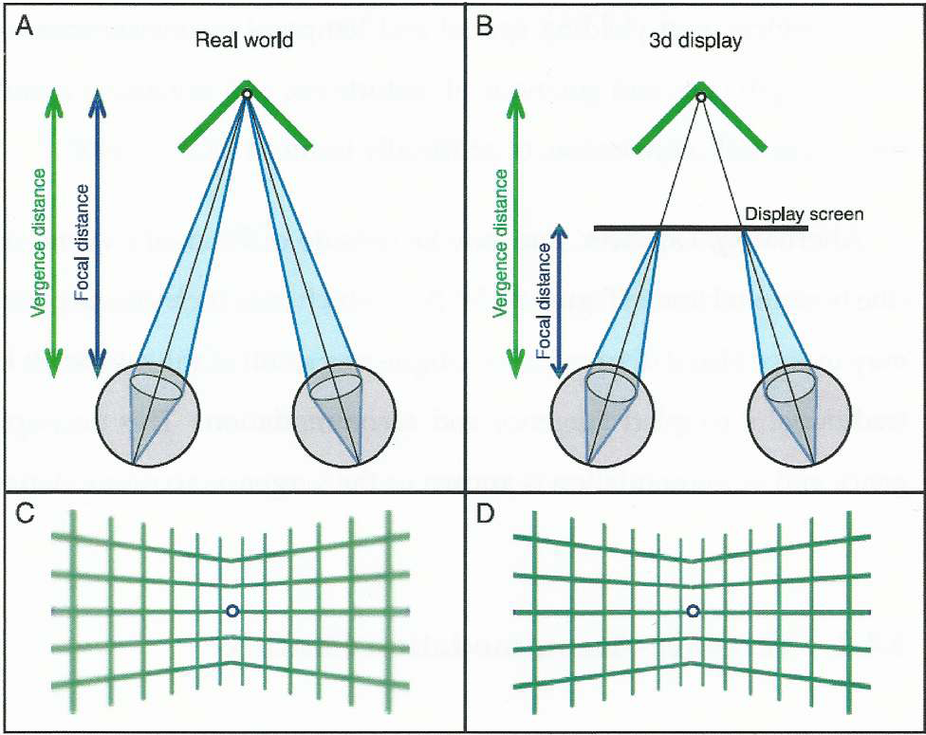
Diagram of Vergence

Slide 39
Vergence – Accommodation Conflict

Slide 40
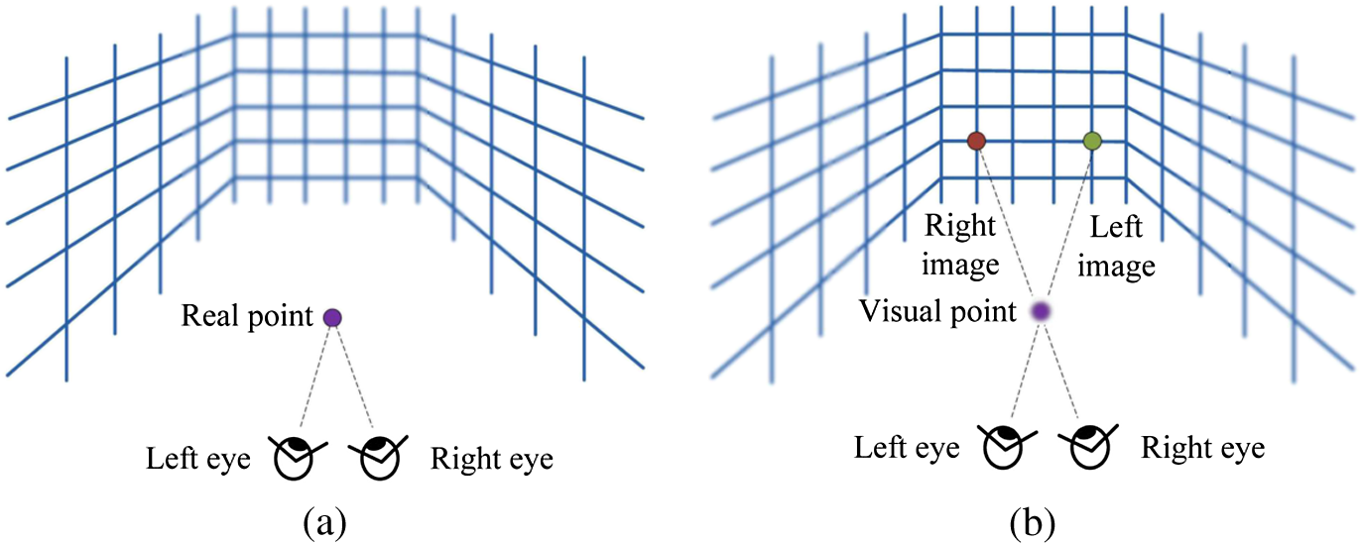
Vergence – Accommodation Conflict

Slide 41
Stereoscopic Vision: At The Screen
Apparent Image Depth
3D
Screen / Image Plane
L
L
R
R

Slide 42
Stereoscopic Vision: In Front Of The Screen (Convex)
Apparent Image Depth
3D
3D
Screen / Image Plane
3D
L
L
R
R

Slide 43
Stereoscopic Vision: Behind The Screen (Concave)
Apparent Image Depth
3D
3D
3D
Screen / Image Plane
L
L
R
R

Slide 44
Is the gaze direction of the human eye constant?

Slide 45

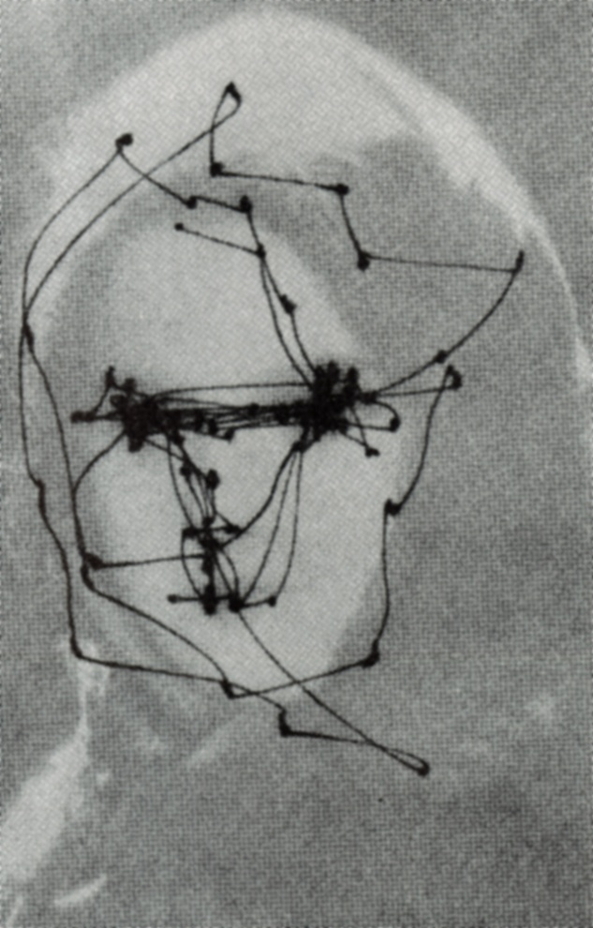
Saccadic Motion
The eye jumps, comes to rest momentarily (producing a small dot on the record), then jumps to a new locus of interest.
- David H. Hubel. EYE, BRAIN, AND VISION, 1988 Scientific American Books, Inc. p. 80.

Slide 46
Saccade Control
Saccade control is the ability of the eye(s) to move quickly from one fixation point to another (100-300 ms)
To obtain a complete picture, normal adults perform 3-5 saccades (“snapshots”) per second
Fixation “restops” are ≈ 50-100 ms

Slide 47
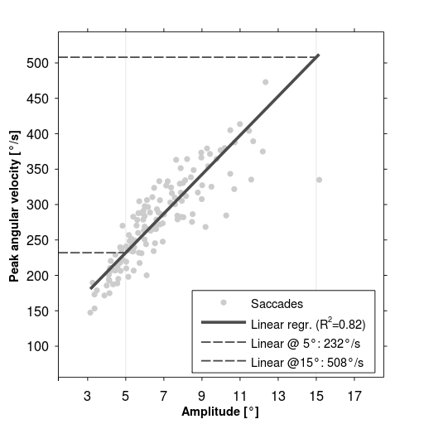
Saccades Peak Angular Velocity
Wikipedia

Slide 48
Saccadic Masking
There are two major types of saccadic masking or suppression
Flash suppression is the inability of the eye to see a flash of light during a saccade
Suppression of image displacement is characterized by the inability to perceive whether a target has moved during a saccade.

Slide 49
End

Slide 50
Virtual Reality
NBAY 6120
March 17,2020
Prof. Donald P. Greenberg
Lecture 6B

Slide 51
What is Virtual Reality?

Slide 52
Virtual Reality
A term used to describe a computer generated environment which can simulate the perception of PRESENCE.

Slide 53
Virtual Reality
A person immersed within this virtual world can manipulate objects, interact with the environment, and explore the virtual world in the same perceptual way as one interacts with the physical world.

Slide 54
The Human in the Loop
Abstract Interpretation
Viewing a Picture on Television
Cinema Viewing
Presence

Slide 59
Characteristics of Visual Sensory Systems
Visual Acuity
Peripheral Vision
Motion Detection
Depth Perception
Color

Slide 60
Characteristics of Visual Sensory Systems
Visual Acuity
Peripheral Vision
Perception of Motion
Depth Perception
Color
Display Resolution and Eye Tracking
Immersion and Field of View
Refresh and Update Rate
3D Environment Simulation
Display Color Gamut
Computation is free! Bandwidth is available?

Slide 61
What will happen next?
It is useful to first compare the history of development acceptance and deployment of similar display technologies

Slide 62
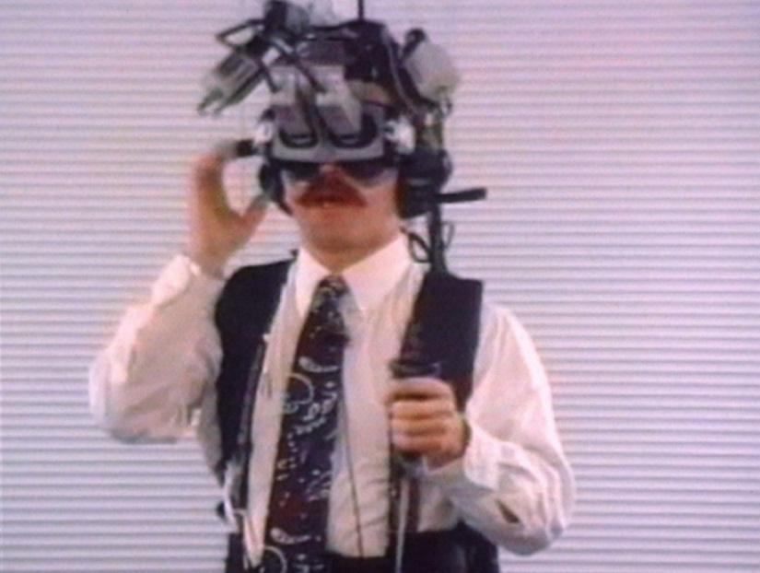
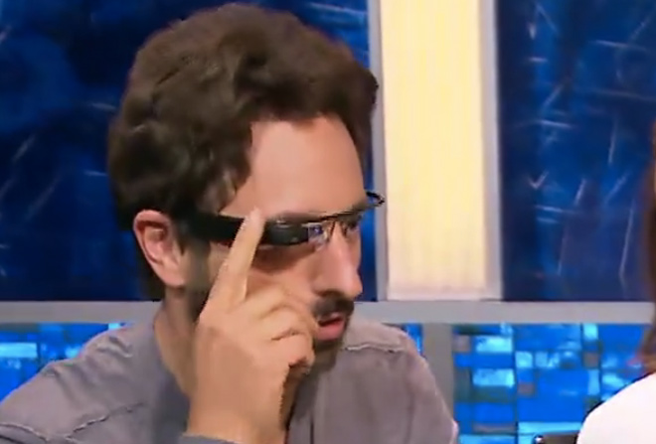
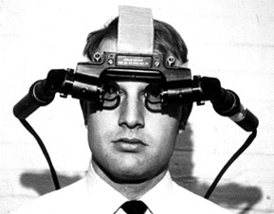
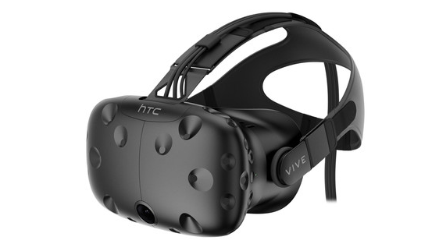
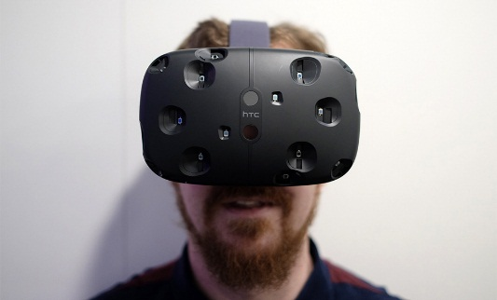
2013: Google Glass
1968: Ivan Sutherland
1990s: HMDs, Henry Fuchs
History of Virtual Reality
2016: HTC & Valve’s SteamVR Vive
48 Years

Slide 63

Henry Fuchs, UNC 1991

Slide 64
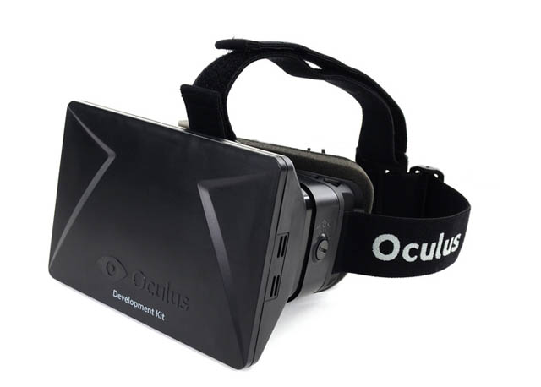
VR Timeline
Palmer Luckey starts building VR headsets when he is 18 years old
Luckey raises funds from kickstarter ($670k in 24 hours)
John Carmack partners with Luckey
FOV 90 degrees H, 110 degrees V
LCD 1080p (960x1080/eye) Facebook buys Oculus for $2B
March 25th, 2014

Slide 65

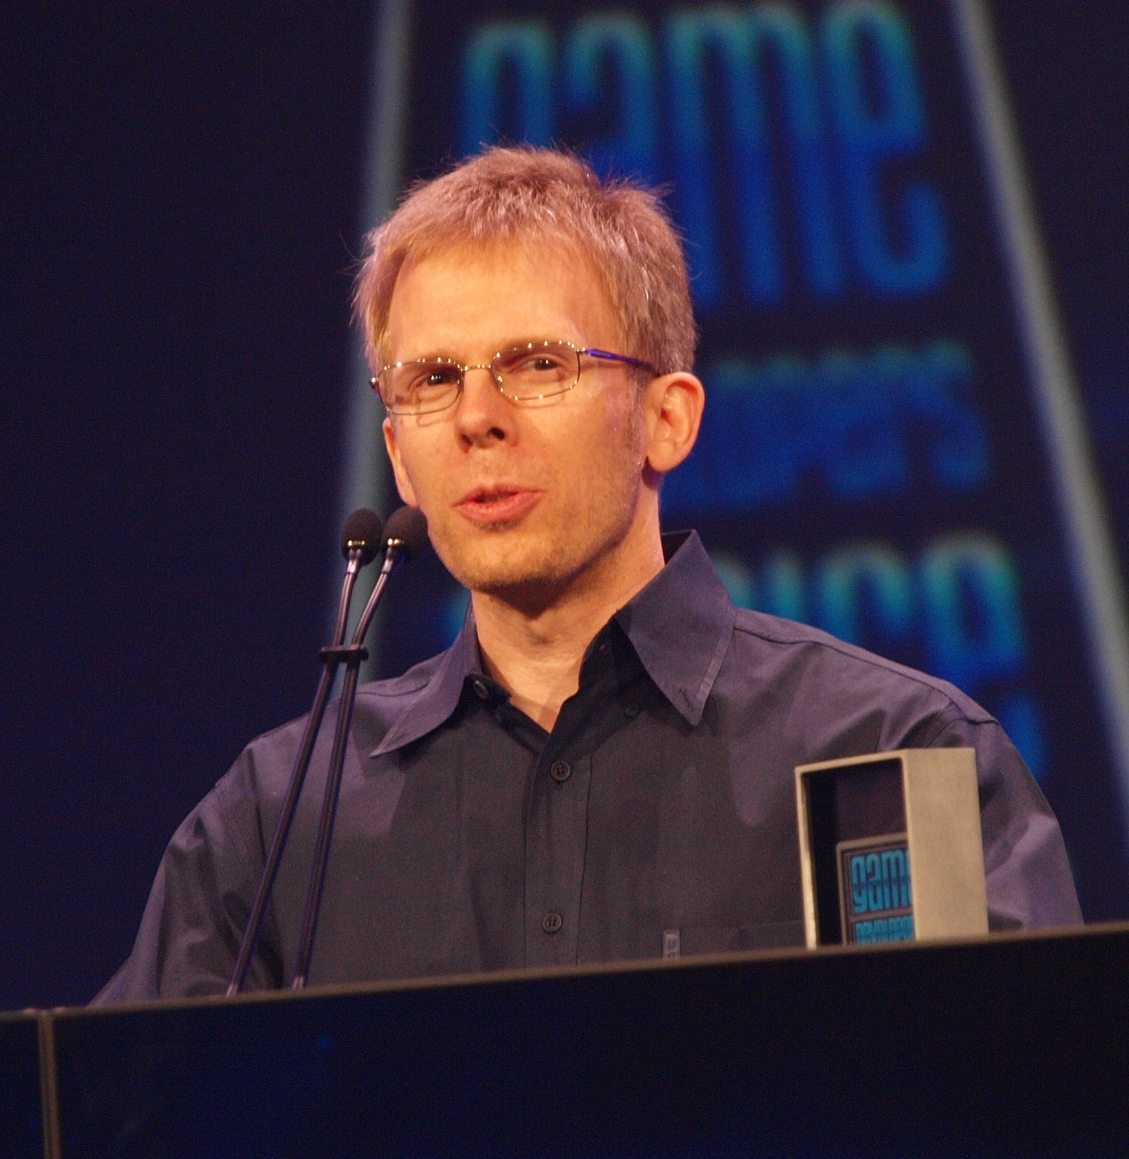
Palmer Luckey John Carmack

Slide 66
Oculus 2014
Why did Facebook invest $2 billion in Oculus Rift?

Slide 67
Microsoft
Why did Microsoft buy Minecraft? Why is Microsoft building its Hololens?

Slide 68
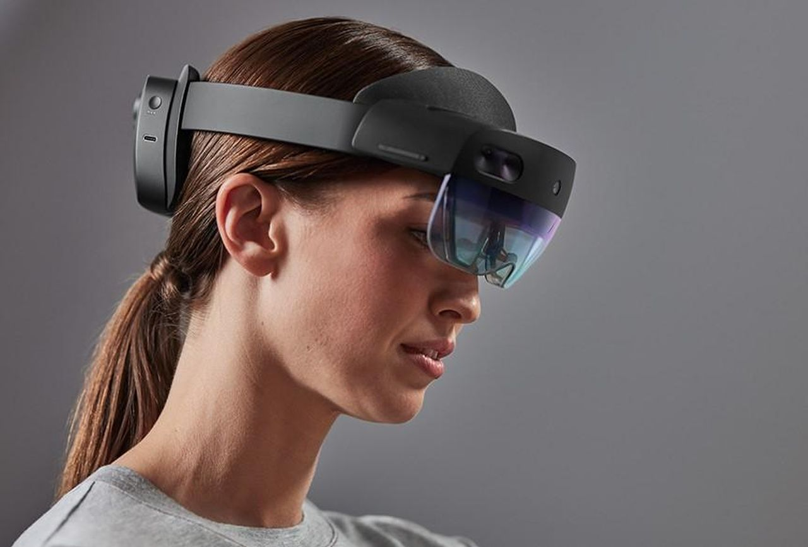
Microsoft’s Hololens 2 2019

Slide 69
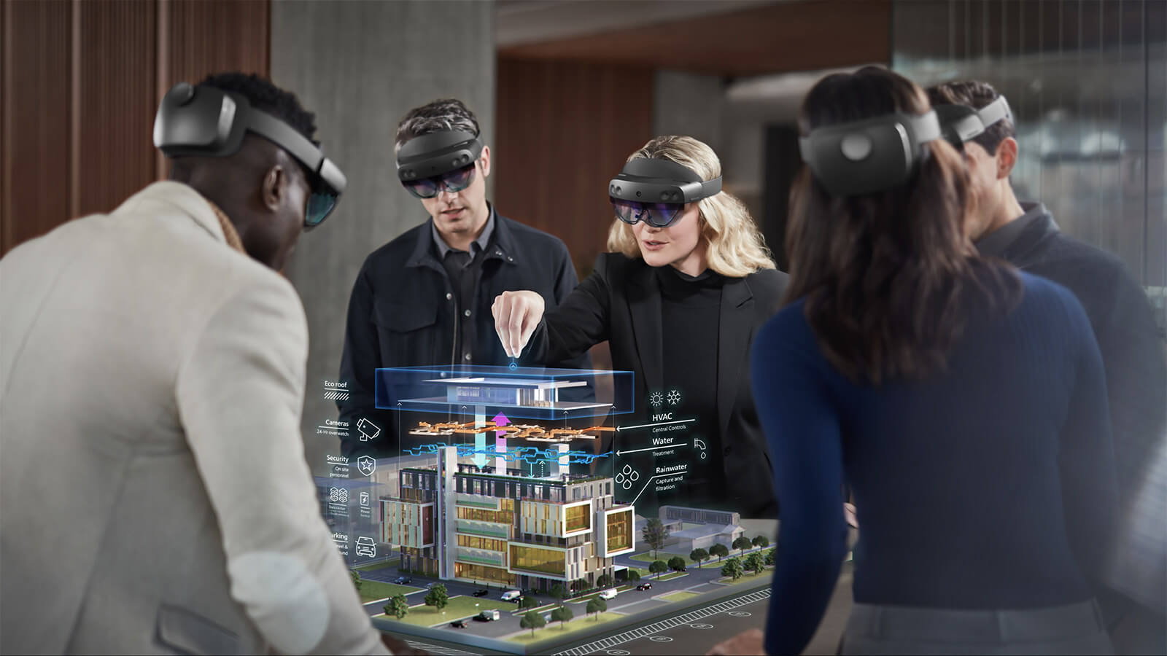

Slide 70
Google Invests in Magic Leap
Why is Google (and Andressen / Horwitz) investing $500+ million in Magic Leap?

Slide 71

Magic Leap

Slide 72
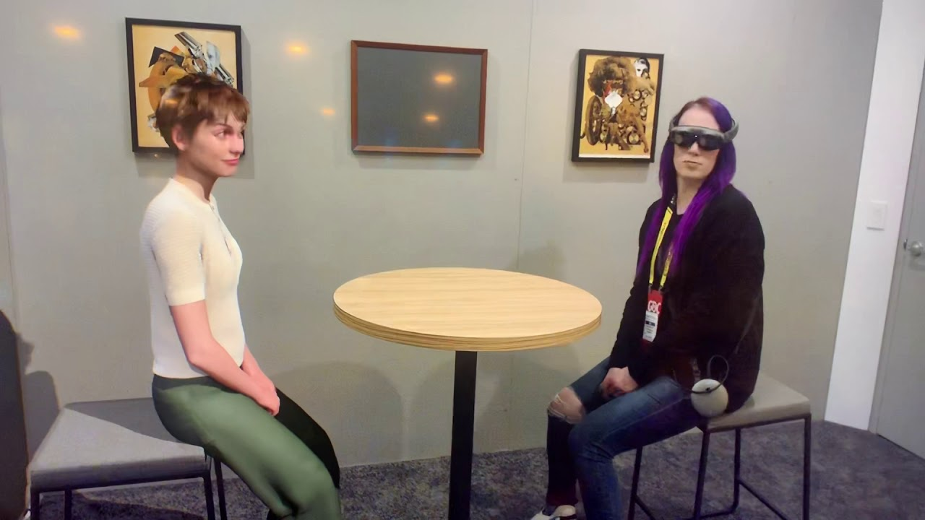
Magic Leap Mica 2019

Slide 73
Technical Requirements for VR/AR Satisfactory Delivery
Display resolution similar to the human visual system
Display quality similar to human visual system (illumination, color, etc.)
Sufficient display rates for motion perception
Rendering speeds to satisfy display rate requirements
Sufficient wireless bandwidth for data
All of this will depend on understanding the human visual system!

Slide 74
Current VR Devices
Most of these new devices include slight improvements, primarily involved with tracking (both location and orientation) and obtaining better accuracy

Slide 75
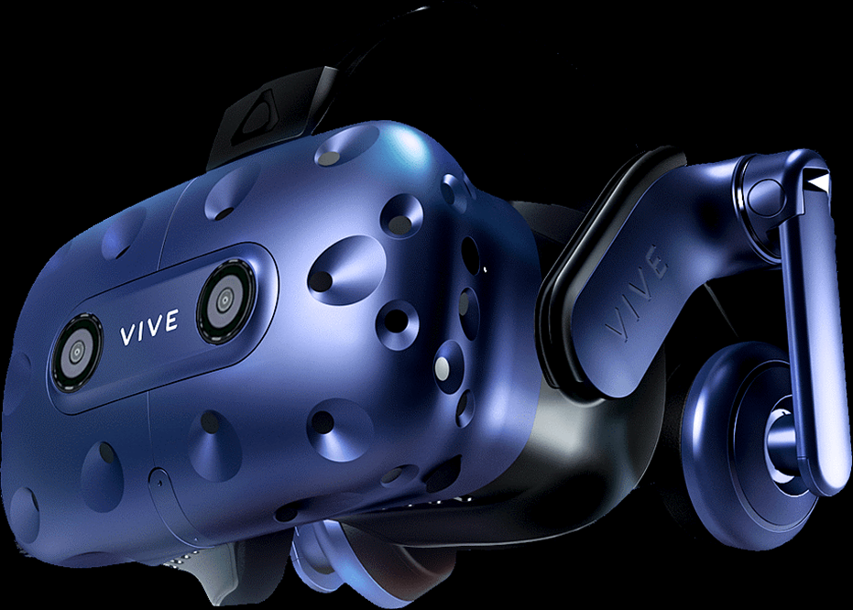
Vive Pro VR Goggles June 2018
OLED
3K resolution
615 ppi

Slide 76
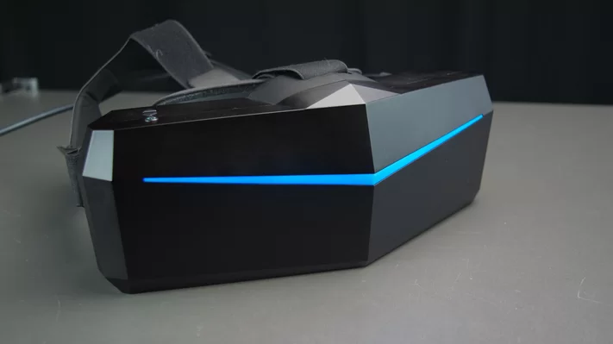
Head Mounted Displays 2019
Pimax 5k+ VR Headset
200 degree FOV
Dual 2560 x 1440 LCD
($999)

Slide 77
Technical Requirements for VR/AR Satisfactory Delivery
Display resolution similar to the human visual system
Display quality similar to human visual system (illumination, color, etc.)
Sufficient display rates for motion perception
Rendering speeds to satisfy display rate requirements
Sufficient wireless bandwidth for data

Slide 78
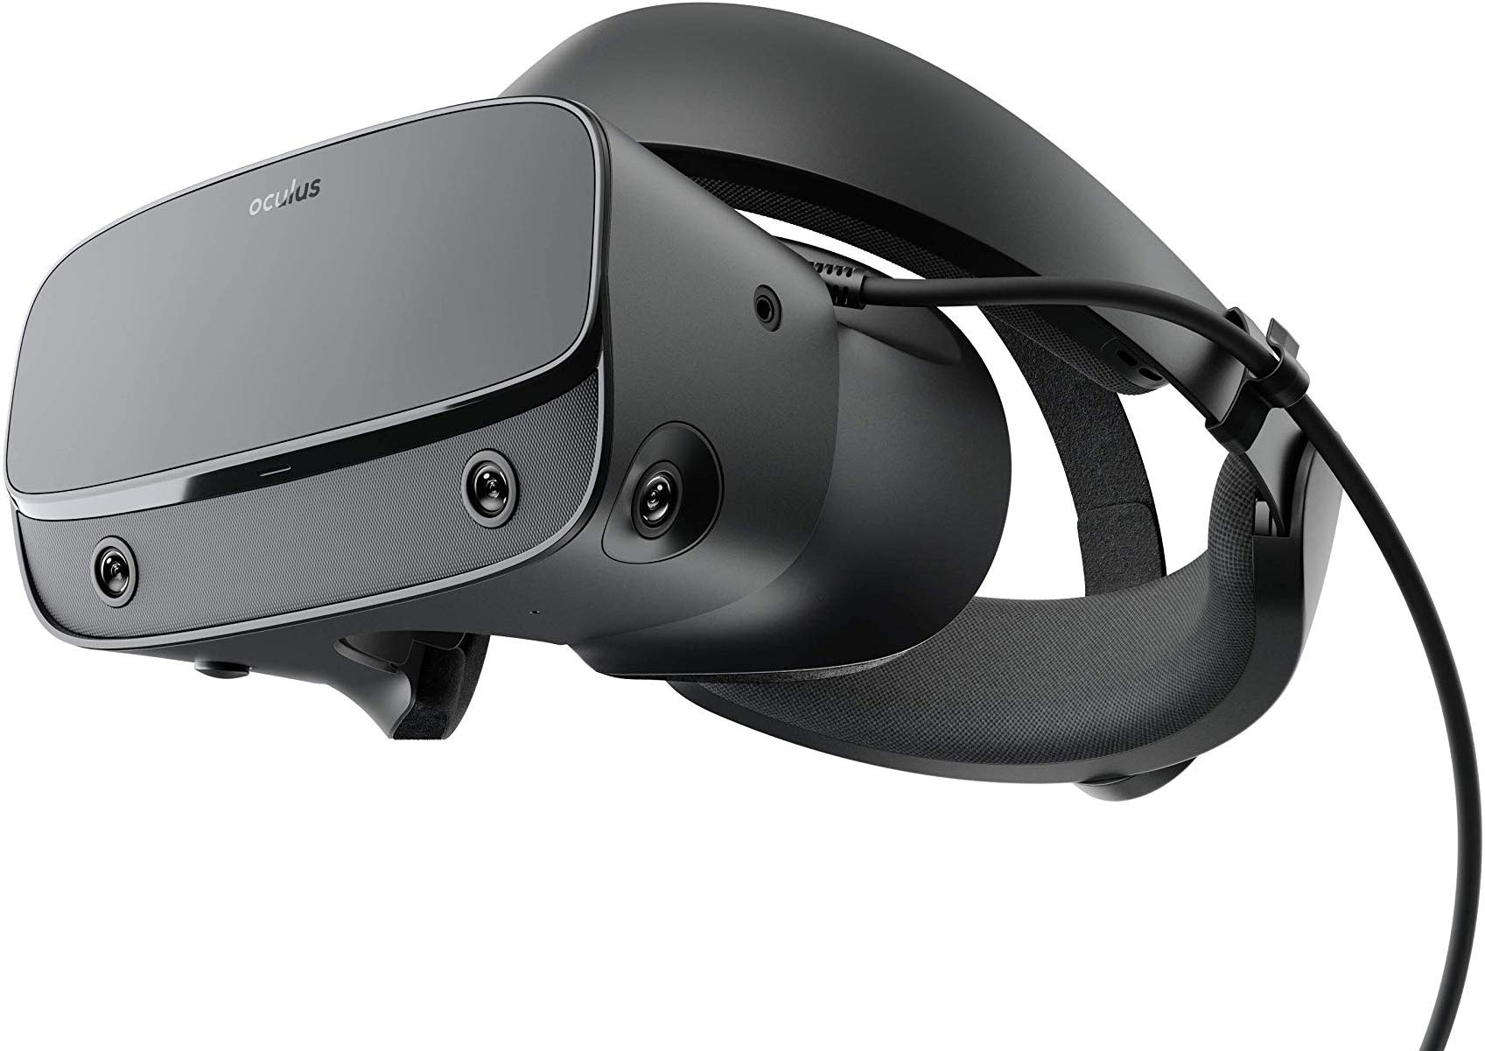
Oculus Rift- S 2019
Oculus Rift
1080x1200/eye
($399)

Slide 79
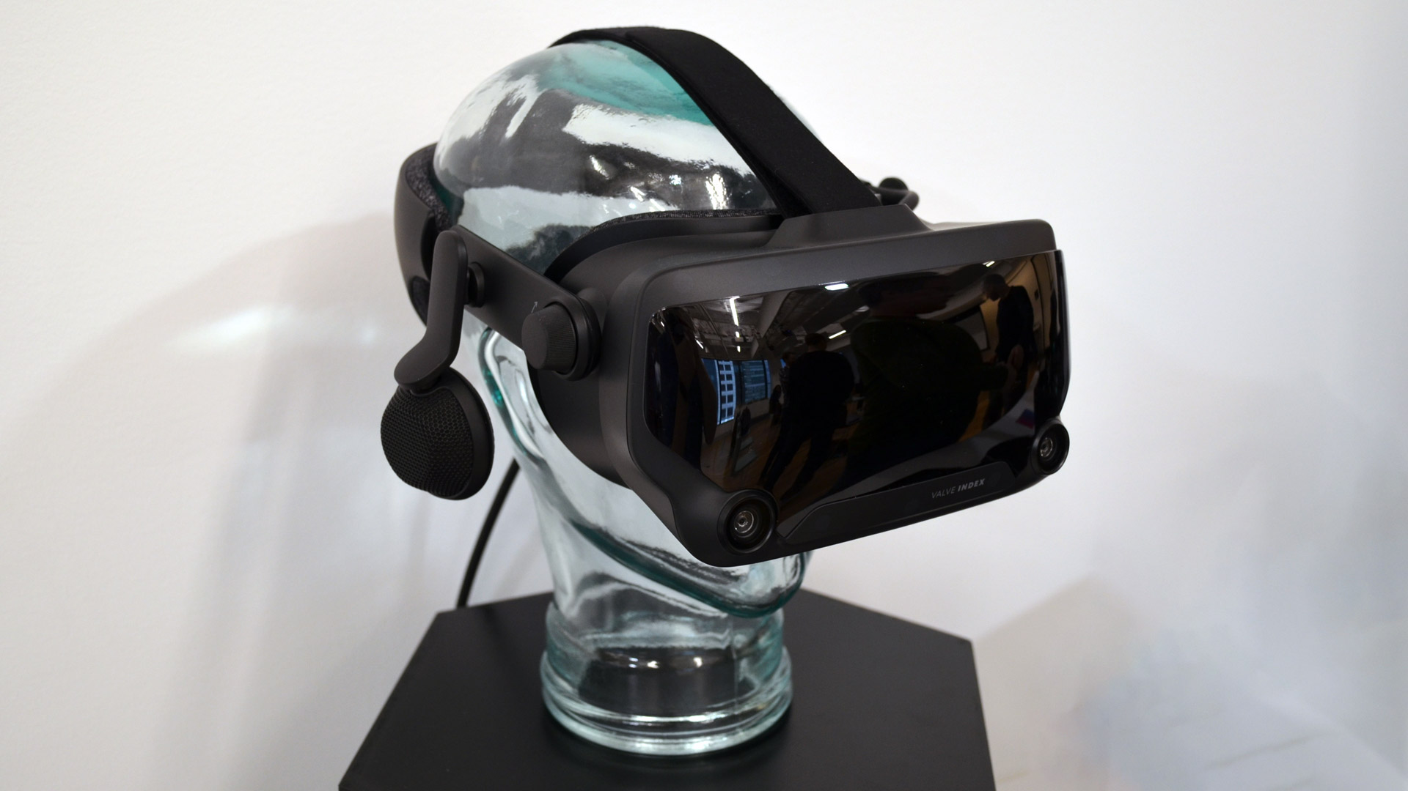
Valve Index 2019

Slide 80
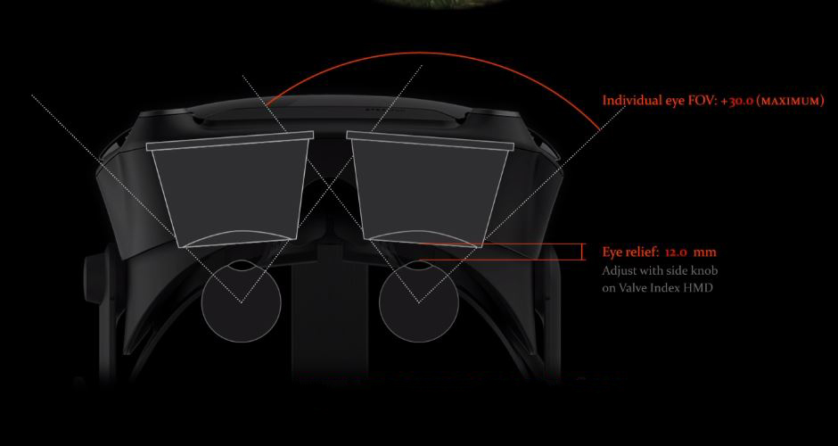
Valve Index 2019

Slide 81
Where Are We Today? 2019-20
The following is the current resolution of state of the art Virtual Reality(VR) goggles.
Is this good enough for Augmented Reality(AR)?

Slide 82
Where Are We Today? 2019-2020
For AR we need to make the images that are “physically accurate and perceptually indistinguishable from real world scenes”
This requires correct illumination, accurate geometric models, valid material reflections, and sufficiently fast computation.

Slide 83
Technical Requirements for VR/AR Satisfactory Delivery
Display resolution similar to the human visual system
Display quality similar to human visual system (illumination, color, etc.)
Sufficient display rates for motion perception
Rendering speeds to satisfy display rate requirements
Sufficient wireless bandwidth for data

Slide 84
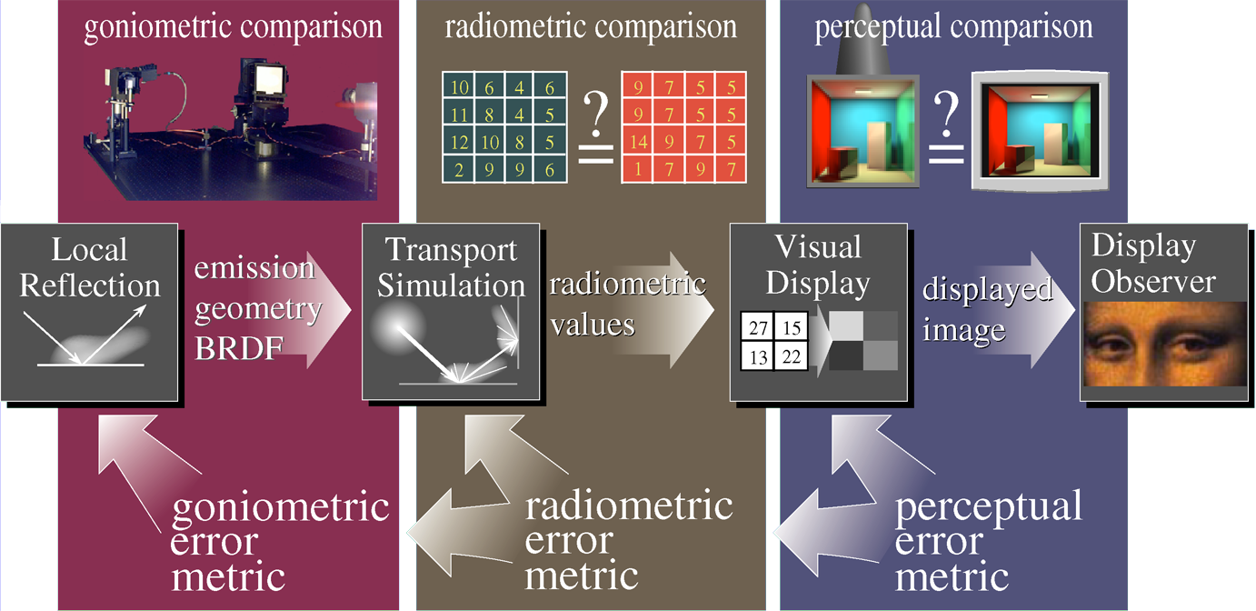
Rendering Framework 1997

Slide 85
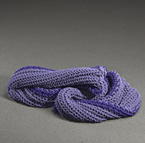
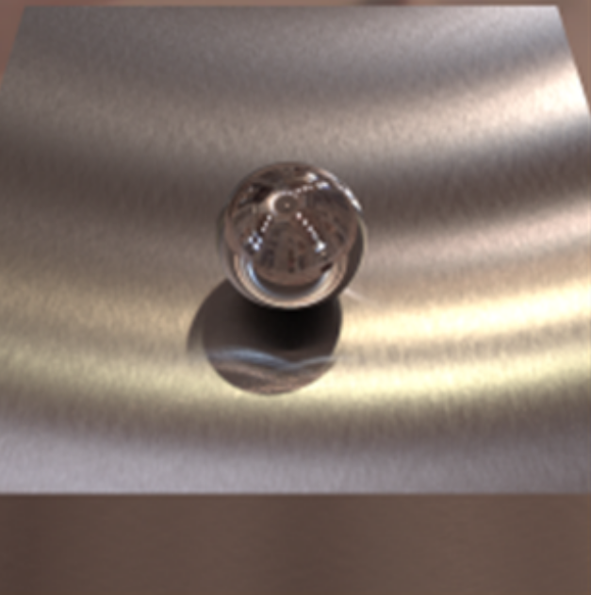
Material Accuracy
Marschner
P. of C. G.
2012
2016

Slide 86
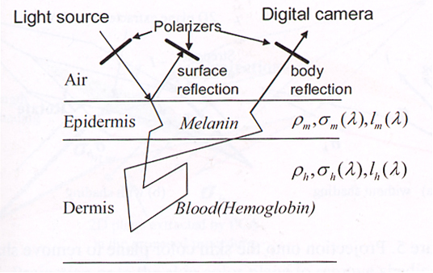
Schematic model of the image process
acm Transactions on Graphics, Siggraph 2003 p. 773

Slide 87
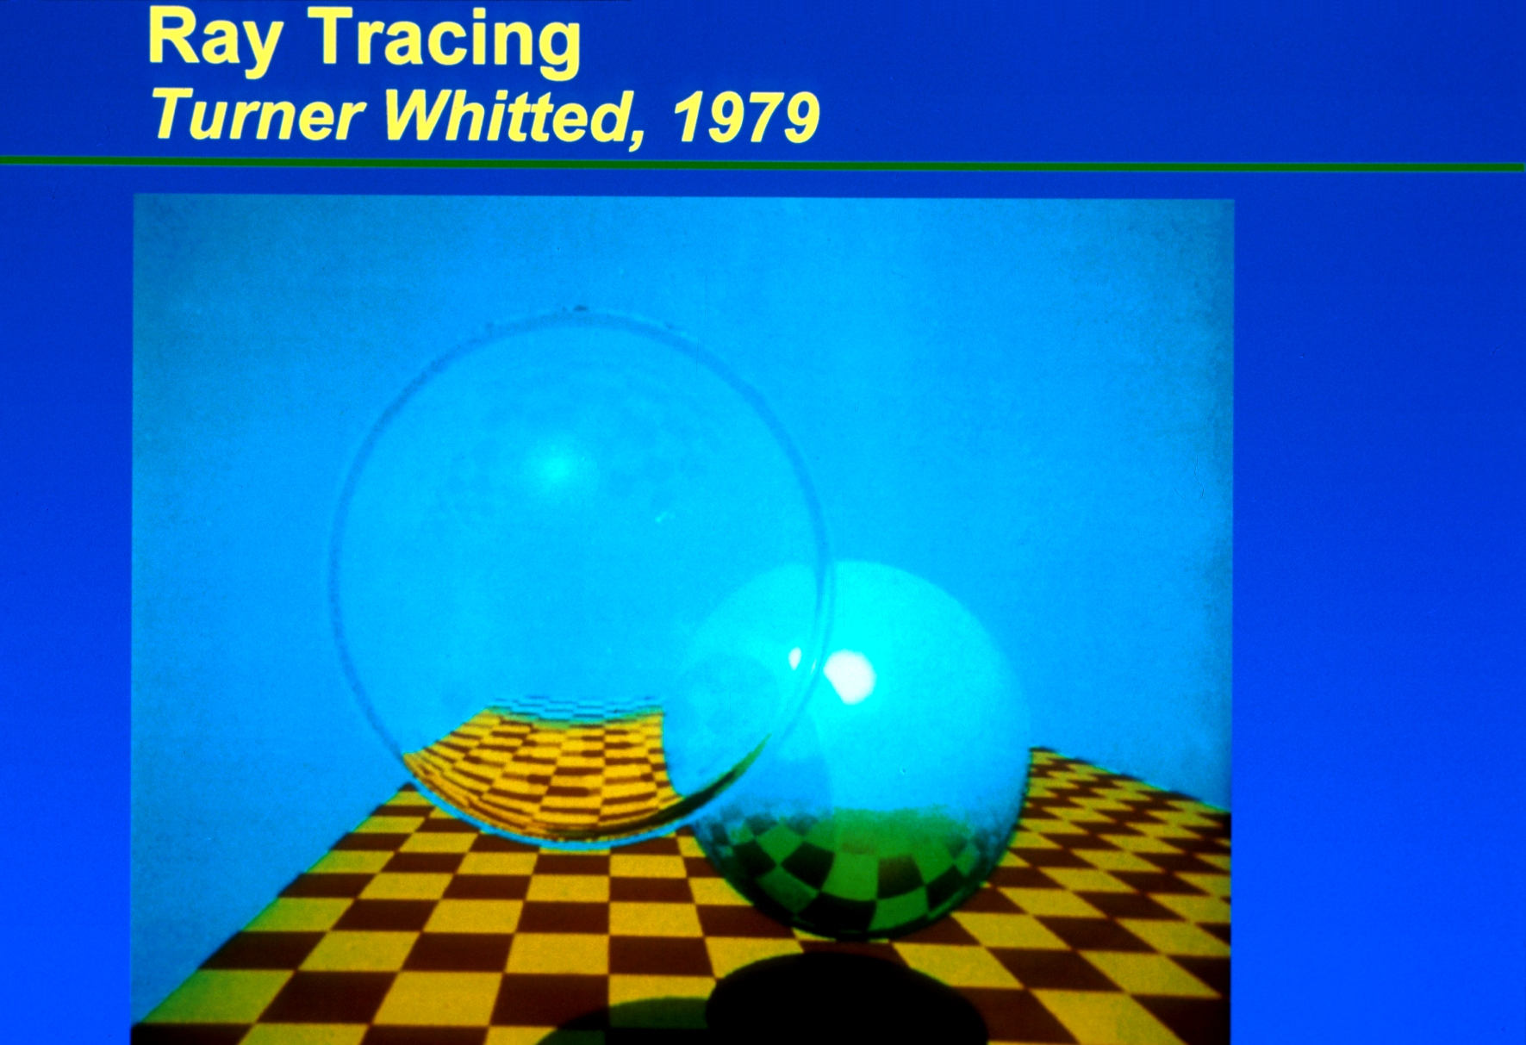

Slide 88
Moore’s Law
“Chip density doubles every 18 months.”
Processing Power (P) in 15 years:
$$P=P_{today}{\left(2\right)}^{\frac{15years}{18 months}}=P_{t}{\left(2\right)}^{\frac{15}{1.5}} \\ =P_{t}{\left(2\right)}^{10}=1000P_{t}$$

Slide 89
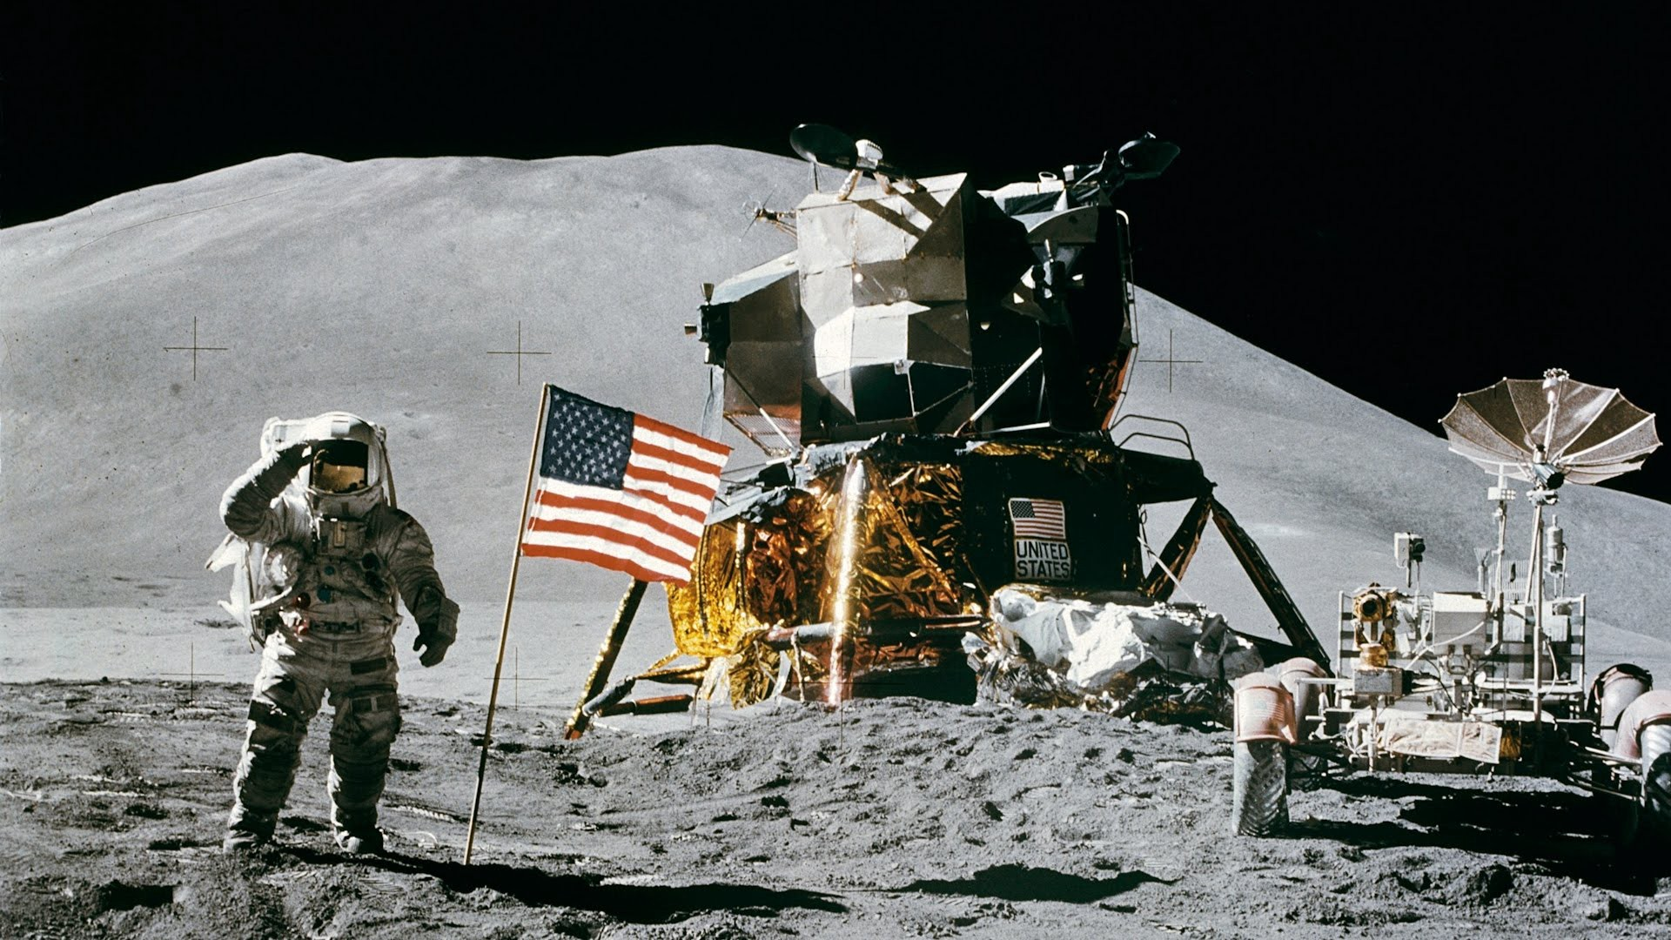
Nvidia RTX Graphics 2019

Slide 90

Instructions Per Clock-cycle per second (IPS) (Microprocessor CPU’S)
Microprocessor GPU’S
Processor / System | MIPS and Frequency | (IPS / clock cycles per second) | (IPS / clock cycles per second / cores) | Year*
*Nvidia Ge-Force RTX-2080T.I | 76,000,000 MIPs at 1.5 GHz | 50,666.7 | 11.6 | 2019
*Nvidia Quadro RTX-2080T.I | 78,000,000 MIPS at 1.6 GHz | 48750.0 | 11.2 | 2019
*Nvidia DGX | 500,000,000 MFLOPs at 1.46 GHz | 357142.9 | 17.4 | 2017

Slide 91
Resolution of the Human Eye
Humans can tell visual details at distances larger than 0.3 arc minutes
The Field of View (FOV) of the human eye can be generously estimated as 120 by 90 degrees

Slide 92
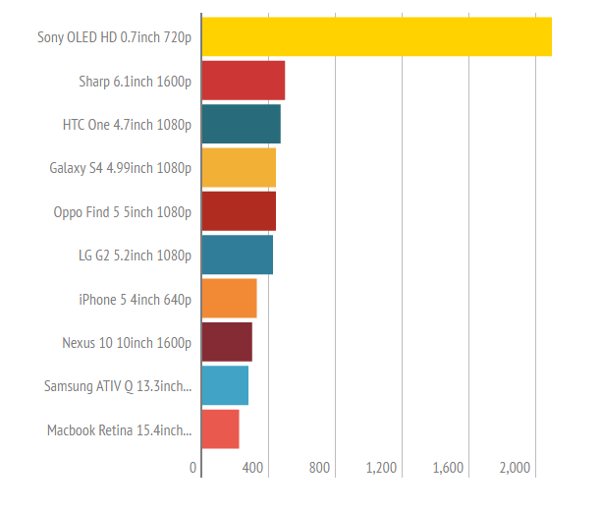
Increasing Densities (ppi) of OLED Displays
This is nowhere near the resolution of the human eye

Slide 93
Necessary Improvements
It is not currently possible to manufacture required pixel densities
Higher resolution is required in the foveal region
High resolution at the periphery is not necessary

Slide 94
Display Rates
Currently, the refresh rate is 90 frames/sec, which translates to 11 milliseconds/frame for each eye

Slide 95
Currently, the refresh rate is 90 frames/sec, which translates to 11 milliseconds/frame for each eye
Remember the Nvidia demonstration with the RTX rendering system in the first laboratory session
But even the increased speed of 10⁶x – 10⁸x may not be enough
How can we increase the rendering speed to generate sufficient refresh rates?

Slide 96

Toy Story 3 Offline Rendering
10 Hours
John Lehrer. “How It’s Done,” Wired 18.06. http://www.wired.com/magazine/18-06

Slide 97

On-line vs. Off-line Rendering
10 hours
Off-line: 10 hours x 60 min./hour x 60 seconds/min. = 36,000 seconds
On-line: 10 milliseconds
Ratio = $\frac{36 x {10}^{3}}{10 x {10}^{−3}}$ = 3.6 x${10}^{6}$
The ratio is even greater when one considers higher resolution (an increase in the number of pixels), both eyes, and the latency which occurs with eye tracking
We probably need more than a million times more processing power

Slide 98
Offline Rendering vs. Online Rendering
$\frac{2 eyes x 10 hours}{10 milliseconds}$ = 7.2 x ${10}^{6}$

Slide 99

Monsters University Pixar
Monsters Inc.
2001
? hours/frame
1.1M hairs
Monsters University
2013
29 hours/frame
5.5M hairs

Slide 100
Technical Requirements for VR/AR Satisfactory Delivery
Display resolution similar to the human visual system
Display quality similar to human visual system (illumination, color, etc.)
Sufficient display rates for motion perception
Rendering speeds to satisfy display rate requirements
Sufficient wireless bandwidth for data

Slide 101
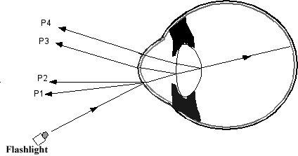
Purkinje Reflections

Slide 102
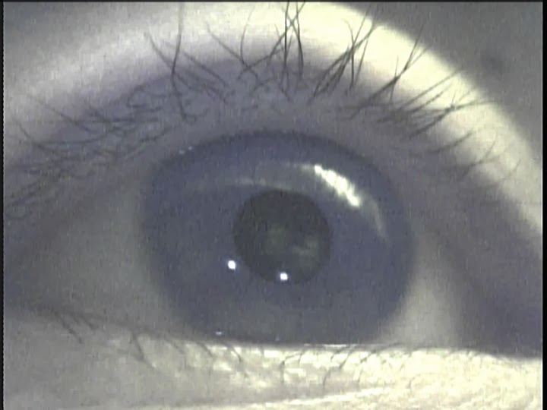
1st and 4th Purkinje Reflections

Slide 103
Foveal Eye Tracking Constraints 2016
Speed- needs to be fast enough to meet update requirements (currently 11 milliseconds, 90 Hz)
Accuracy- Gaze direction is < 0.5 degree
Foveal direction accuracy can be ~ 1.0 arc minutes (1/60 of a degree)
Non-invasive measurements- still need to see entire visual field

Slide 104
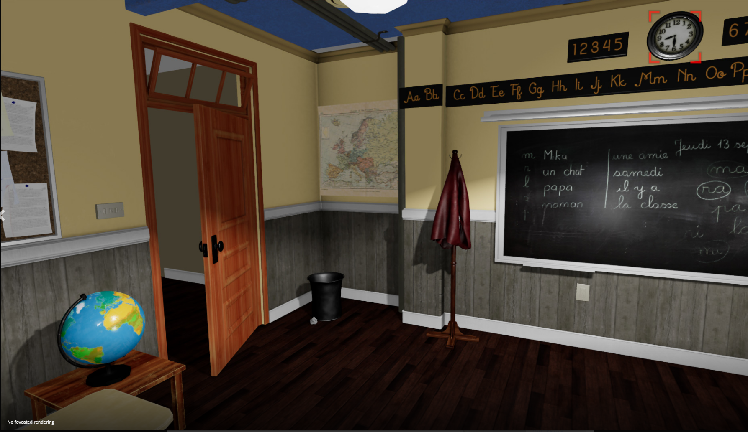
No Foveated Rendering
Roadtovr.com

Slide 105
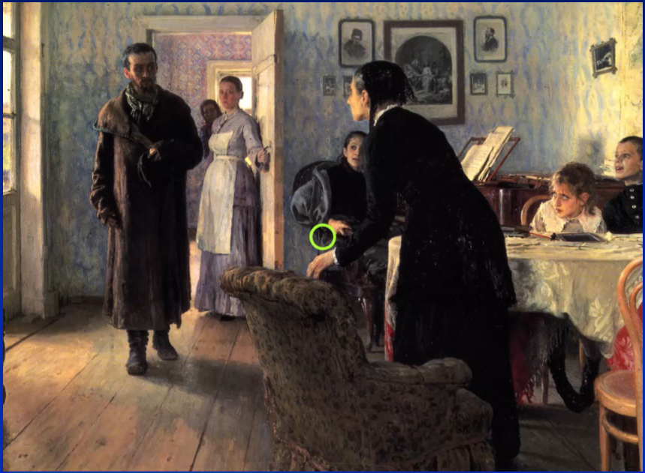
The Unexpected Visitor Ilya Repin, 1888

Slide 106
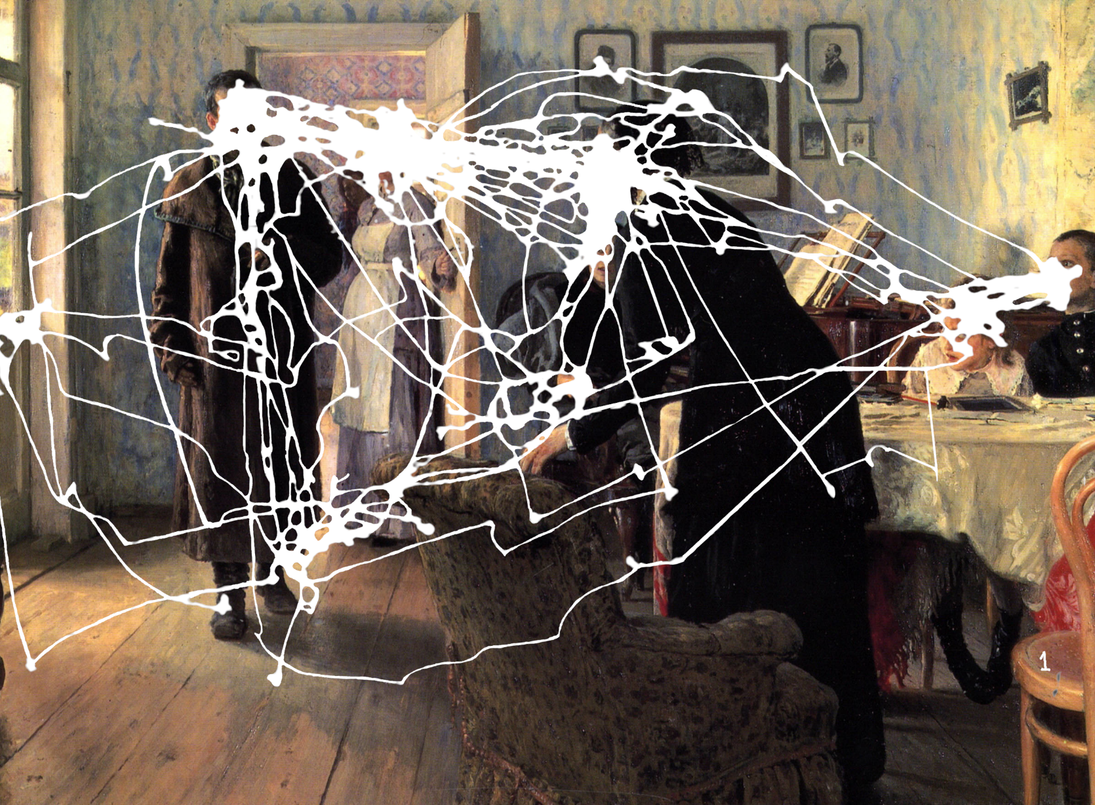
Foveal Eye Tracking
Free

Slide 107
Foveal Eye Tracking Pros and Cons
Pros:
Foveal eye tracking measurements to determine the gaze direction can be performed in 3-4 milliseconds.
Cons:
The two best manufacturers were purchased by Google (Eyefluence) and Apple (SMI)

Slide 108
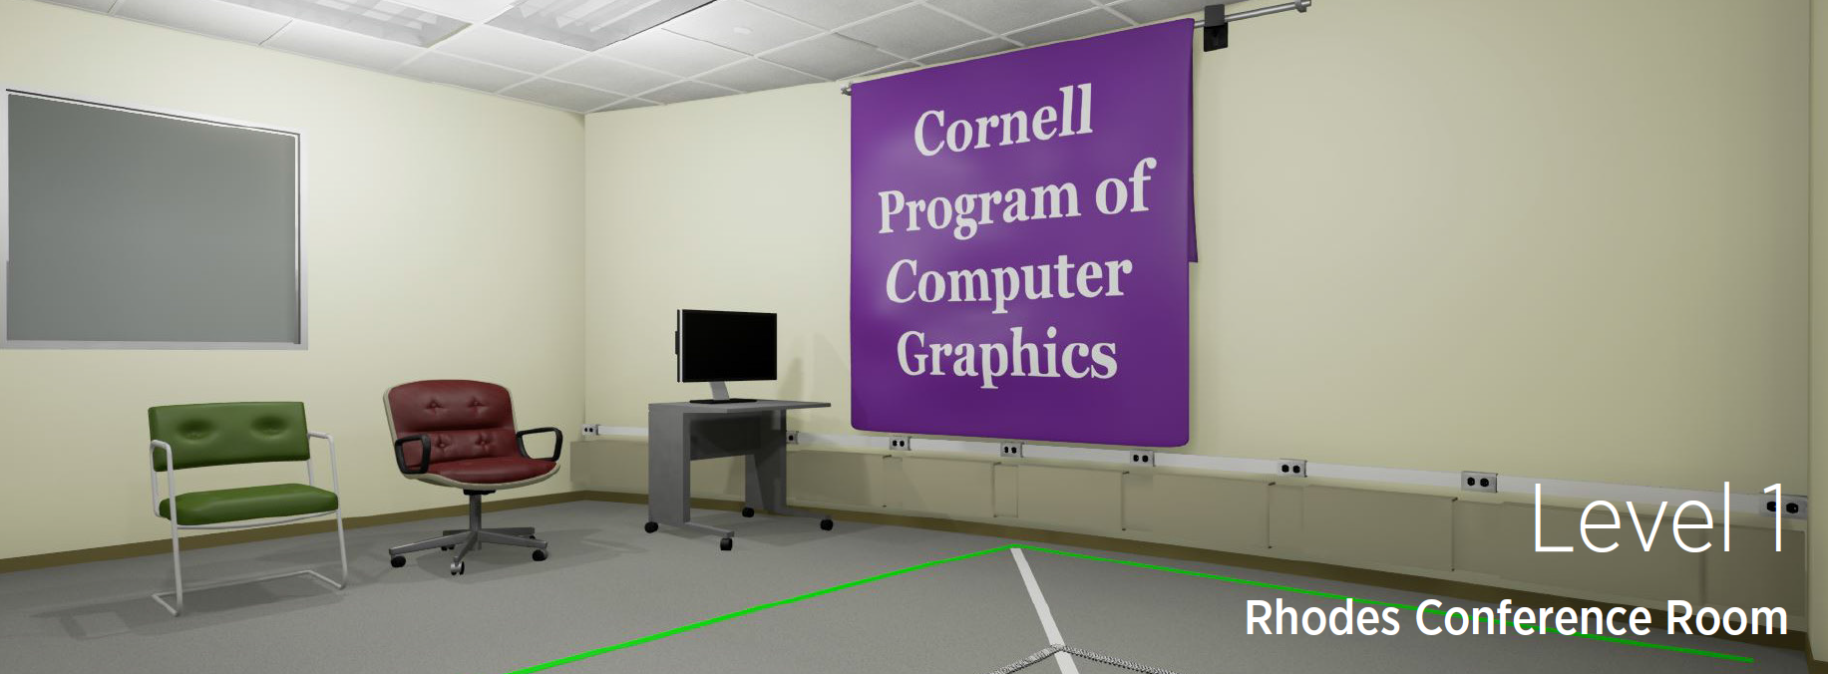
VR Position Accuracy
Ethan Arnowitz, Jeremy Paton, Steven Ren and Zachary Zimmerman

Slide 109

VR Position Accuracy
Ethan Arnowitz, Jeremy Paton, Steven Ren and Zachary Zimmerman

Slide 110
End

Slide 111
Visual Acuity Example
Assume 120 degree x 90 degree field of view
120 * 90 * 60 * 60 / 0.3 * 0.3 = 432 megapixels

Slide 112
Resolution of the Human Eye
(120 degrees x 60 arcminutes / degree x 1 pixel / 0.3 arcminutes) x (90 degrees x 60 arcminutes / degree x 1 pixel / 0.3 arcminutes)
431,568,000 pixels; 432 MegaPixels. A 1080p display is 2.1 megapixels.

