Slide 1
Networks, History, Bandwidth and Compression
NBAY 6120
Lecture #4
March 10, 2020
Dr. Donald P. Greenberg

Slide 2
Required Reading
“Uncle Sam, Ma Bell and Her Babies: A Timeline,” The New York Times. December 22, 1994. Barbara Kantrowitz. The Birth of the Internet, Newsweek, August 8, 1994, vol. 124, Is. 6, pg. 56.

Slide 3
Recommended Reading
Klint Finley. “Tech Giants to Join Legal Battle Over Net Neutrality,” January 5, 2018. Wired

Slide 4
Comparison between auditory and visual sensory systems
The human auditory channel is serial.
All of the different frequencies are condensed into a single channel at a given point in time.
The human visual system is parallel.
Many pieces of information (e.g. electrical impulses, pixels) are received at the same time.
Both systems are time dependent.

Slide 5
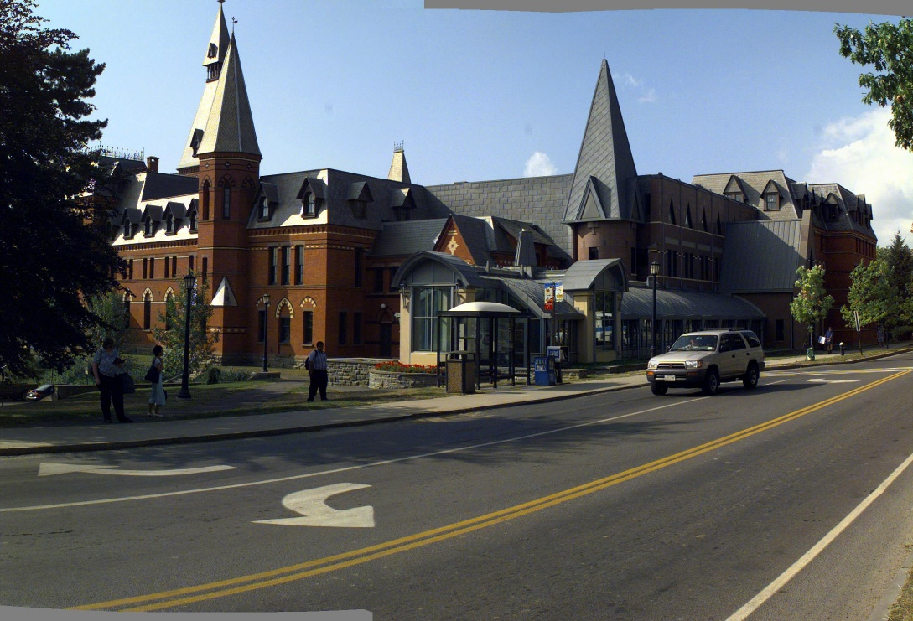

Slide 6
Pictorial Data vs. Text
Text
1 character = 8 bits
1 word = 8 characters 2.4 Kilobytes
1 page = 300 words
Picture
1280 x 1024 x 3 bytes/pixel = 3 ¾ Mbytes

Slide 7
Dynamic Information (Bandwidth Required)
Voice 44,000 bits/second
Video 512 x 480 x 8 bits x 30 fps = 7 1/2 Mbytes/second = 60 Mbits/second (1363x)
HDTV 1920 x 1280 x 3 bytes x 60fps = 420 Mbytes/second (76,328x)
* Statistics represent uncompressed data.

Slide 8
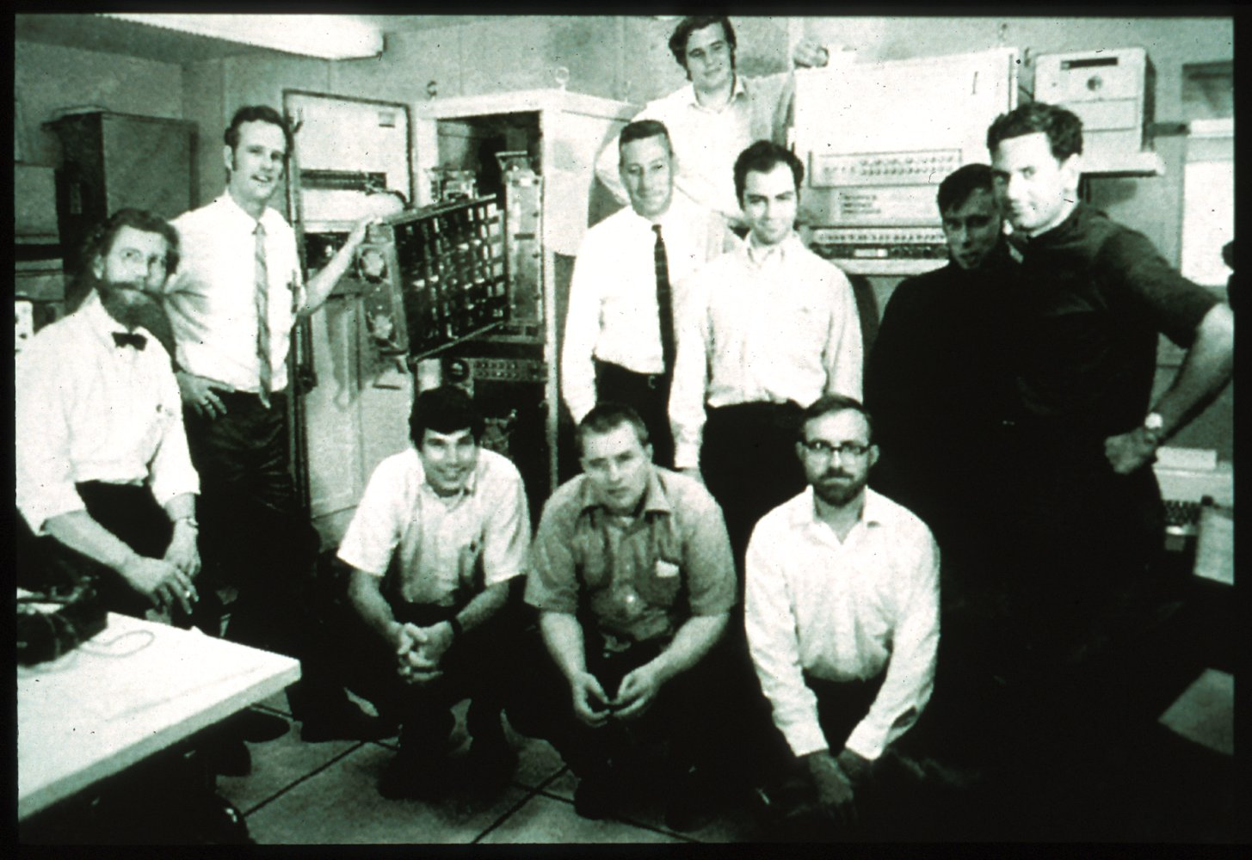
History Of The Internet ARPA Team

Slide 9
Internet - History & Growth Chronology
1973 - Vinton Cerf & Robert Kahn - designed Internet architecture based on TCP/IP
1979 - Configuration Control Board - contracted parts of infrastructure
1980 - U.S. Department of Defense - adopted TCP/IP,
MILNET designed to withstand atomic attack - becomes
ARPANET
Early 1980’s - ARPANET becomes known as Internet
researchers enticed to use CSNet (paid by NSF)

Slide 10
Internet - History & Growth Chronology cont’d
1983 - TCP/IP - becomes standard
1990 - ARPANET - decommissioned and replaced by NSFNet backbone
NSF -expands network to other research communities
1993 - NSF -no longer provides funding for NSFNet backbone
NAP’s (network access points) established in four cities

Slide 11
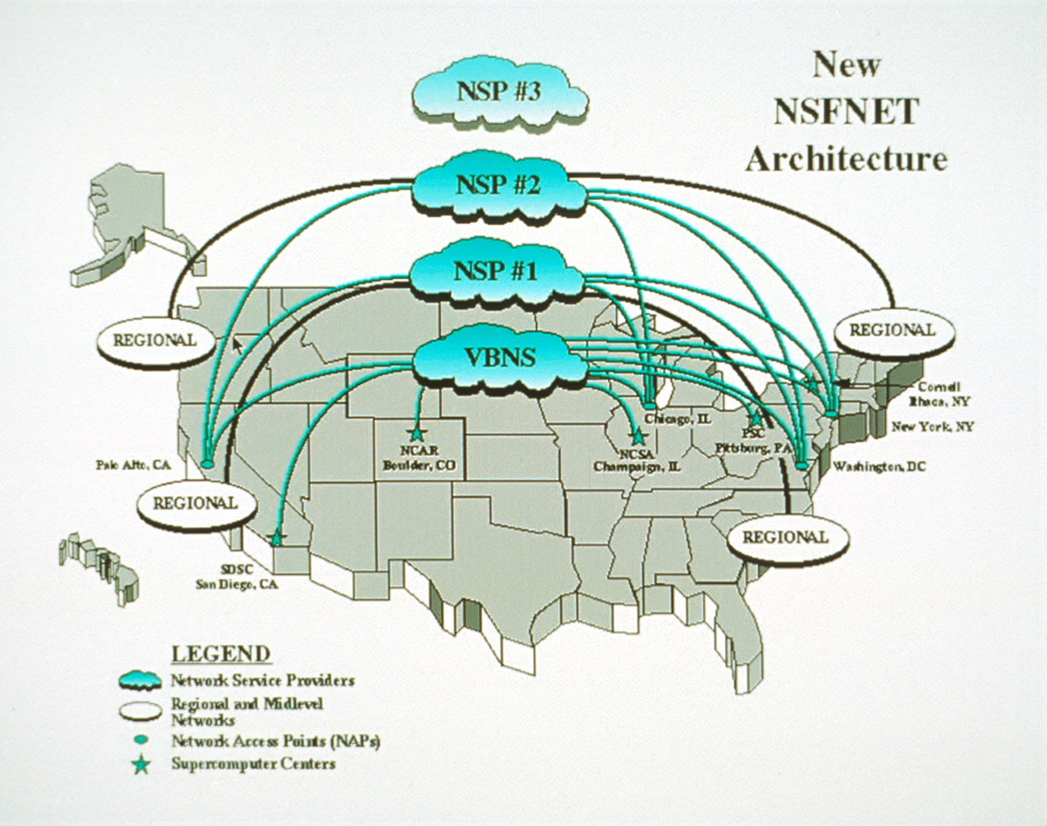
Circa 1993

Slide 12
Internet - History & Growth Chronology cont’d
1993 - Mosaic - Introduced by University of Illinois
(Marc Andreesen)
1994 - NSF -links four national supercomputer centers at
155 Mbs (bandwidth to approach 2.5 Gbs)
contracts MCI to link other sites
Internet - opens to commercial usage
1994 - Netscape - formed by Jim Clark

Slide 13
Uncle Sam, Ma Bell And Her Babies: A Timeline
1982 - AT & T and the Department of Justice signed consent decree.
• AT & T divests its 22 local Telco’s
• AT & T can enter previously restricted arenas
• Baby Bell’s prohibited from manufacturing equipment and offering long distance services. They cannot provide content

Slide 14
Uncle Sam, Ma Bell And Her Babies: A Timeline
1984 - The AT & T divestiture takes effect.
1987 - The F.C.C. scraps rules that limit phone company profits.
1988 - Judge Greene agrees to let the Bells offer voice mail and E- mail services, and transmit electronic publishing for others, but not provide content.

Slide 15
Con’t: Uncle Sam, Ma Bell And Her Babies: A Timeline
1989 - A seven-year ban on AT & T’s entry into electronic publishing is allowed to lapse.
1991 - Judge Greene removes the information services restriction from the Bells, but leaves in place the rules against manufacturing and long- distance service.
1993 - A Federal court in Virginia lifts for Bell Atlantic the video programming ban contained in the Cable Television Act of 1984.

Slide 16
Con’t: Uncle Sam, Ma Bell And Her Babies: A Timeline
1994 - The House overwhelmingly approves legislation's that would let the Bells make equipment and enter the cable and long-distance business in return for accepting competition in their local telephone markets.
• A comparable Senate bill collapses - too much competition for the cable and long-distance companies.
1995 - The Senate passes a bill to overhaul communications regulation.
• The House passes a communications bill that is similar to the Senate version.
1996 - New Telecommunication bill passed February 1, 1996

Slide 17
The Telecommunication Bill of 1996

Slide 18
What The Telecommunication Bill Will Do
LONG-DISTANCE PHONE SERVICE
Seven regional Bell’s can enter into the long-distance phone business, must open their local phone networks
LOCAL PHONE SERVICE
Local phone markets open to new competitors (AT & T, MCI and cable TV companies) without specifying how much they pay

Slide 19
What The Telecommunication Bill Will Do
BROADCAST
Raises the national TV-station ownership cap. Requires TV sets to block violent or sexual programs.
CABLE
Lifts all rate regulations in three years for big cable systems.

Slide 20
What The Telecommunication Bill Will Do
INTERNET
Transmission of indecent material is a crime without restricting minor’s access.
SPECTRUM
TV Stations get valuable new broadcast spectrum for advanced TV free of charge. (To be revisited)

Slide 21
How Did We Get Into This Mess?

Slide 22
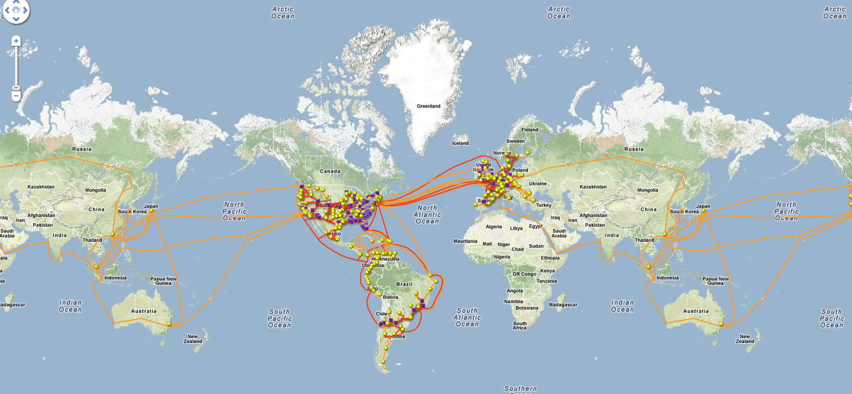
Level 3 Map 2012

Slide 23
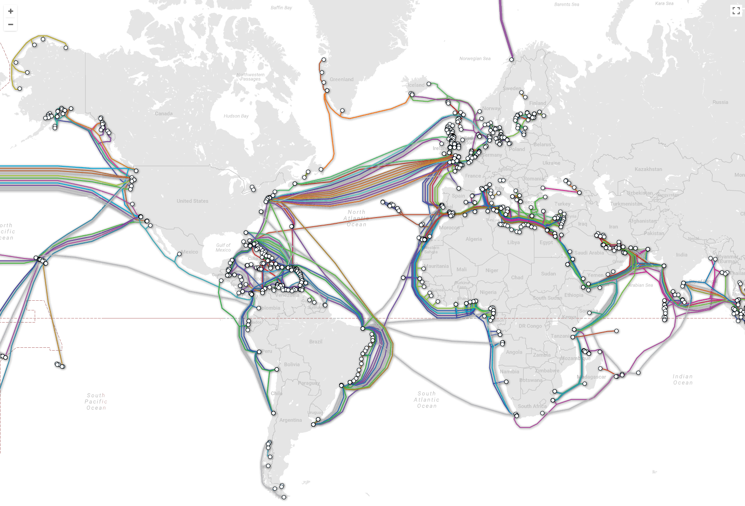
Submarine Cable Map 2018
https://www.submarinecablemap.com/

Slide 24

MAREA Facebook & Microsoft

Slide 25
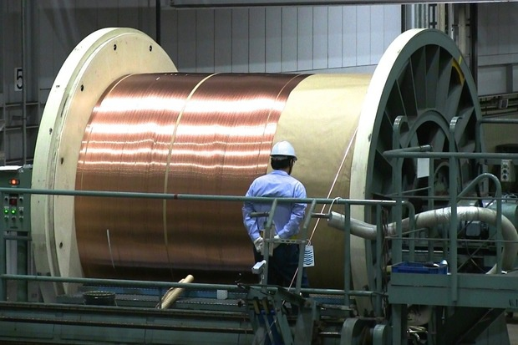
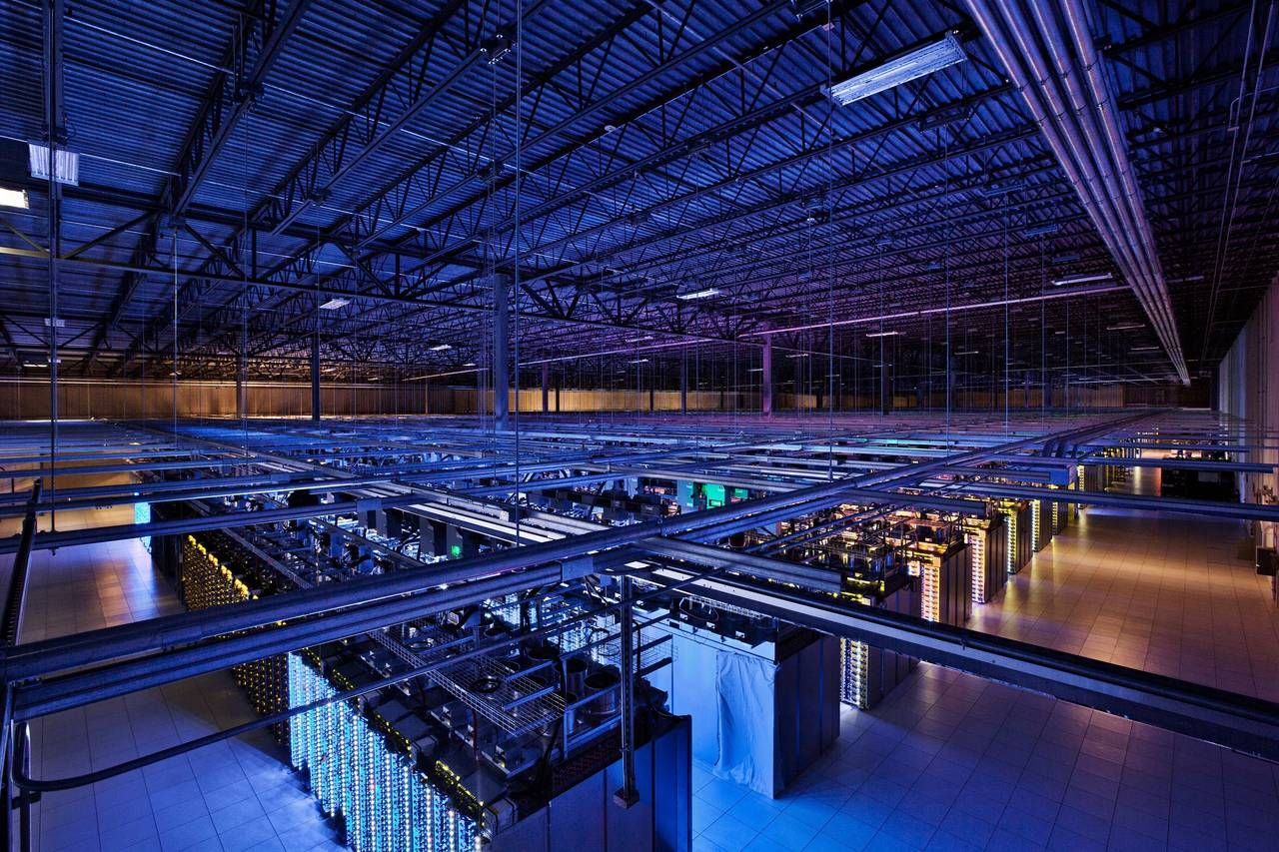
Google & Amazon Transpacific Submarine Cable

Slide 26
Network Typologies
Wired Networks –
Copper wires (telephone companies, DSL)
Fiber/coaxial cables
(cable television companies)
Fiber to the home (everybody)
Wireless Networks –
Satellites
Hybrid Networks –

Slide 27
Wired Technology

Slide 28
What is the current bandwidth of a single channel of coaxial cable?
One NTSC TV channel
512 x 512 x 8 bits/pixel x 30fps = 7.5MBs = 60 Mbs
One coaxial cable can carry 256 channels
∴ Theoretically, one coaxial cable has lots of bandwidth
Assuming one-half is used for digital information,
e.g. 128 x 60 Mbs = 7.68 Gbs (shared)

Slide 29
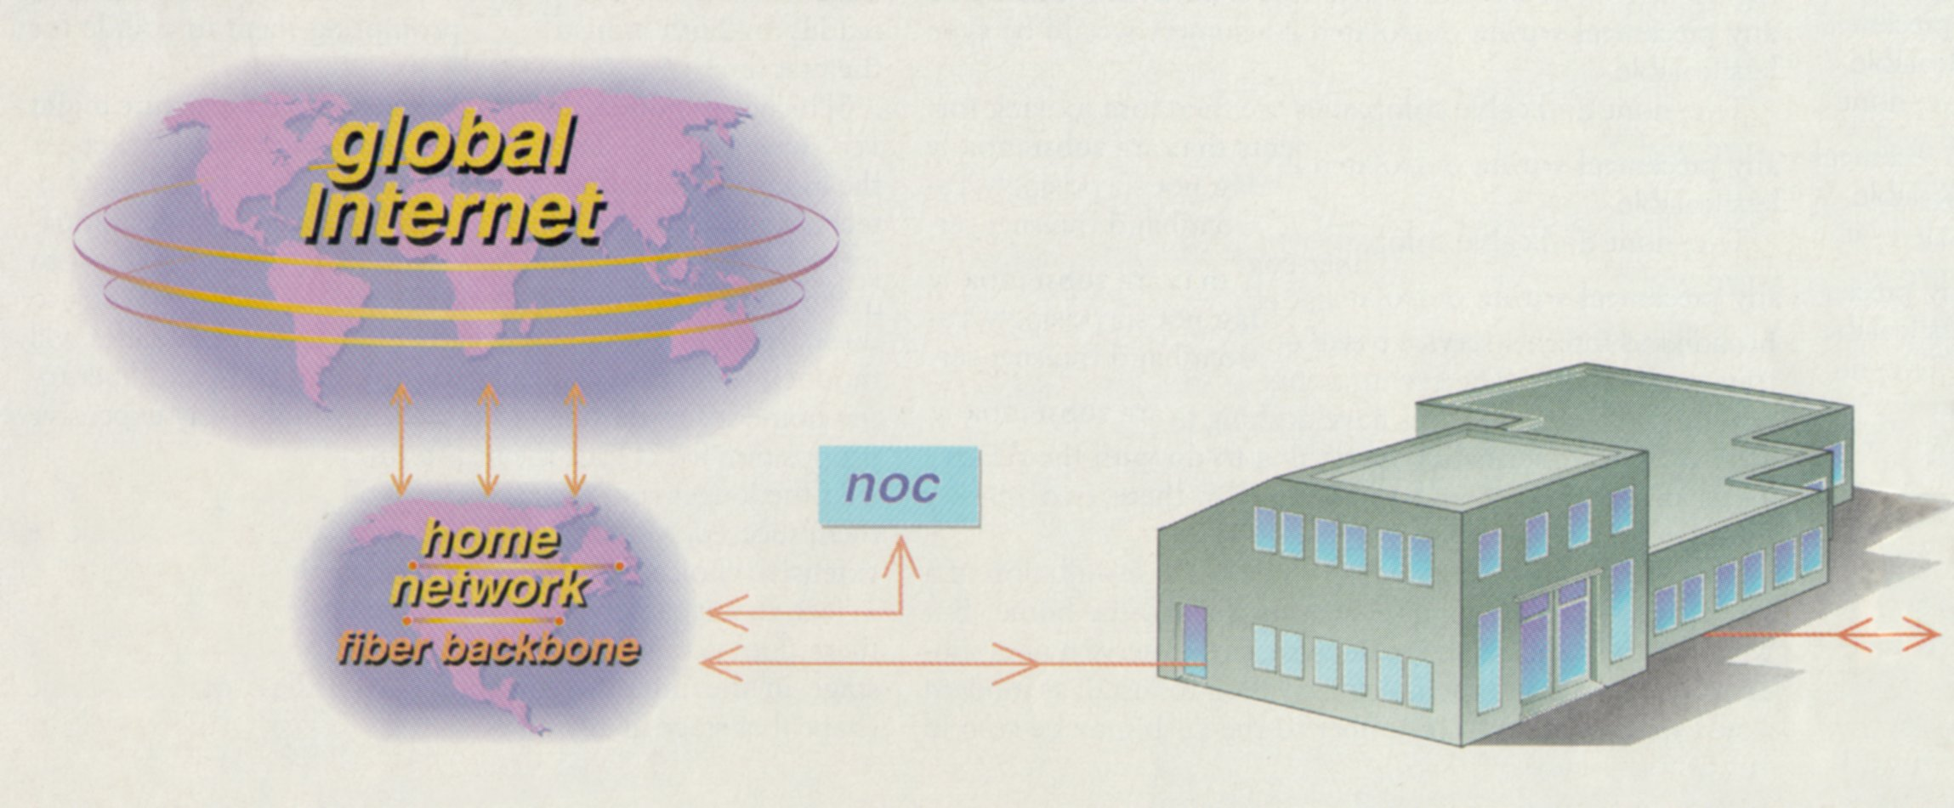
The Architecture of a Hybrid Fiber-Coaxial Network
3 - A regional data center caches copies of frequently requested content.
2 - The Network Operations Center (NOC) monitors the network, using data from cable modems.
1 - Content transferred from the Internet to the fiber-optic backbone.

Slide 30
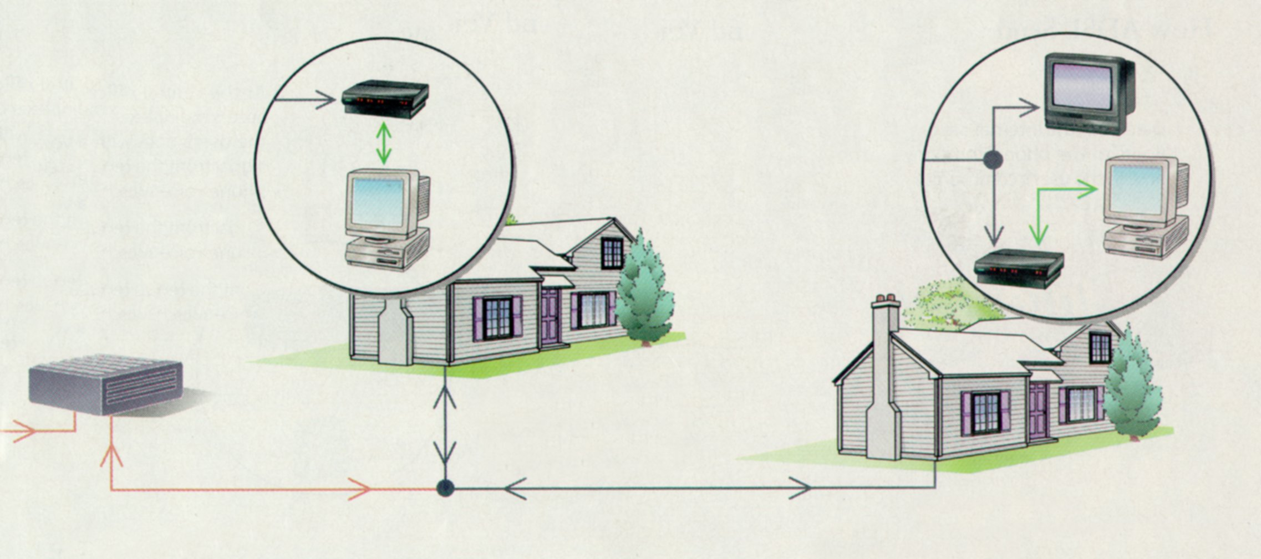
The Architecture of a Hybrid Fiber-Coaxial Network
7 - A home office may have a splitter sending the TV signals to a TV and the data to a cable modem.
6 - A cable modem in the home decodes that user’s data.
4 - Information is relayed by fiber optics (red) to “head ends.”
5 - Each fiber node connects to coaxial cable (blue) that links about 1,000 homes.

Slide 31
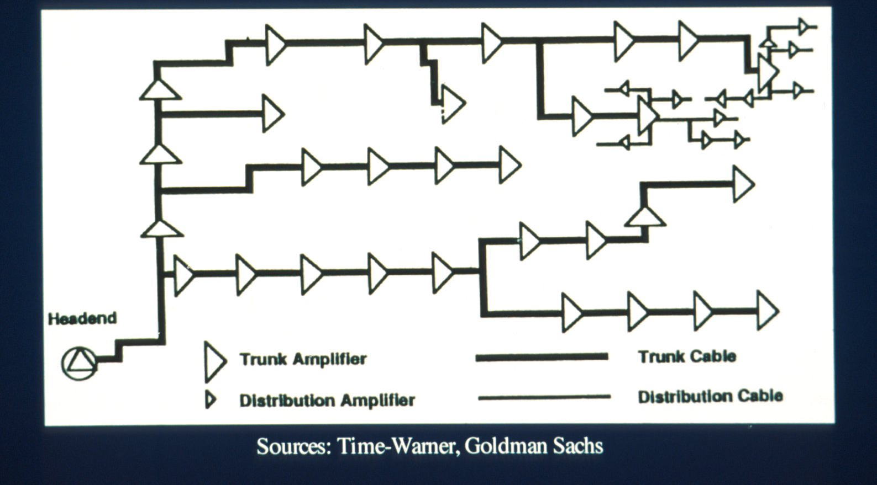
Coaxial Cable Network

Slide 32
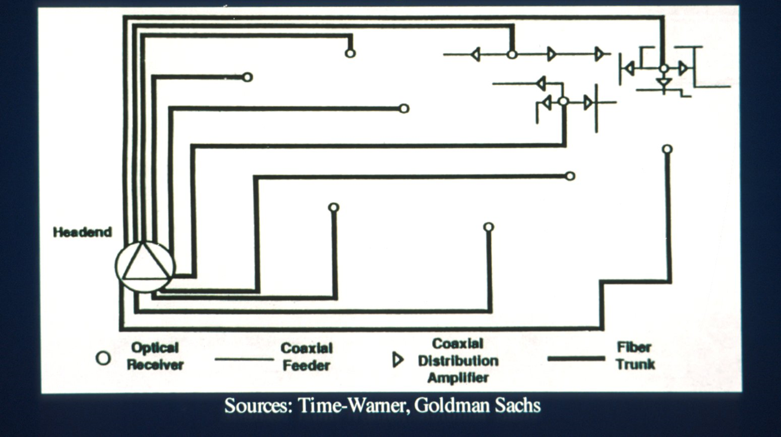
Fiber Optic Cable Network

Slide 33
Advantages of Optical Fiber
High bandwidth capacity
Light within fiber can be “bent”
Cheap and abundant raw material
Low signal deterioration reducing need for amplification
Multichannel capacity (WDM)

Slide 34
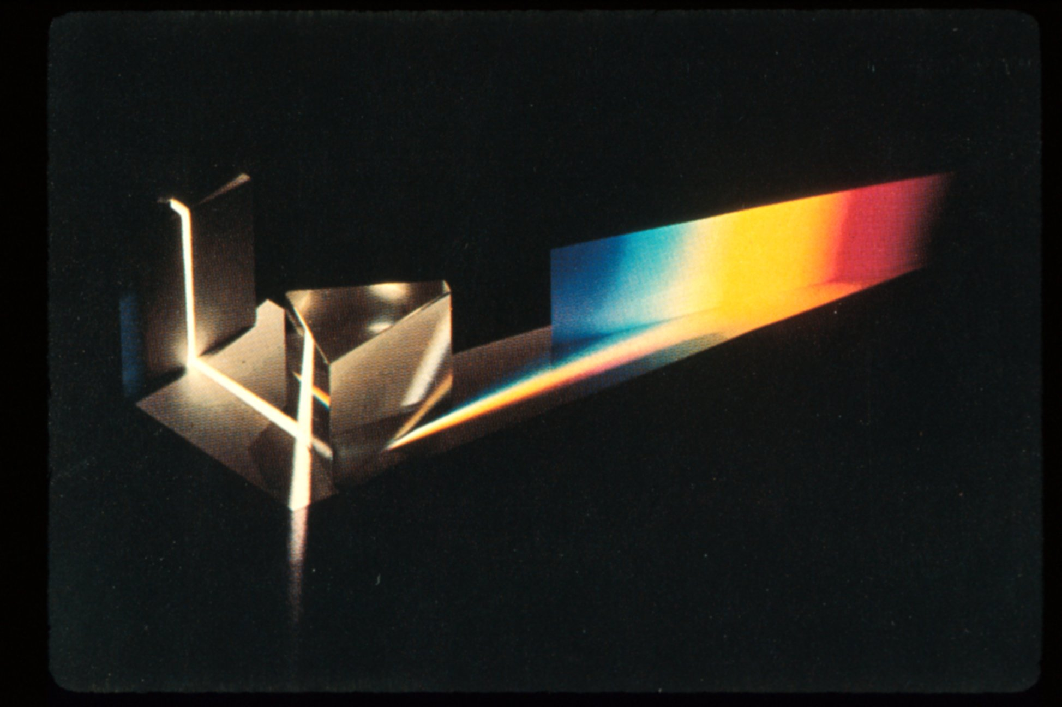

Slide 35
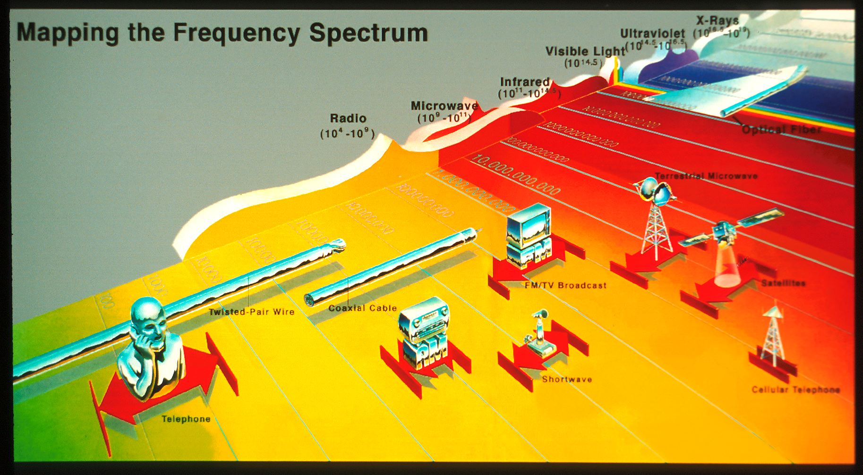
Frequency Spectrum

Slide 36
Internet Ping Times Stanford - MIT

Slide 37
Ping Test Link

Slide 38
Wireless Coding Technologies

Slide 39
First Generation (Analog)
Early 1980’s - 2000
AMPS (Advanced Mobile Phone System)
FDMA (Frequency Division Multiple Access)
Scientific American Oct. 2000

Slide 40
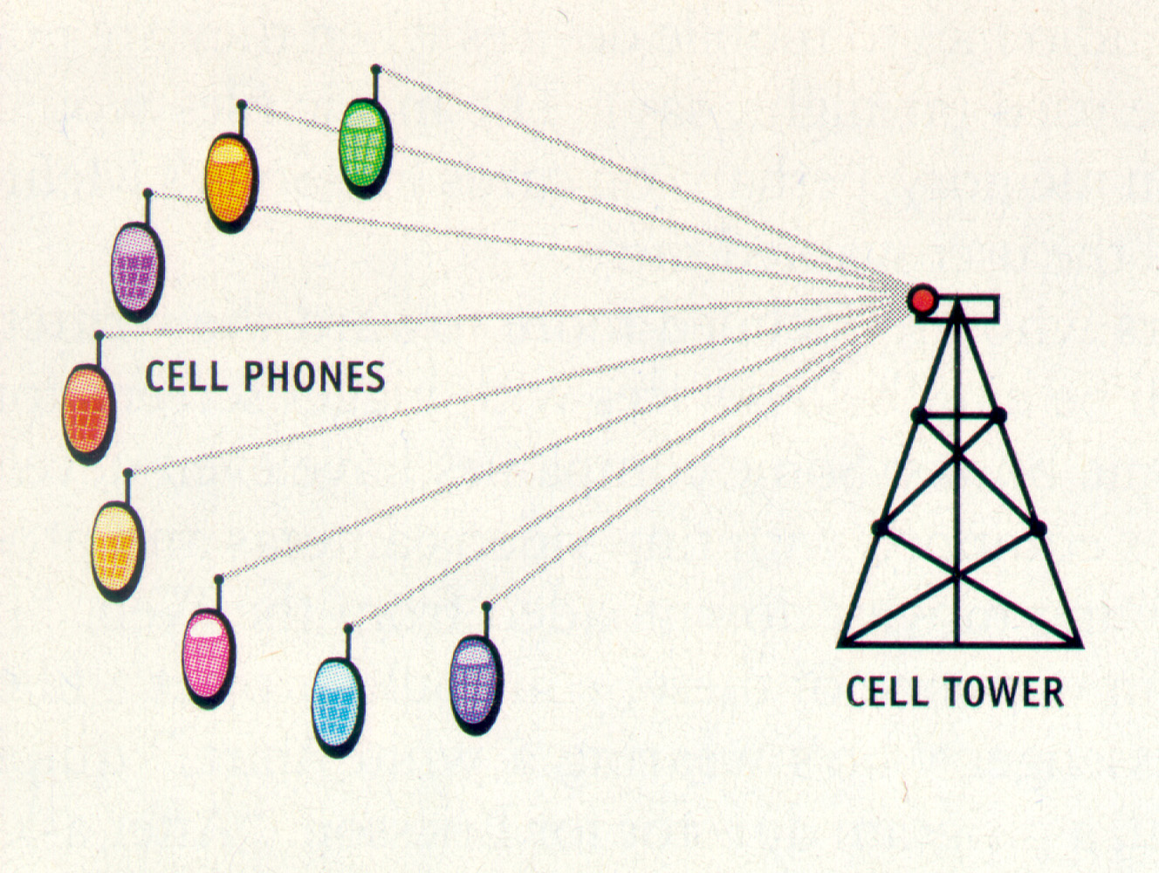
Scientific American Oct. 2000

Slide 41
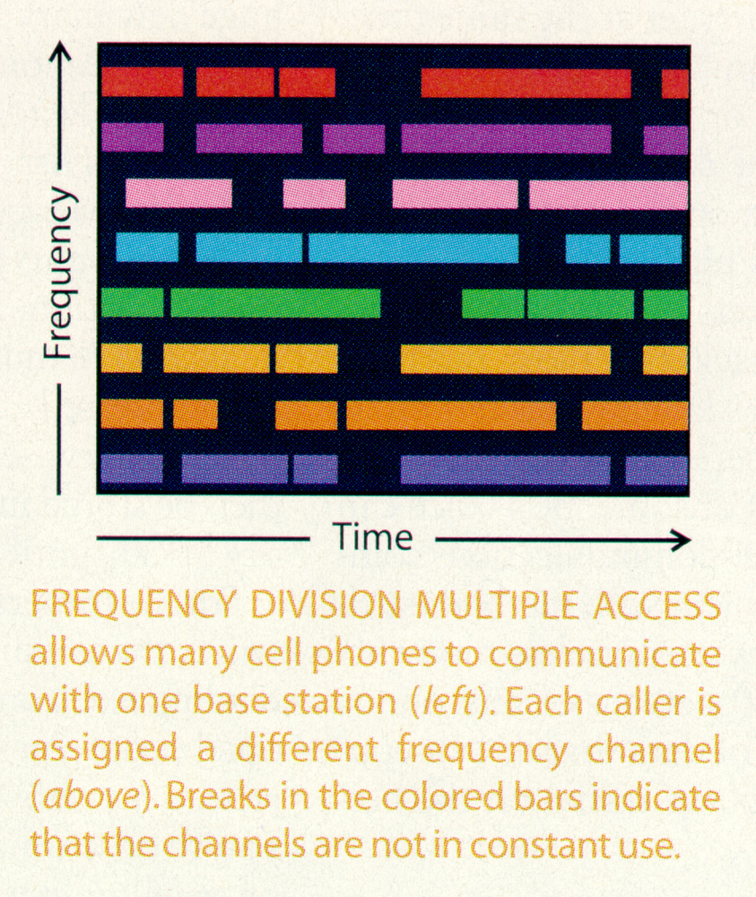
Scientific American
Oct. 2000

Slide 42
Second Generation (Digital)
Early 1990’s - 2000
TDMA (Time Division Multiple Access)
Original GSM (Global System for Mobile Communication)

Slide 43
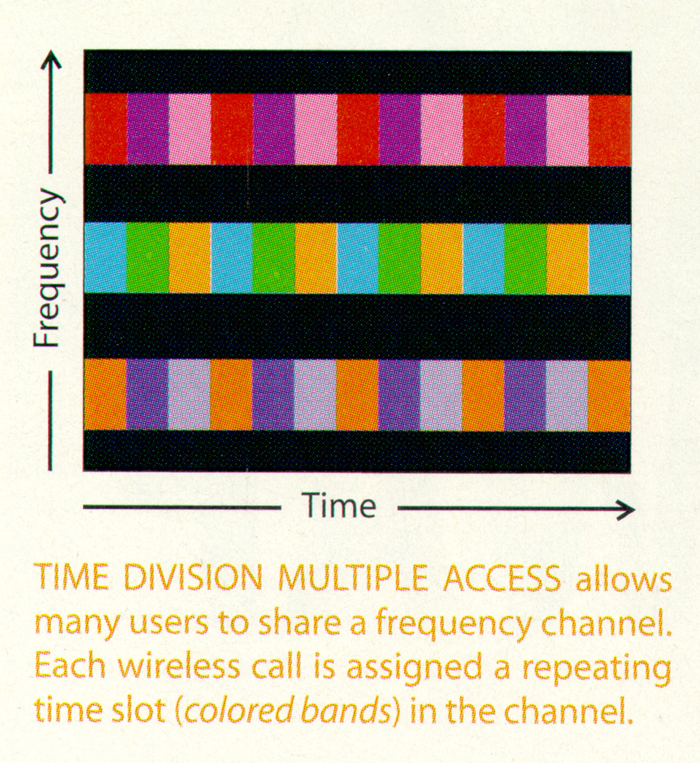
Scientific American
Oct. 2000

Slide 44
Second Generation (Digital)
Early 1990’s - 2000
TDMA (Time Division Multiple Access)
Original GSM (Global System for Mobile Communication)
CDMA (Code Division Multiple Access)
PCS (Personal Communications Service)

Slide 45
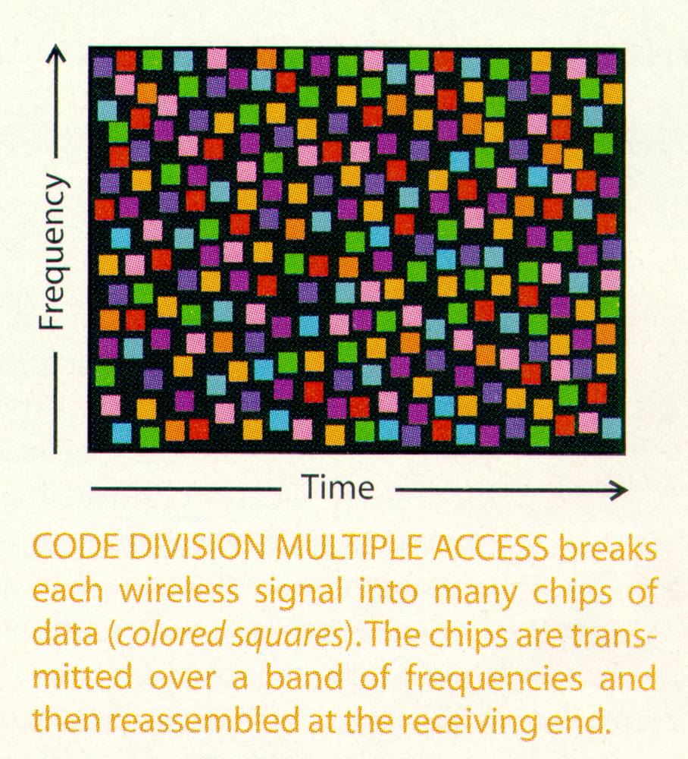
Scientific American
Oct. 2000

Slide 46
Third Generation (Broadband) 1991-2000
W-CDMA (Wideband Code Division Multiple Access)
Refinement of CDMA technology
Minimum data rate for stationary users is 2Mbs
Scientific American Oct. 2000

Slide 47
What is 4G?
Introduced in 2012.
4G is an entirely IP based technology using internet protocols and is the approximately 10x 3G.
The goals included enhanced security measures, mobile technology, and a smoother transition of data when a device moves across areas covered by different networks.
Specifications include peak data rates, latency, spectrum efficiency, etc.

Slide 48
What is 4G?
The IP telephony includes ultra-broadband internet access, gaming services, and Internet TV, and at least 100Mbs when client is moving at high speeds and 1 Gbs when the client is stationary.

Slide 49
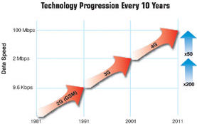
Wireless Technology Progression
Emerging Wireless Technologies, http://www.safecomprogram.gov/NR/rdonlyres/5C74C631-ACF6-433F-B313-C04D041A5489/0/Look_Future_Wireless_Communications_Beyond3G.pdf

Slide 50
The Negroponte Switch
1990’s Voice communication sent through wires
Video programs sent through air
2010 → Voice communication sent through air
Video programs sent through cable
Note the exception: Satellite direct broadcast TV
Gilder Report

Slide 51
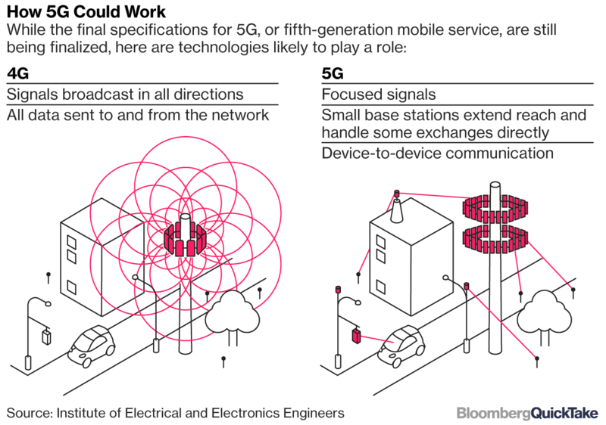
5G Technologies 2018
Bloomberg Businessweek, August 2017

Slide 52
5G Goes for the Gold February 2018
Korea telephone announced plans to demonstrate 5G
(100x with delays < 1ms) at the winter Olympics
Anticipated to be available in 2019
IEEE Spectrum, January 2018

Slide 53
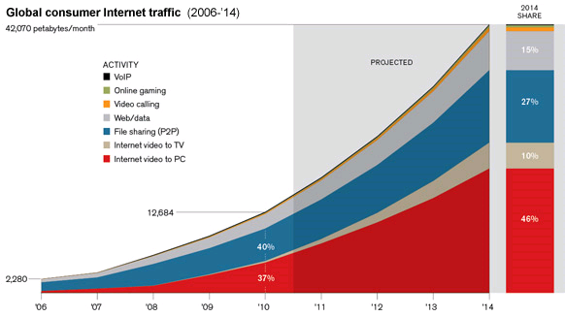
Global Consumer Internet Traffic

Slide 54
Prediction of Demand Cisco
Globally, mobile data traffic will increase sevenfold between 2016 and 2021
The number of devices connected to IP networks will be three times as high as the global population in 2021
Traffic from wireless and mobile devices will account for more than
63 percent of total IP traffic by 2021

Slide 55
Prediction of Demand Cisco 2017-2022
Globally, IP video traffic will be 82 percent of all consumer Internet traffic by 2022, up from 73 percent in 2016.
Virtual reality and augmented reality traffic will increase 20-fold between 2016 and 2021, at a CAGR of 82 percent
Forecast and Trends, Cisco 2017-2022

Slide 56
Data explosion vs. bandwidth?
Which will grow faster?
The problem is that wireless bandwidth is limited!

Slide 58
Compression Technology

Slide 59
Why Compress ?
Space requirement (storage)
Bandwidth requirements (channel width)
Time requirement (latency)

Slide 60
How to Compress?
Color Fidelity
Redundancy
Accuracy
Lossless
Lossy

Slide 61
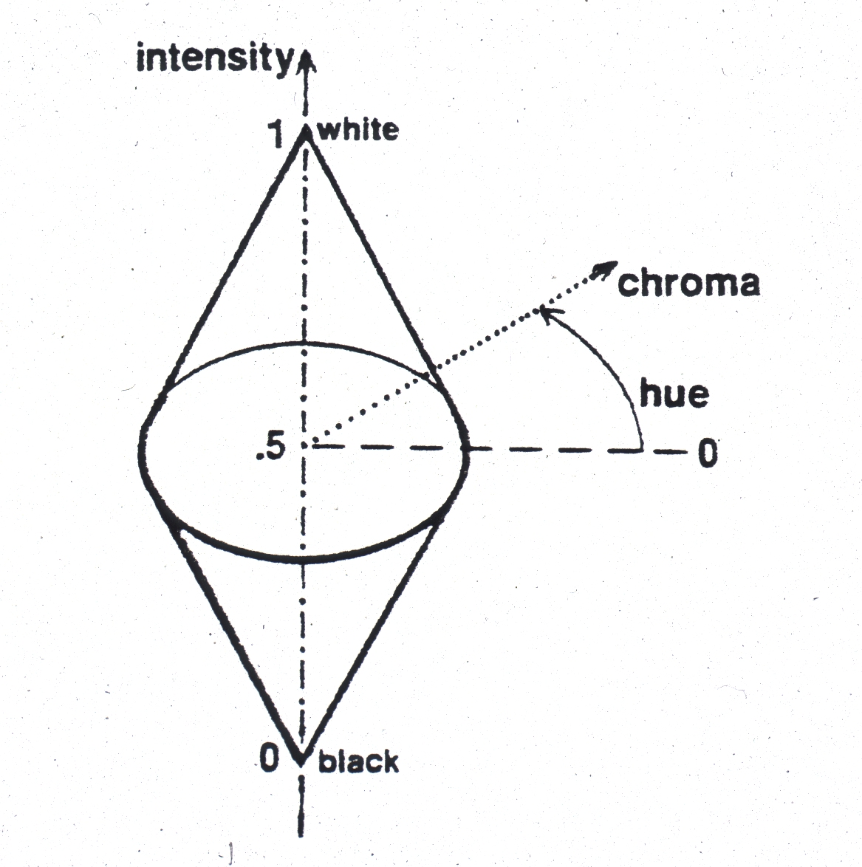
Biconical Color Solid
George Joblove

Slide 62
Opponent Color Theory
Figure 12.1– Foundations of Sensation and Perception, George Mather

Slide 63
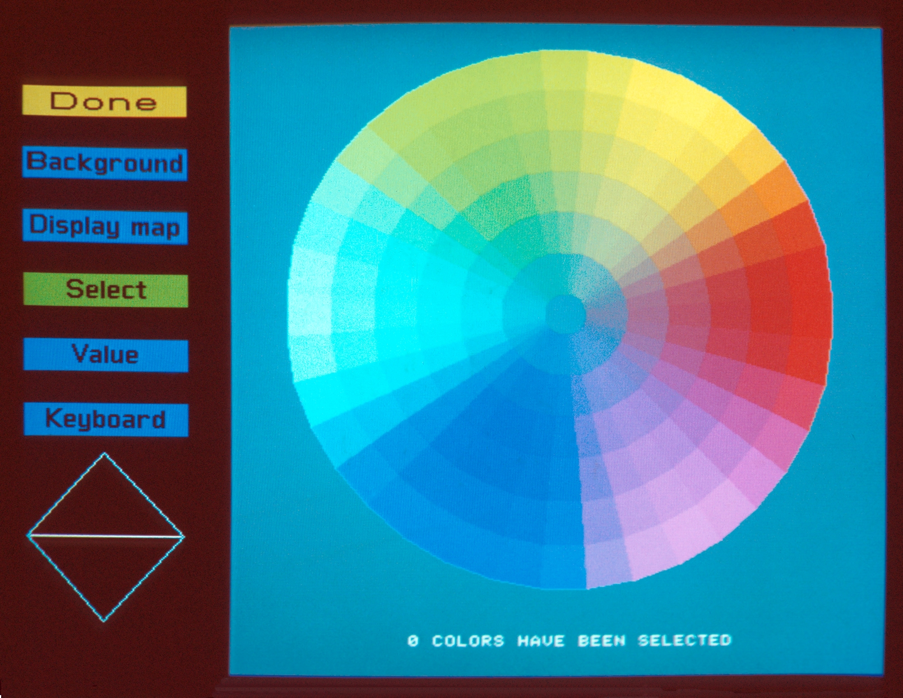
Biconical Color Solid
George Joblove

Slide 64
Opponent Color Theory Hering 1892
There are three types of color receptive fields called opponent channels.
Black – White (luminance) channel M + L
Green – Red channel M - L
Yellow – Blue channel M + L - S

Slide 65
Opponent Color Theory Hering 1892
Four particular colors appear to be “unique”.
Red, Green, Blue, and Yellow
He considered these to be the “cardinal directions” of chromaticity
All other colors seem to be intermediate between these four

Slide 66
Opponent Color Theory Hering 1892
Channel | Combination | Resolution
black - white | M + L | very high
Green - red | M – L | High
yellow - blue | M + L – S | low

Slide 67
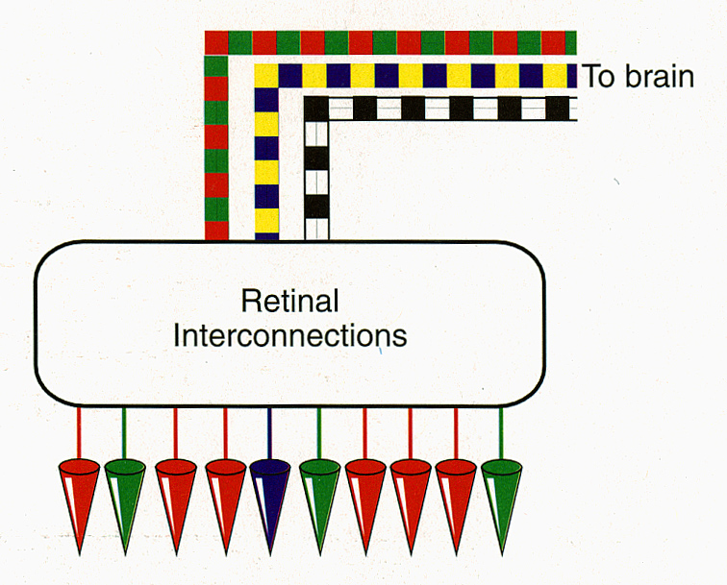
Opponent Color Theory
Cones interconnect in the retina, eventually leading to opponent-type signals.
Roy S. Berns. “Billmeyer and Saltzman’s Principles of Color Technology, 3rd Ed. 2000, John Wiley & Sons, Inc. p. 16.

Slide 68
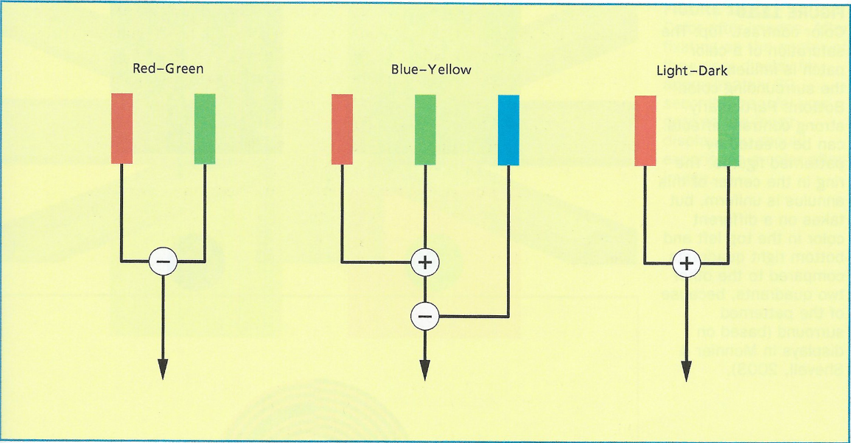
Opponent Color Theory Hering 1892
Figure 12.9– Foundations of Sensation and Perception, George Mather

Slide 69
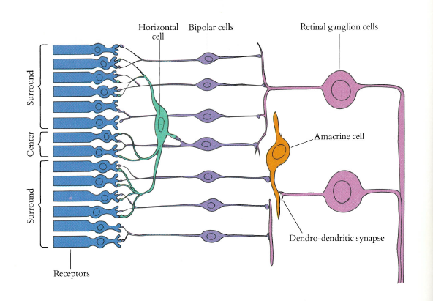
Image from “Eye, Brain, and Vision,” David Hubel, 1988

Slide 70
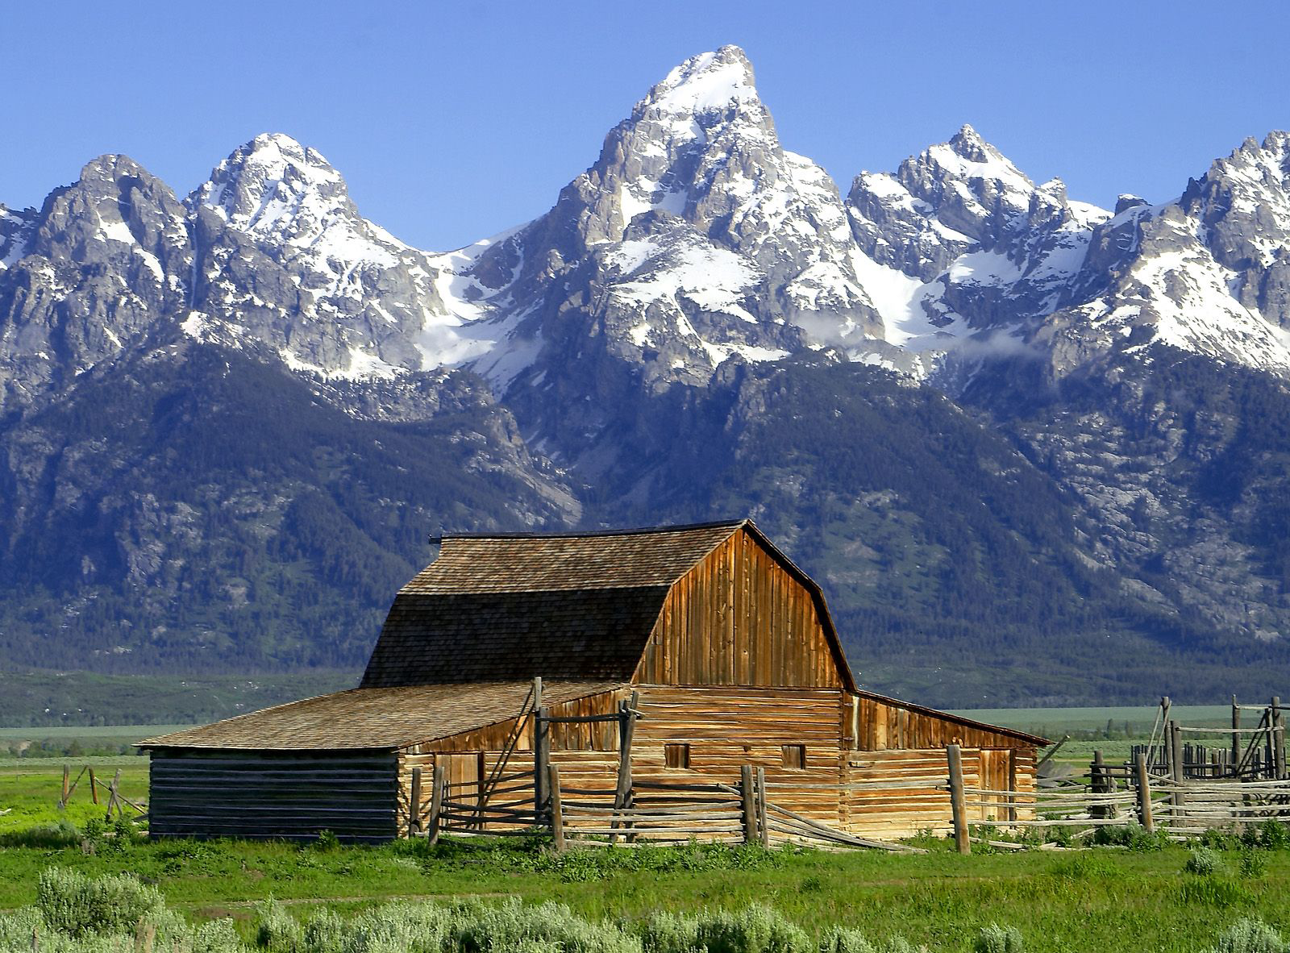
Full Color Image
YIQ http://en.wikipedia.org/wiki/YIQ

Slide 71
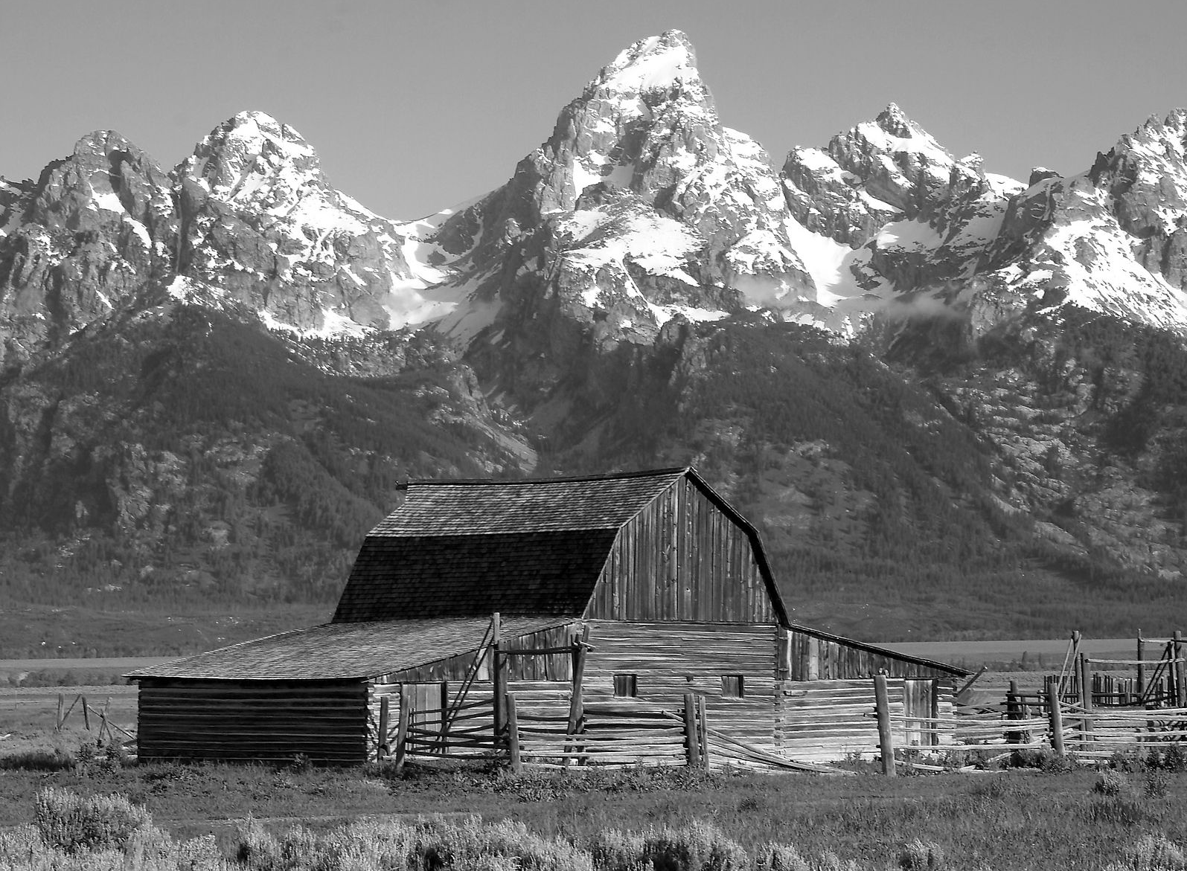
Luminance Image (Y)
YIQ http://en.wikipedia.org/wiki/YIQ

Slide 72

Color Addition (Red/Green Axis)(I)
YIQ http://en.wikipedia.org/wiki/YIQ

Slide 73

Color Addition (Yellow/Blue Axis)(Q)
YIQ http://en.wikipedia.org/wiki/YIQ

Slide 74
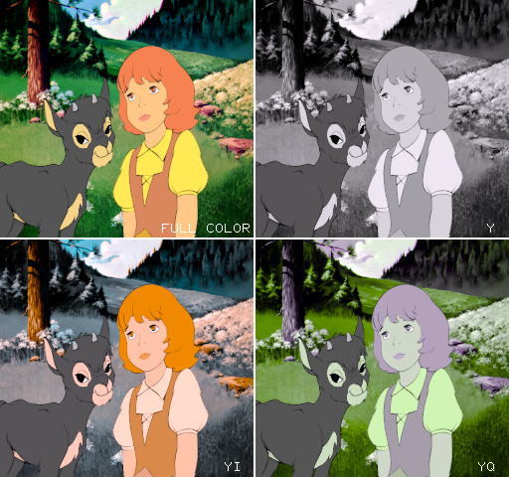
Heidi YIQ

Slide 75
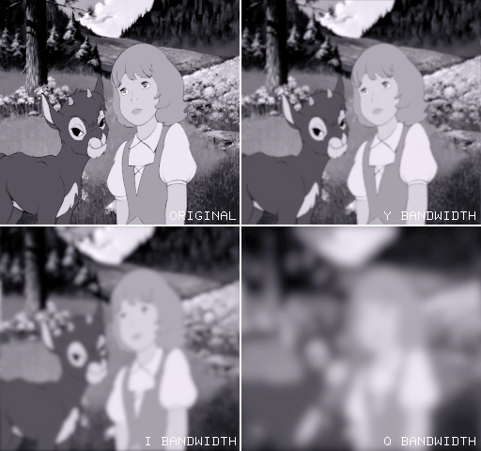
Heidi YIQ

Slide 76
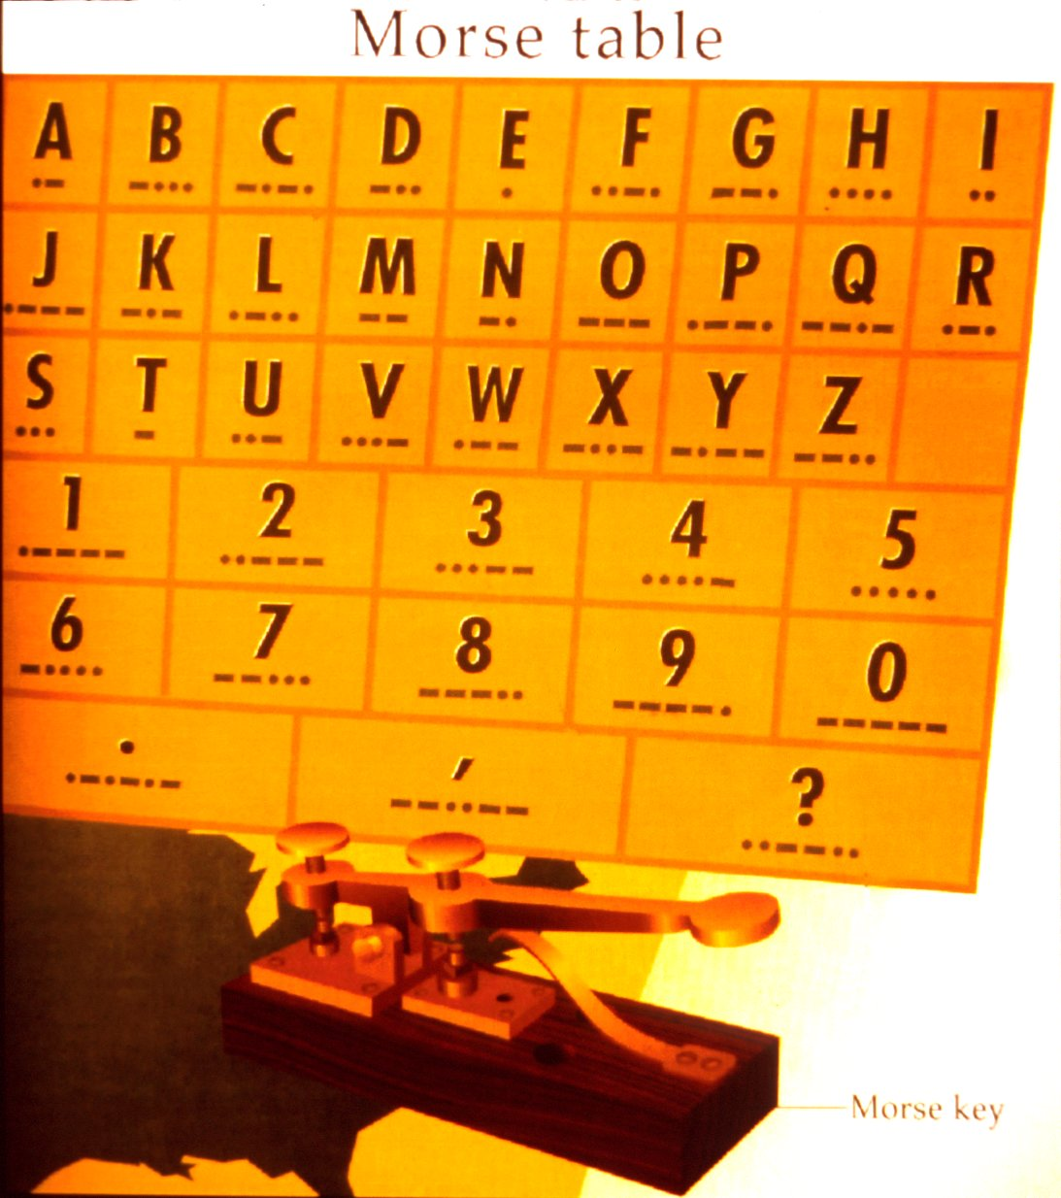
Morse Code

Slide 77
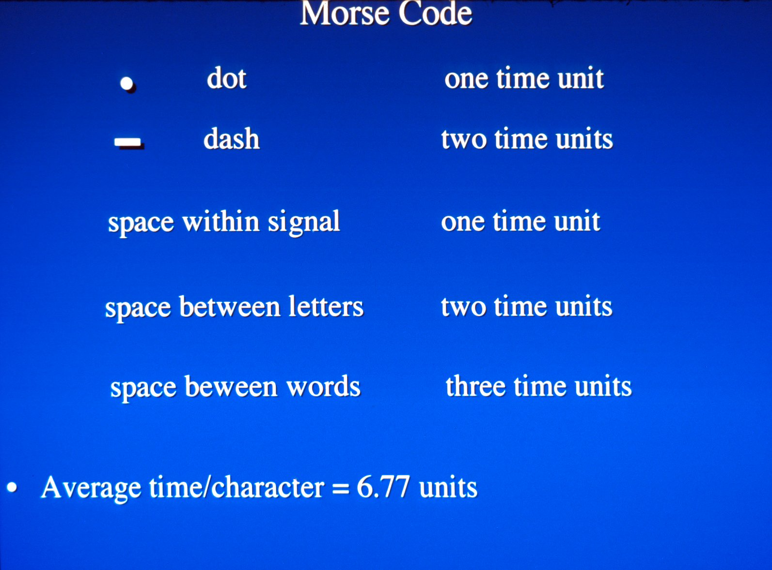

Slide 78
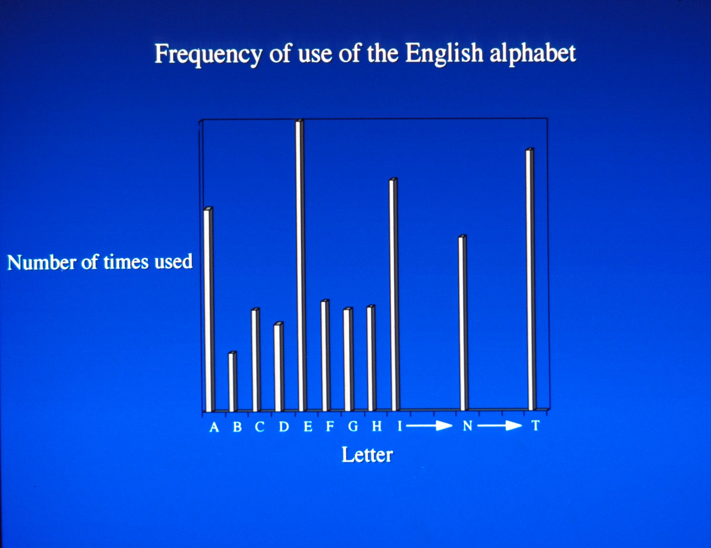

Slide 79
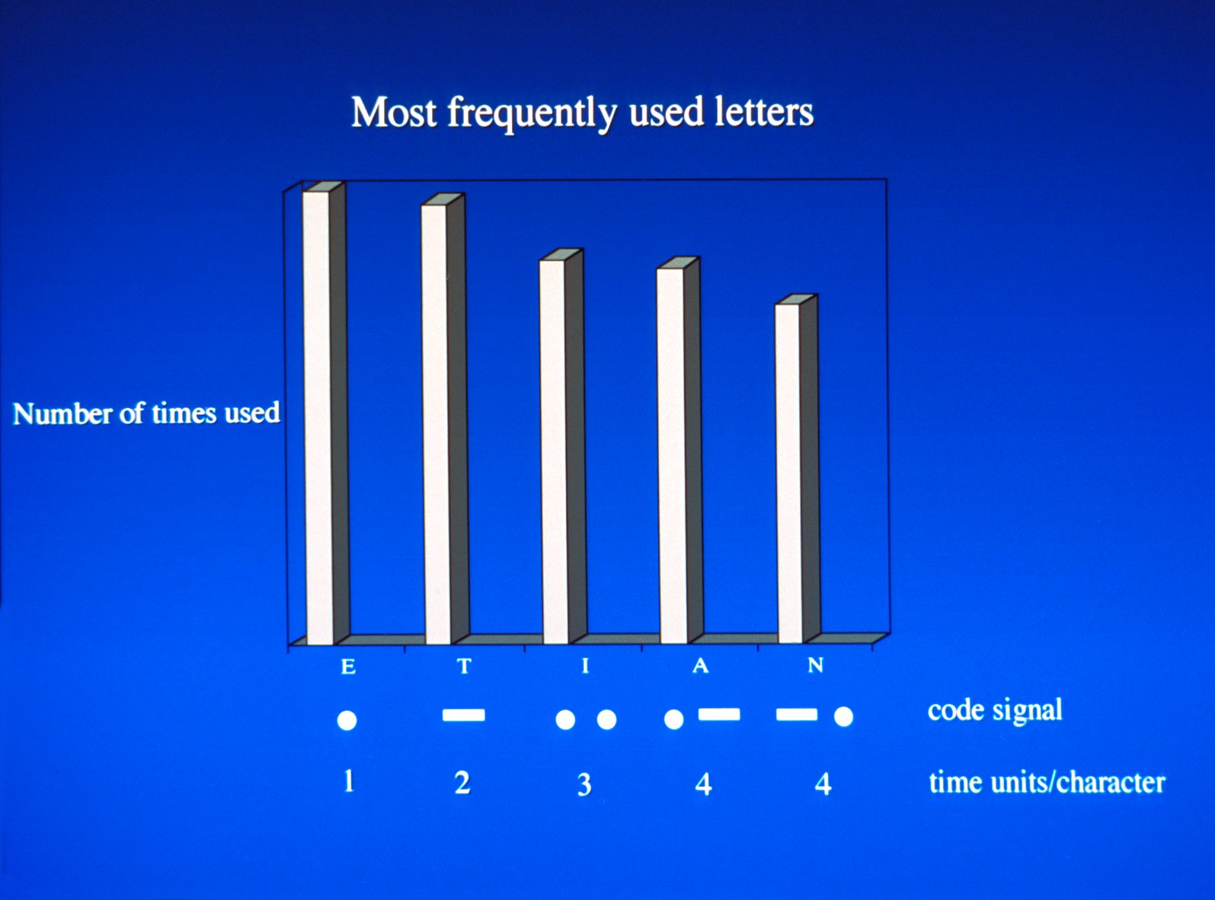

Slide 80
Lossless Compression System
Decompressed Data = Original Data.
Original
Data (X)
Lossless
Encoder
Compressed
Data
Decoder
Original
Data (X)

Slide 81
When is Lossless Compression Needed?
Medical – patient diagnosis
Aerial photography – surveillance
High quality art and photo reproduction
Legal evidence
Augmented Reality

Slide 82
Lossless Compression Methods
Run Length Codes
Huffman Codes
Lempel-Ziv Codes
Notes:
In a memory-less code, each sample in the data-vector to be encoded is replaced by a code-word from a prefix set of bit-strings.
Huffman encoding gives an efficient way to find an optimal Kraft vector L for the given frequency vector F such that L.F is minimized.
Entropy Bounds : Let R(X) be the compression rate in code-bits per data sample arising from the encoding of the data vector X via a Hoffmann code for X. Let H(X) be the entropy of X, then
H(X) <= R(X) <= H(X) + 1
H(X) = (sum F_{i} log₂(n/F_{i}))/n and R(X) = (L.F)/n
Codes with memory : Codes which are not memory-less codes are codes with memory. These are the lossless codes for which its sometimes possible to achieve a compression rate below the entropy bound. 3 types
Block codes : It partitions the data vector into blocks of given length, then each block is replaced by a code-word from a prefix set of binary words.
Finite memory codes : Each data sample is encoded using a memoryless code from the code book which is determines by looking at a fixed number of previous data samples.
Finite state code : It generalizes upon both the block codes and the finite memory codes.

Slide 83
Run length encoding
A run-length code encodes the binary data-vector via encoding of the sequence of run lengths r₁,r₂,…,r_{k}.
Notes:
Useful for compression of binary data.
Conditional run length coding is another way in which run length coding can be implemented on a non-binary image.
It involves a pre-coding step in which a binary code word is assigned adaptively to each pixel,
followed by run length coding of the concatenated code words.
The decomposition into bit planes is not used in conditional run length coding.

Slide 84

Lossless coding Example Run length encoding
160 Blue,
3 Black,
8 Red,
3 Black,
8 White,
3 Black,
10 White,
3 Black,
12 Red,
3 Black,
8 White,
3 Black,
10 White,
3 Black,
4 Red,
3 Black,
40 Blue.
Numbers + colors
17(1) + 17(1) = 34 bytes
Compression ratio = 274÷34
≈ 8:1
274 pixel wide
274 bytes

Slide 85
Lossless Compression System
Decompressed Data = Original Data.
Original
Data (X)
Lossless
Encoder
Compressed
Data
Decoder
Original
Data (X)

Slide 86
Lossy Compression Systems
Original
Data (X)
Lossy
Encoder
X’
Compressed
Data
Decoder
Decompressed
Data (X’)
Note: Decompressed Data ≠ Original Data.

Slide 87
JPEG

Slide 88
Lossy coding (example)
Original Data :
Lossy encoding :
(Quantization)

Slide 89
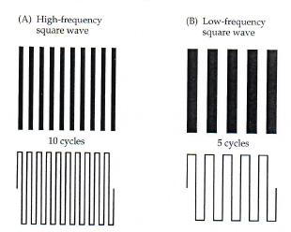
Frequency and Cycles Square Waves
Biological Psychology, Breedlove and Watson, 2013

Slide 90
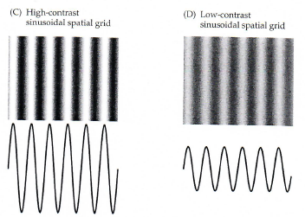
Frequency and Cycles Sine Waves
Biological Psychology, Breedlove and Watson, 2013

Slide 91
DCT-based encoder
8x8 blocks
FDCT
Quantizer
Entropy
Encoder
Source
Image Data
Compressed
Image Data
Table
Specification
Table
Specification

Slide 92
DCT-based decoder
Entropy
Decoder
Dequantizer
IDCT
Compressed
Image Data
Reconstructed
Image Data
Table
Specification
Table
Specification

Slide 93
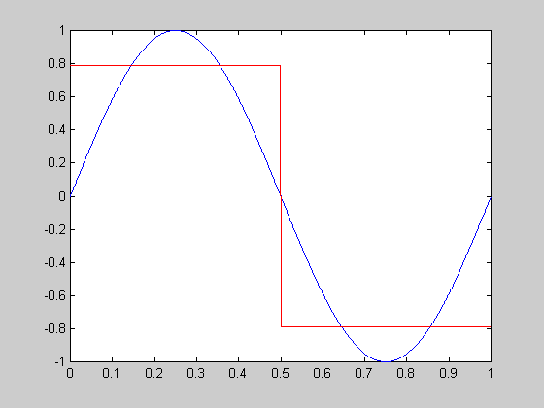
Square Wave using One Sine Wave
Sin(X)

Slide 94
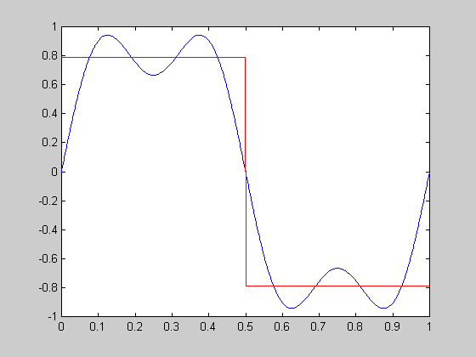
Square Wave using Two Sine Waves
Sin(X)+Sin(3x)

Slide 95
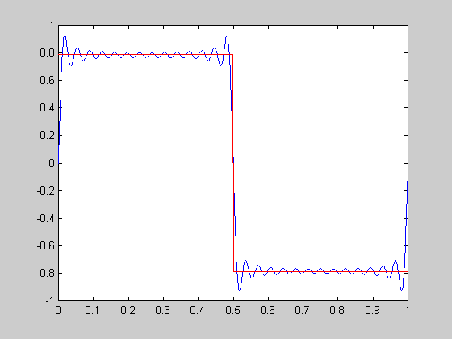
Square Wave using Many Sine Waves
Sin(X)+Sin(3x)+Sin(5x)+Sin(7x)+...

Slide 96

2D DCT Functions
DC
DC + 1 AC
DC + 1 AC

Slide 97

Discrete Cosine Transform JPEG

Slide 98
Preparation for Entropy Coding
DC
AC₀₁
AC₀₇
DC_{i-1}
DC_{i}
block_{i-1}
block_{i}
ΔDC_{i} = DC_{i} - DC_{i-1}
AC₇₀
AC₇₇
Differential DC encoding
Zig-zag sequence

Slide 99
Example: Lenna Original

Slide 100

Example: Lenna (DC)
0.19 bits/pixel

Slide 101

Example: Lenna (DC + 1AC)
0.32 bits/pixel

Slide 102

Example: Lenna (1DC + 2AC)
0.43 bits/pixel

Slide 103

Example: Lenna (7msb DC)
0.15 bits/pixel

Slide 104
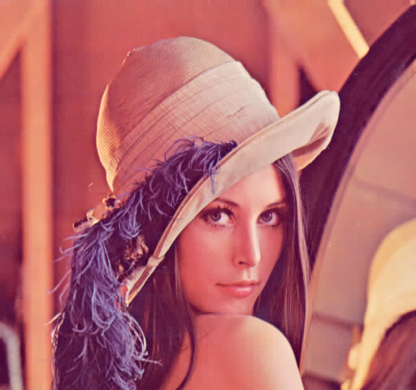
Example: Lenna (7msb DC+7msb AC)
0.8 bits/pixel

Slide 105
MPEG

Slide 106
MPEG Video Coding Compression & Decompression
Video
input
Preprocess
Motion
Compensation
DCT
Algorithm
Compressed
Video
Compression
Compressed
Video
Reverse
Algorithm
Inverse
DCT
Reverse
Motion Comp.
Filtering
& Processing
Video
Decompression

Slide 107
MPEG Video Coding Interframe coding
Forward Prediction
1
I
2
B
3
B
4
B
5
P
6
B
7
B
8
B
1
I
Bidirectional Prediction

Slide 108
MPEG video coding procedure
(MPEG : Movie Picture Experts Groups)
Input image
Transform coded
macroblock
B
Y
Encoder output
G
I frame :
R
01101100...
C_{r}
C_{b}
Entropy
Coding
YUV
conversion
Macroblock
Transform Coding
Reference frame(s)
Y
C_{r}
C_{b}
Transform
Coding of
Error
Terms
Input image
Transform coded
macroblock
B
Y
error terms
G
R
+
+
P/B frame :
C_{r}
C_{b}
-
+
110...
YUV
conversion
Motion
compensation
Entropy
Coding
Motion vectors

Slide 109
Motion JPEG & MPEG
A digital video sequence can be represented as a series of JPEG images.
In MPEG video, only the new (changed) parts of the video sequences need to be transmitted along with the information about the moving parts.
http://www.balooga.com/mpeg4.php3 A comparison of the encoding efficiencies..

Slide 110
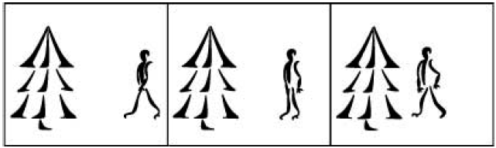
JPEG Video sequence
A three-picture JPEG video sequence
http://www.axis.com/documentation/whitepaper/video/video_compression.htm “Compression techniques,” White Paper – Axis .Communications

Slide 111
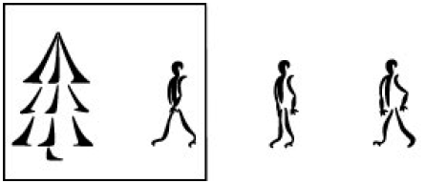
MPEG Video sequence
A three-picture MPEG video sequence
http://www.axis.com/documentation/whitepaper/video/video_compression.htm “Compression techniques,” White Paper – Axis .Communications

Slide 112
End

