Slide 1
Digital Photography
NBAY 6120
March 5, 2020
Donald P. Greenberg
Lecture 3

Slide 2
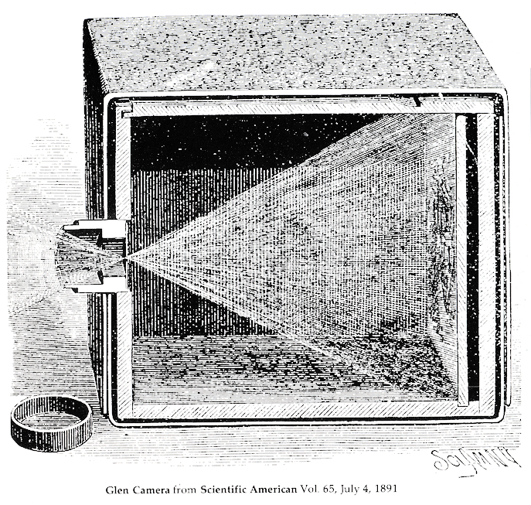
Pinhole Camera
Note that the entire image through the pinhole is totally in focus on a single image plane.

Slide 3
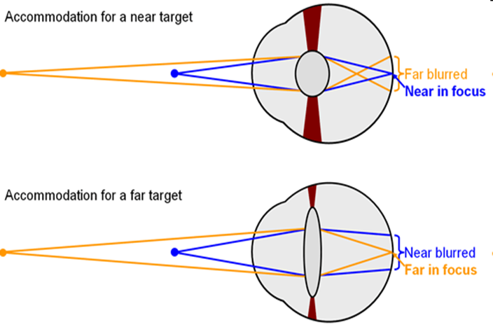
Focus Fundamentals

Slide 4
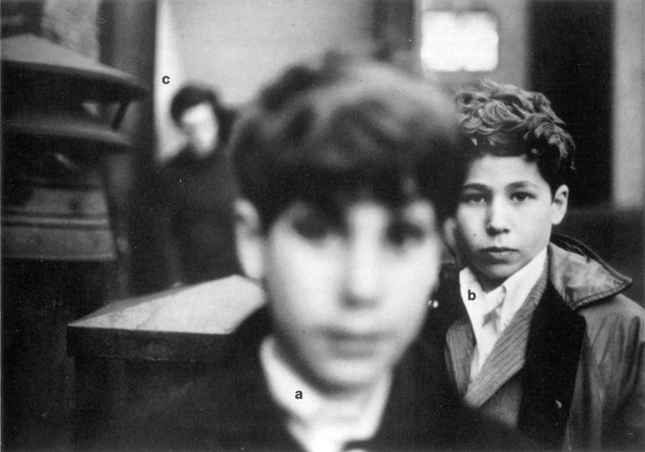

Slide 5
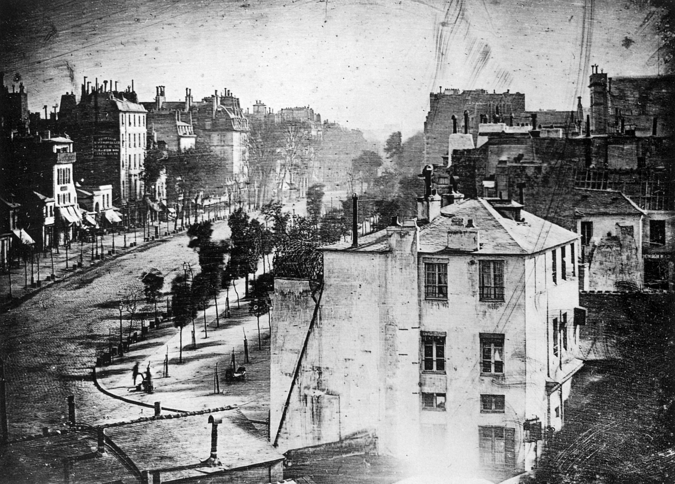
Daguerre’s Early Photograph 1838

Slide 6
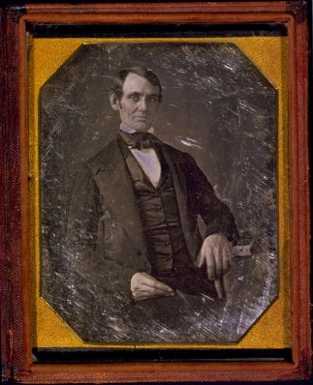
Lincoln’s Daguerreotype 1860s

Slide 7
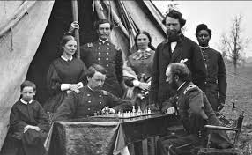
Civil War Mathew Brady

Slide 8
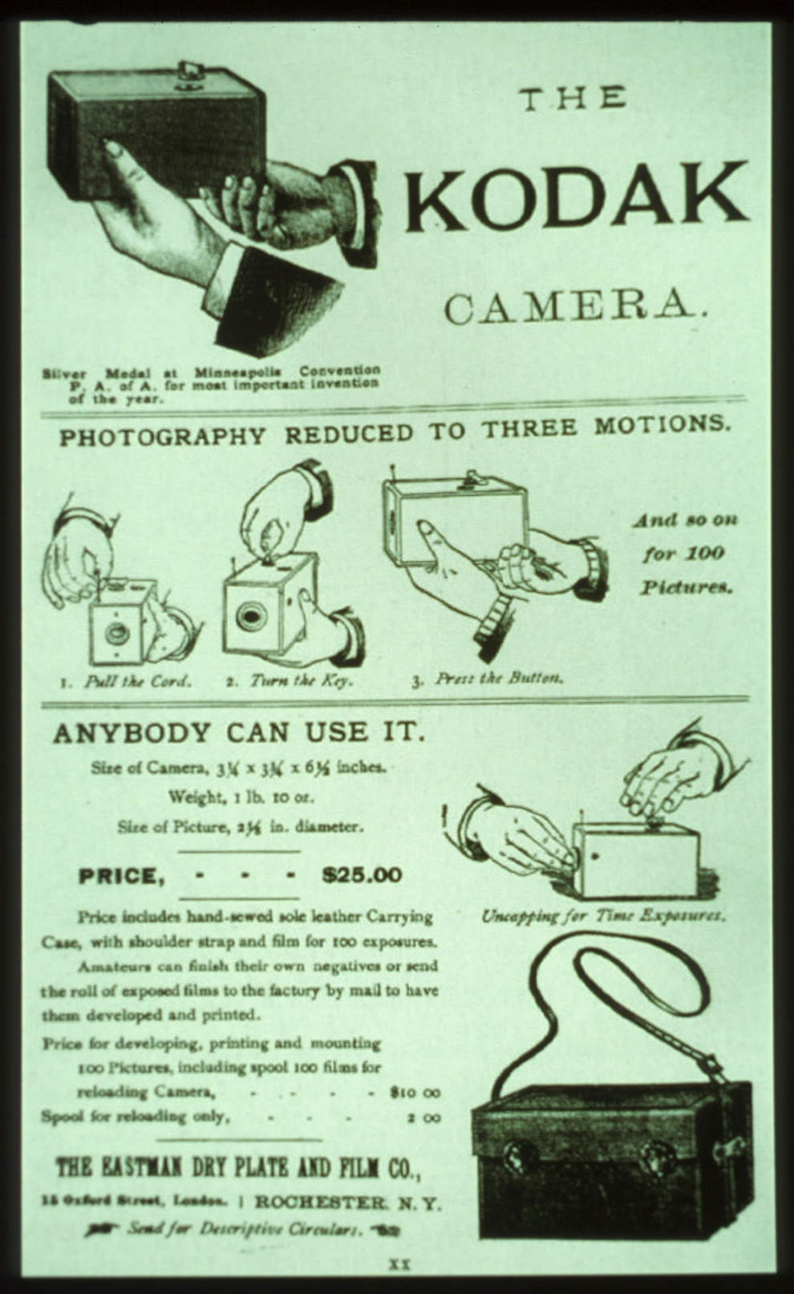
Kodak’s Early Camera 1888
from The Story of Kodak, Douglas Collins 1990, p. 57

Slide 9
Color Film Paradigm Shift 1934
From multiple lenses or multiple exposures
to multiple layered film
The transition from the optical approach to the
chemical approach formed the new basis for
color photography
Mannes & Godowsky
1920’s

Slide 10
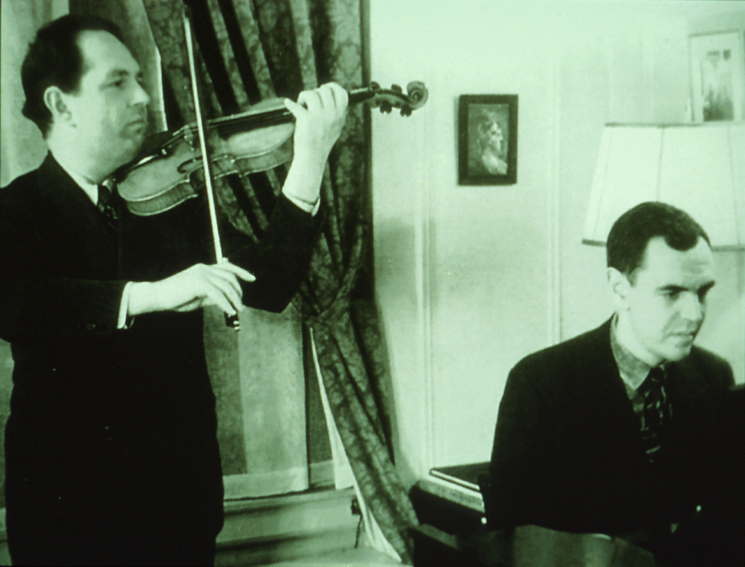
Mannes & Godowsky 1930s
(The Story of Kodak, Douglas Collins p. 205)

Slide 11
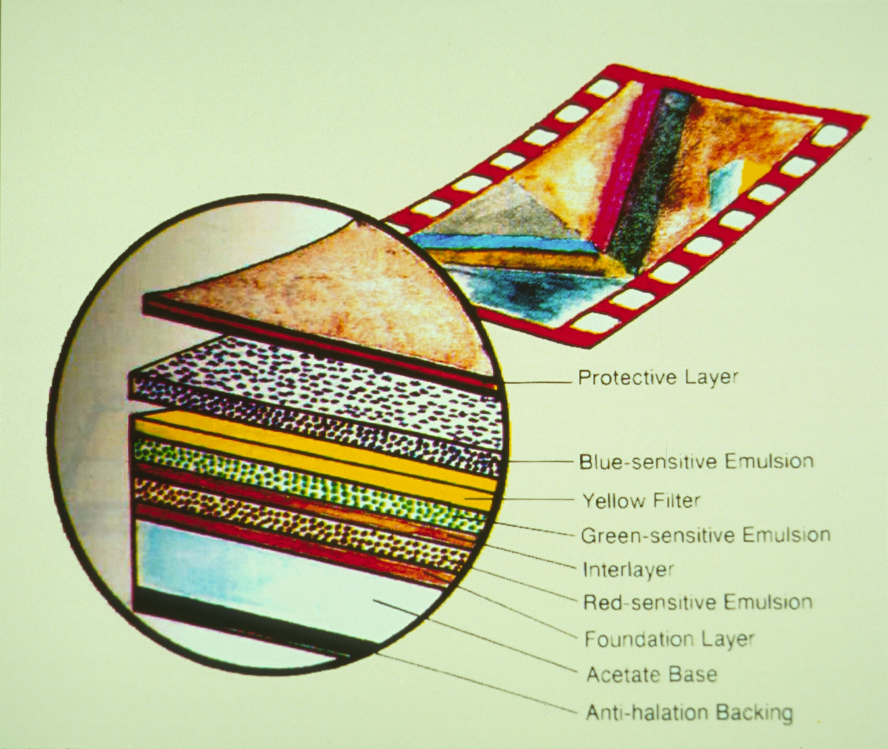
Protective Layer
Blue-sensitive Emulsion
Yellow Filter
Green-sensitive Emulsion
Interlayer
Red-sensitive emulsion
Foundation Layer
Acetate Base
Anti-halation Backing
(fig. 1.6, Color Photography, Robert Hirsch, p. 5)

Slide 12
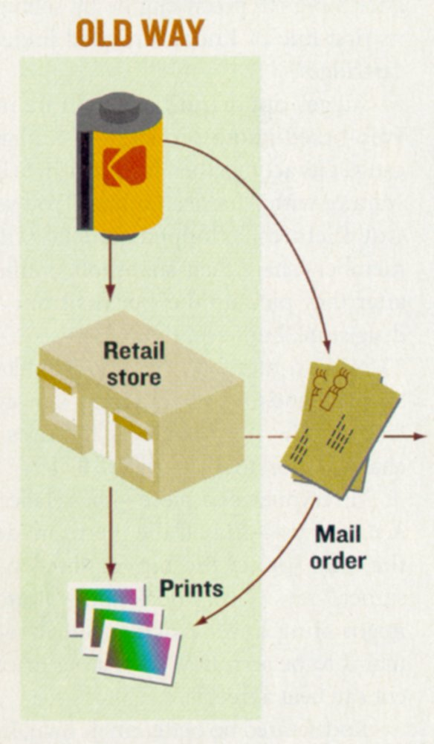
Old Way – Mail film and receive prints 1940s

Slide 13
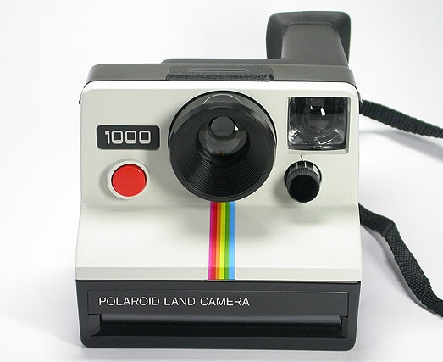
Polaroid Land Camera 1947

Slide 14
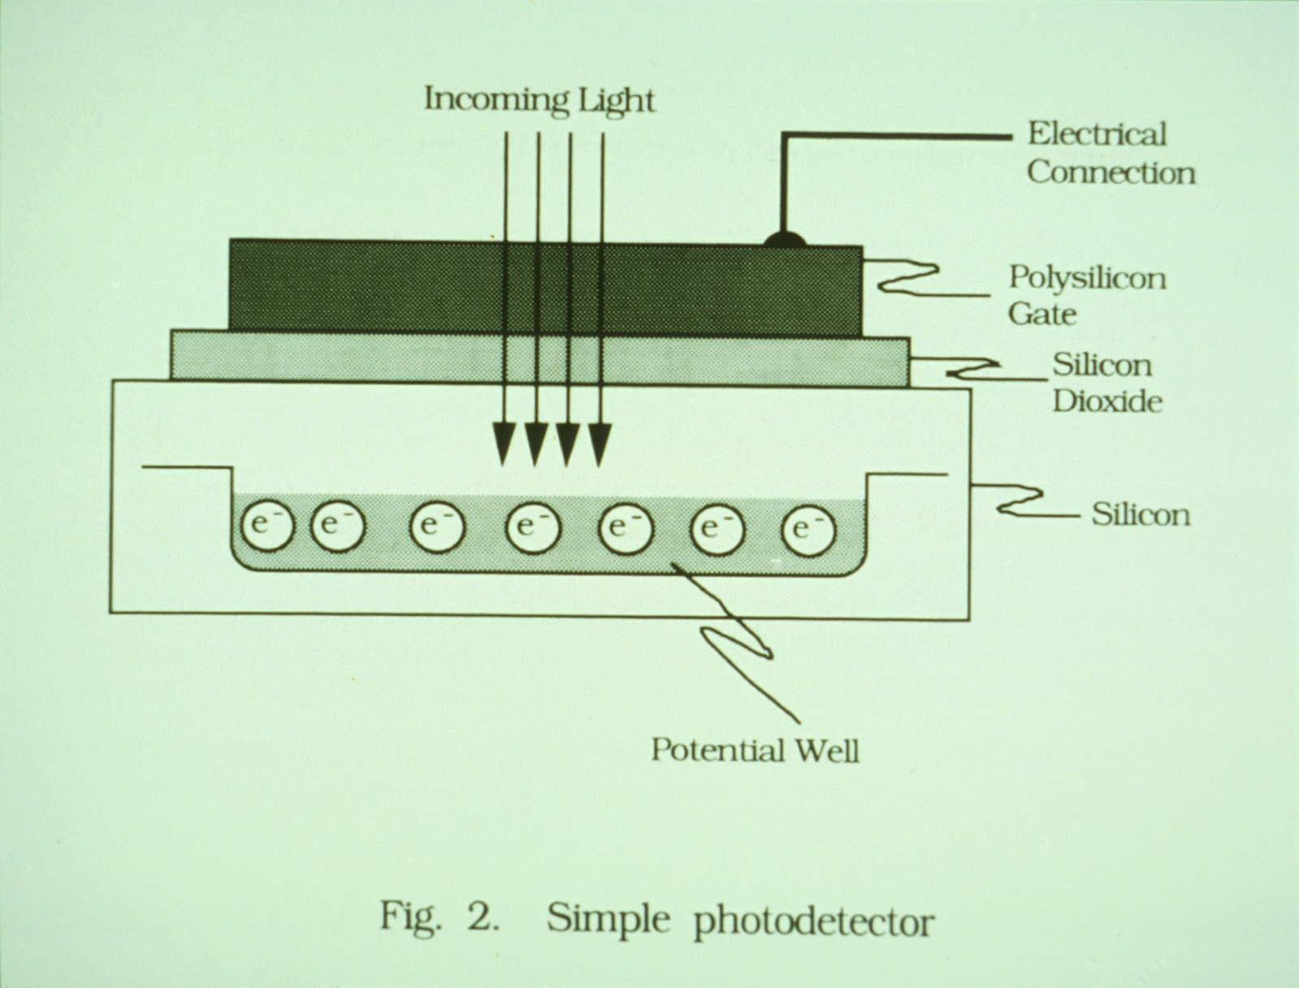
Photo-detector Technology
(Charge-Coupled Devices for Quantitative Electronic Imaging, 1991 Photo-metrics, Ltd. p. 6)

Slide 15
CMOS Technology
Complementary metal oxide semiconductor
Follows the semiconductor industry cost curves
Processing (which is “free”) can perform calculations on each pixel within frame time (e.g. correct for lighting, motion blur, etc.).

Slide 16
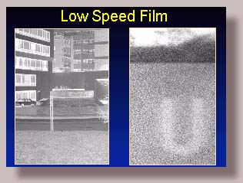
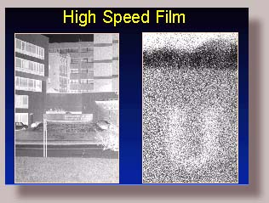
Silver Halide
A low speed, ISO 32 film produces this fine grained image. The right image is a small portion of the whole negative on the left.
A high speed, ISO 400 film produces a coarser grain with less apparent sharpness in the image.
Paul R. Montague. “Digital Imaging Comparing Film with Digital Images,” The Ophthalmic Photographers’ Society, Inc. http://www.opsweb.org/Op-Photo/Digital/DigImage1.htm

Slide 17
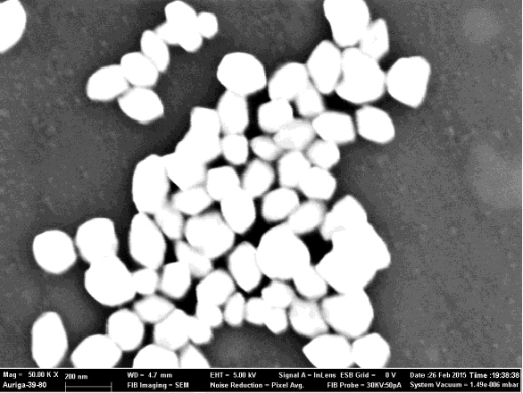
Silver Halide Crystals
Is this analog or digital?

Slide 18
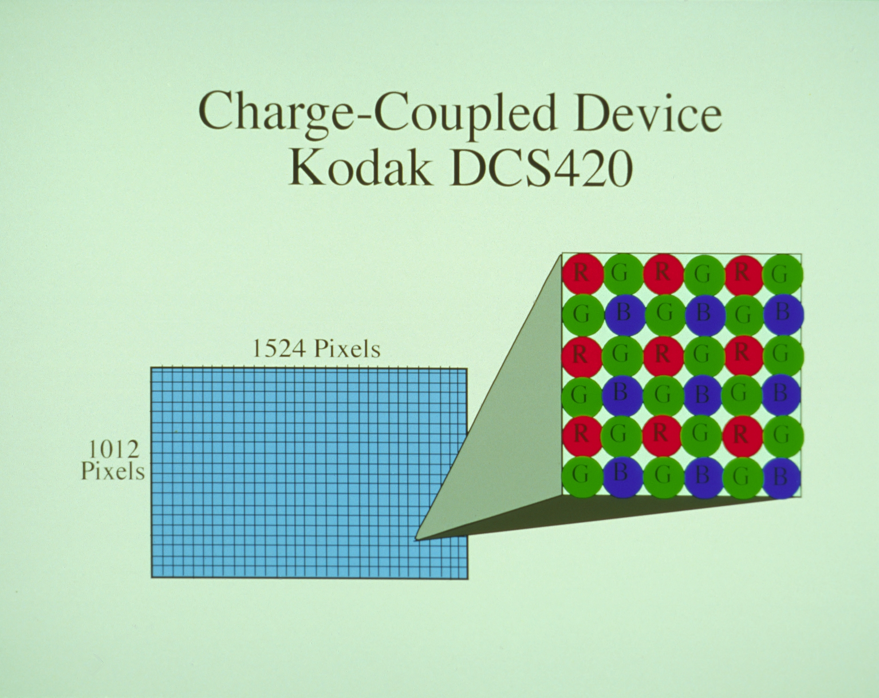
Bayer Pattern 1994
$14,000 approximately, June 1994

Slide 19
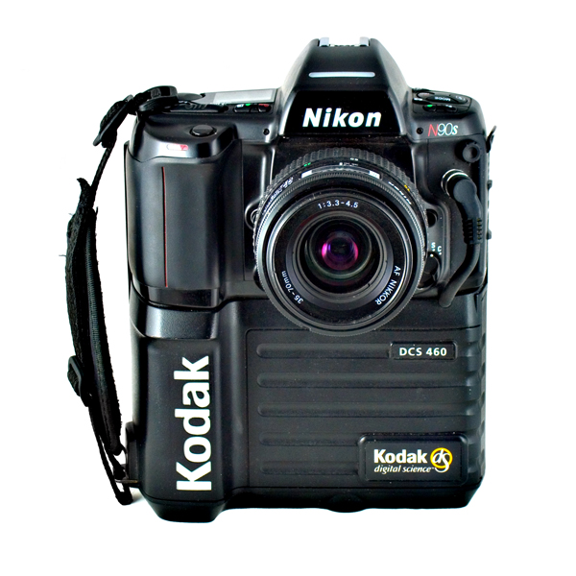
Kodak DCS 460
1995 – the highest resolution digital camera ($35,600)
2000 – price had dropped to $2,500

Slide 20
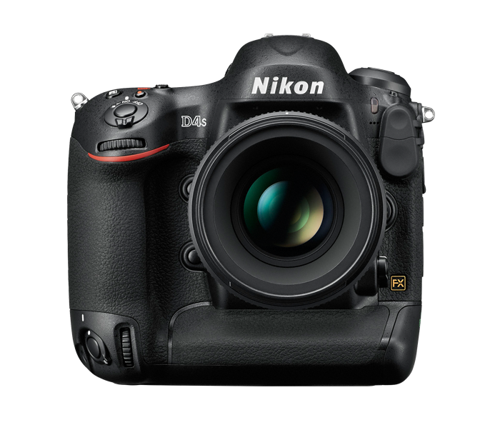
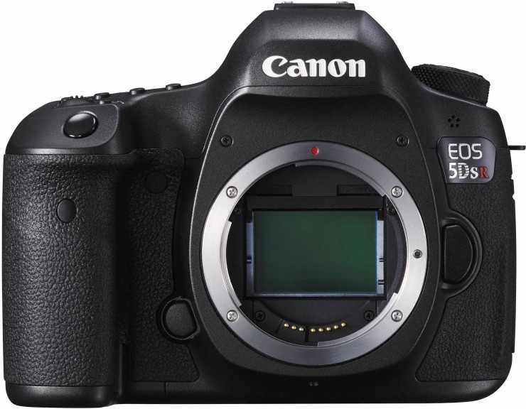
PROFESSIONAL
Digital Cameras 2014
Canon EOS 5DSR
50.6 MegaPixels
$3,899
Nikon Digital SLR
16.2 MegaPixels
$5,999

Slide 21
When is a phone not a phone?
…when it’s a camera...

Slide 22

iPhone 8 & 8+ Fall 2017 Release 9/12/17
Basic chip – 6 processors
  2 performance + 4 efficiency
  GPU
  4.3 B transistors
  10nm technology
2 – 12mp cameras
Wireless charging
Applications
  A/I
  Machine learning
  Face recognition
  Augmented reality

Slide 23
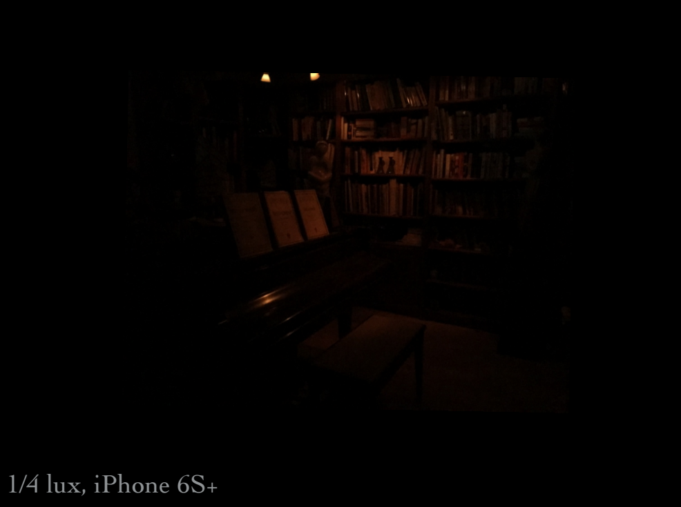
Extreme Imaging Pixel Camera, 9/15/2016
Marc Levoy

Slide 24
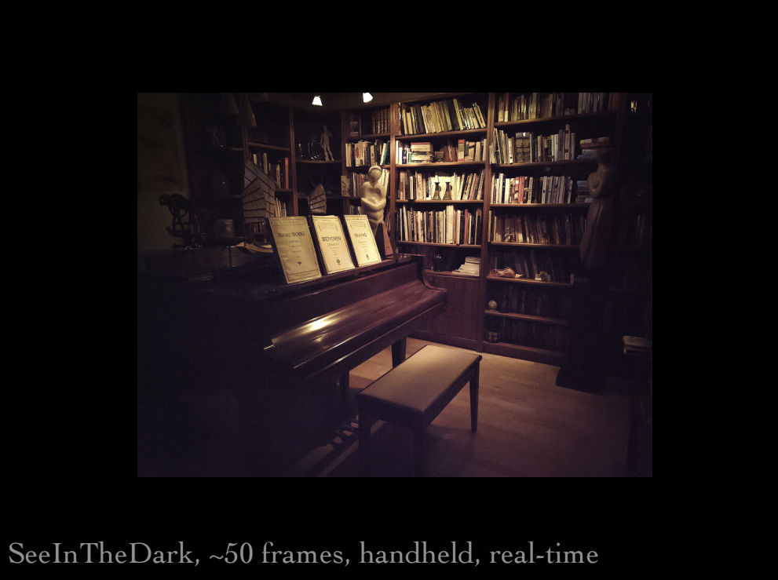
Extreme Imaging Pixel Camera, 9/15/2016
Marc Levoy

Slide 25
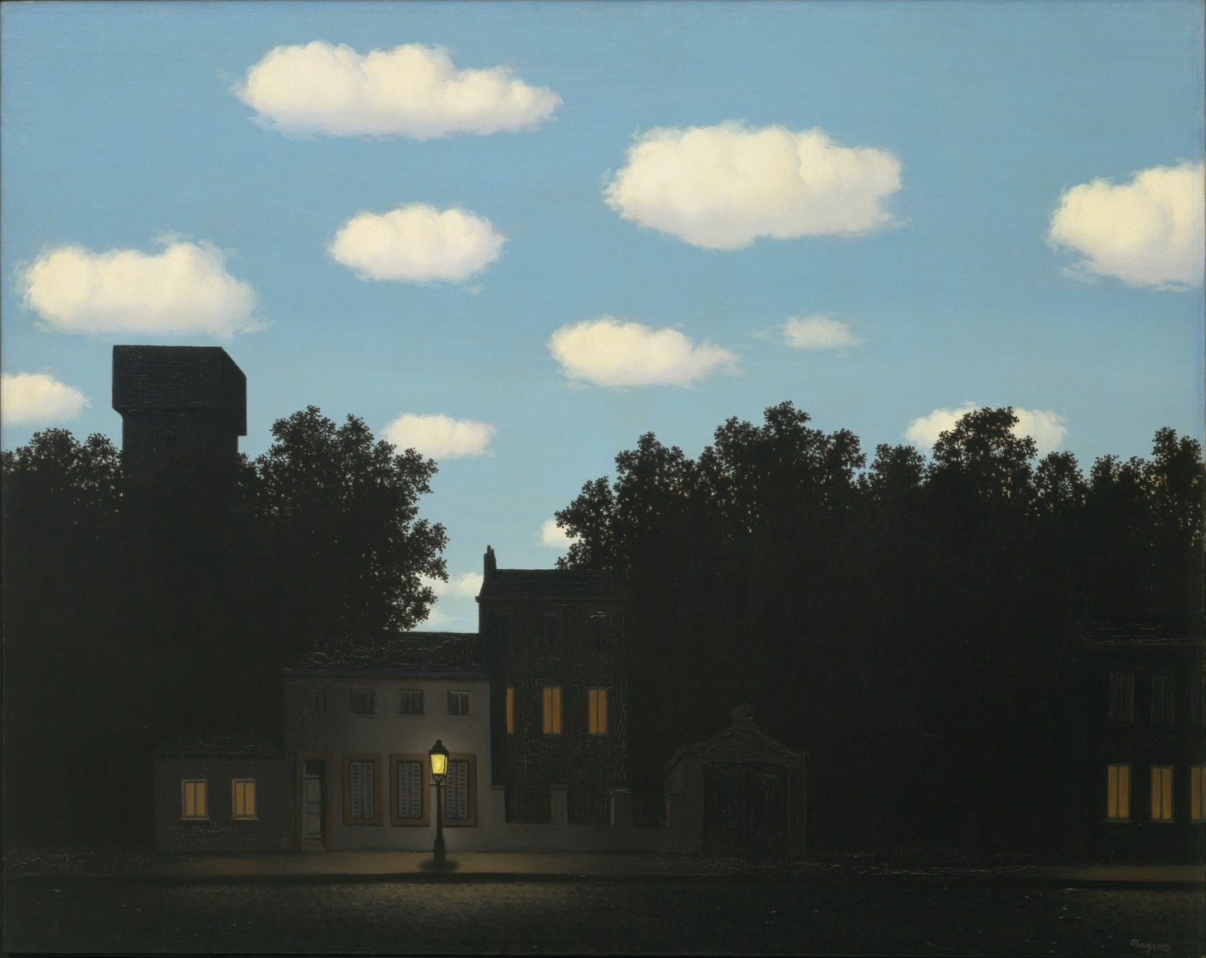
Magritte’s The Empire of Light II 1950

Slide 26

Pixel Night Sight 2018
Marc Levoy. “Night Sight: Seeing in the Dark on Pixel Phones”

Slide 27
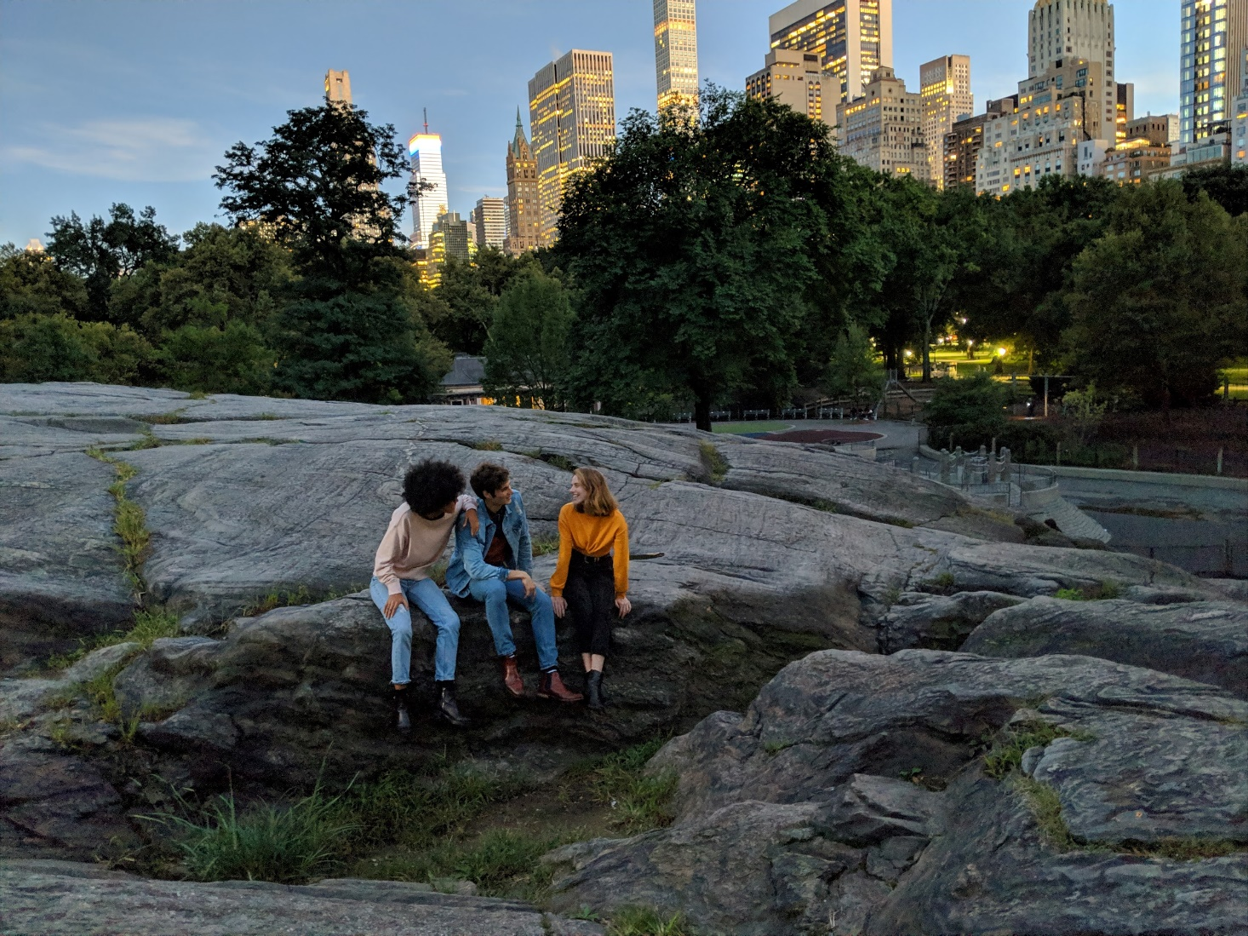
Pixel Night Sight 2018
Marc Levoy. “Night Sight: Seeing in the Dark on Pixel Phones”

Slide 28
Advanced Digital Photography

Slide 29
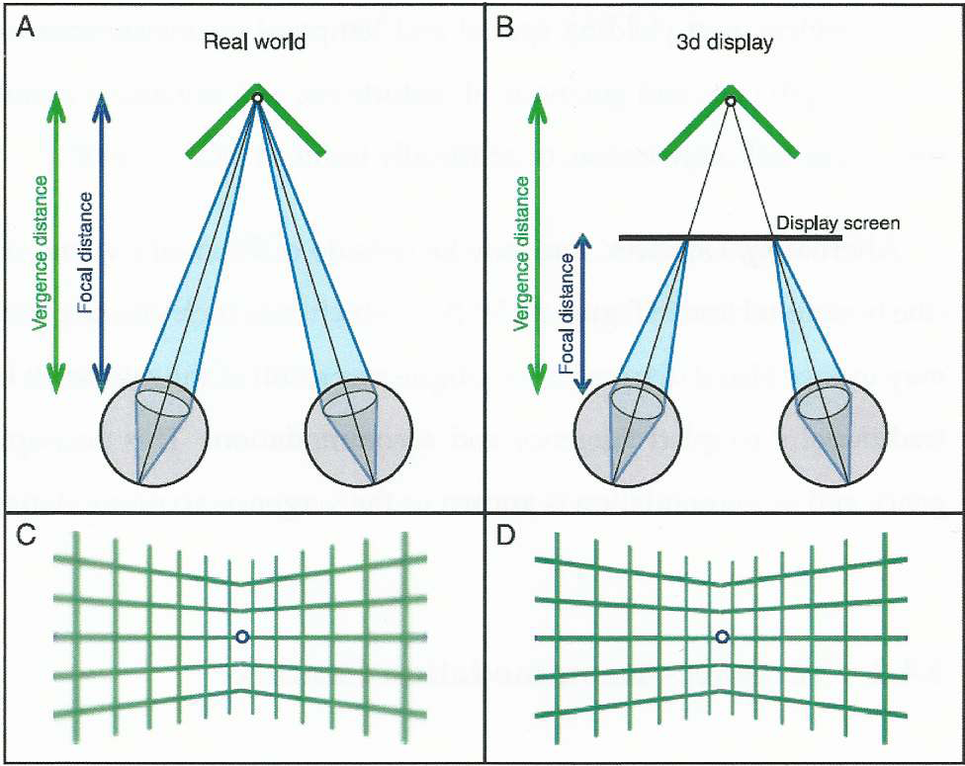
Vergence-Accommodation Conflict

Slide 30

Pixel 2 Phase Detection for Depth Mapping 2018
Marc Levoy. “Portrait mode on the Pixel 2 and Pixel 2 XL smartphones”

Slide 31
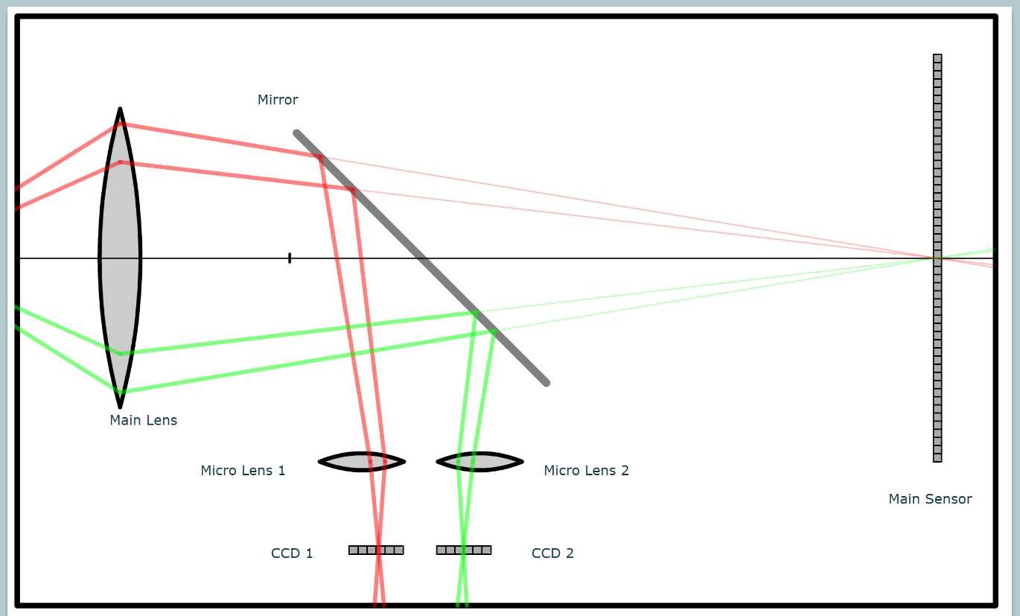
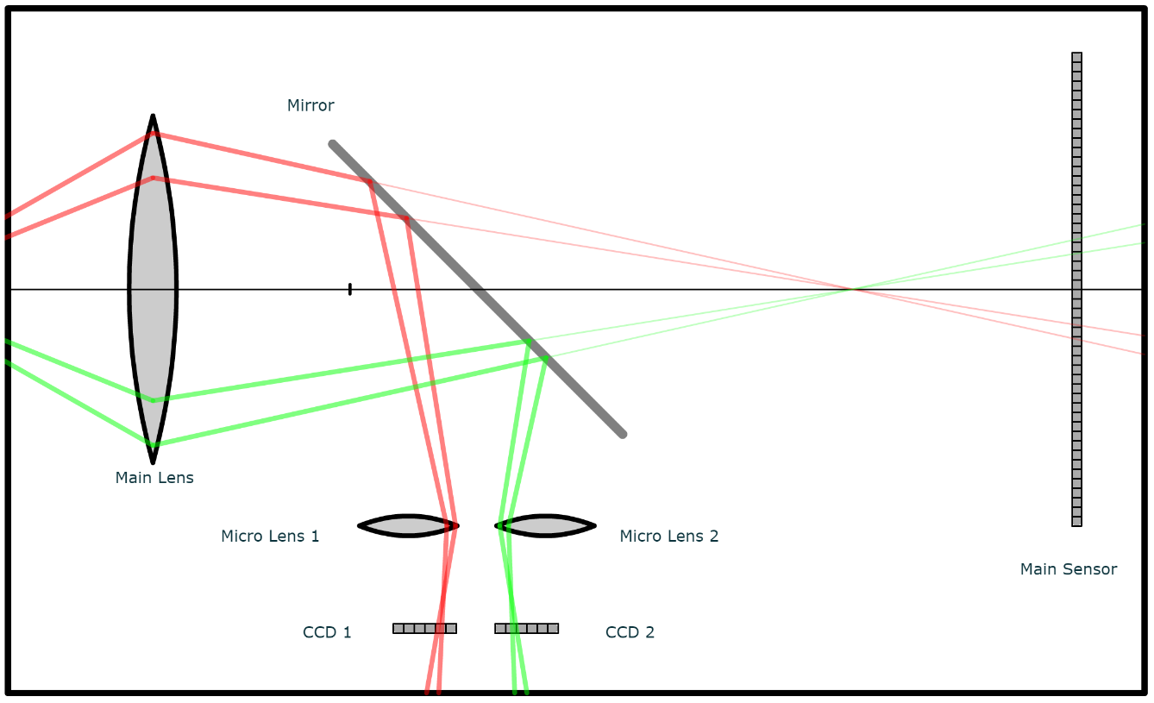
Autofocus by Phase Detection
Marc Levoy and Nora Willet. “Autofocus: phase detection”

Slide 32

Pixel 2 Phase Detection for Depth Mapping 2018

Slide 33
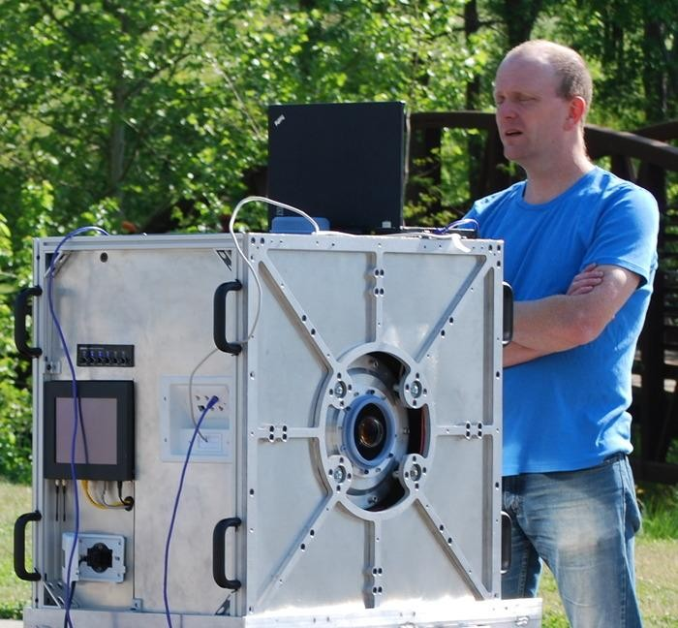
AWARE-2
http://www.kickstarter.com/projects/aqueti/carolina-zoomin

Slide 34
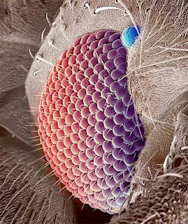
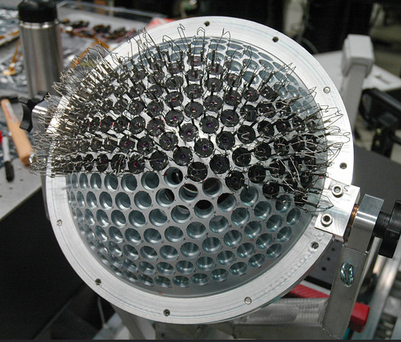
Eye of a Fly AWARE-2 Duke University
http://www.nanowerk.com/spotlight/spotid=3744.php

Slide 35
http://gigapan.com/galleries/11088/gigapans/146504

Slide 36
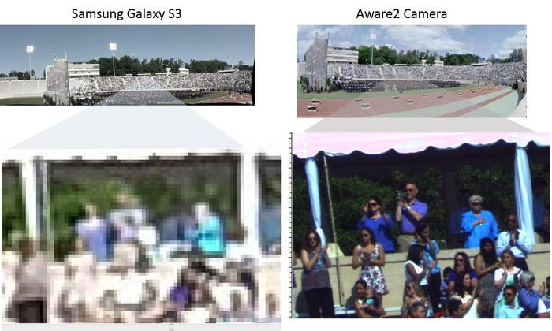
AWARE-2
http://www.kickstarter.com/projects/aqueti/carolina-zoomin

Slide 37
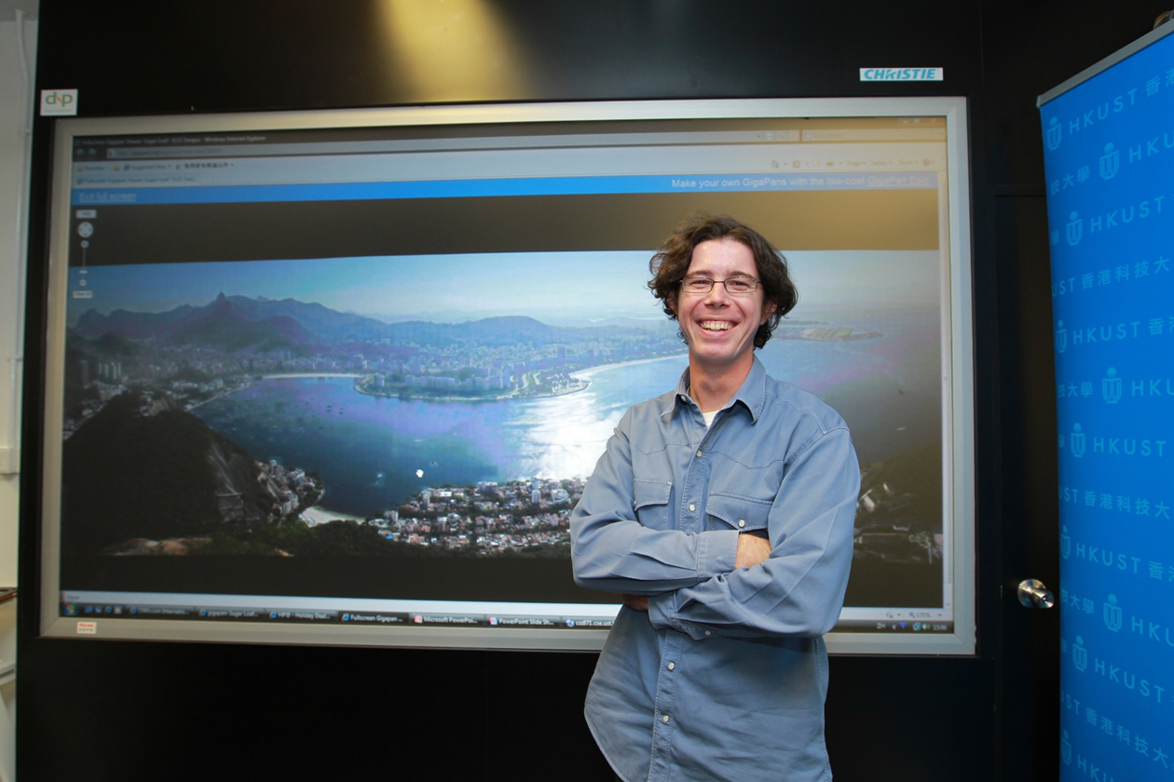
Gigapixel Images Prof. Pedro Sander HKUST
2010

Slide 38
http://gigapan.com/gigapans/58857

Slide 39
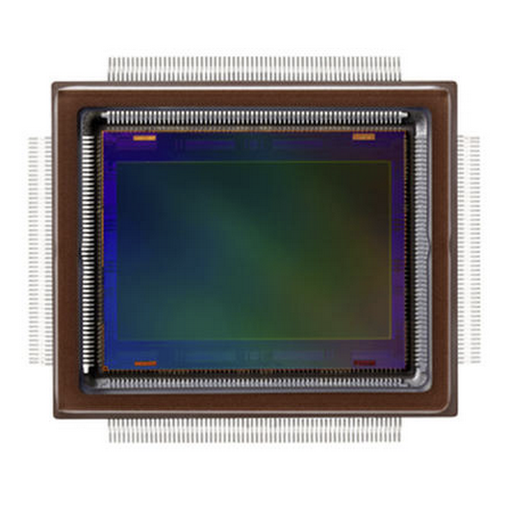
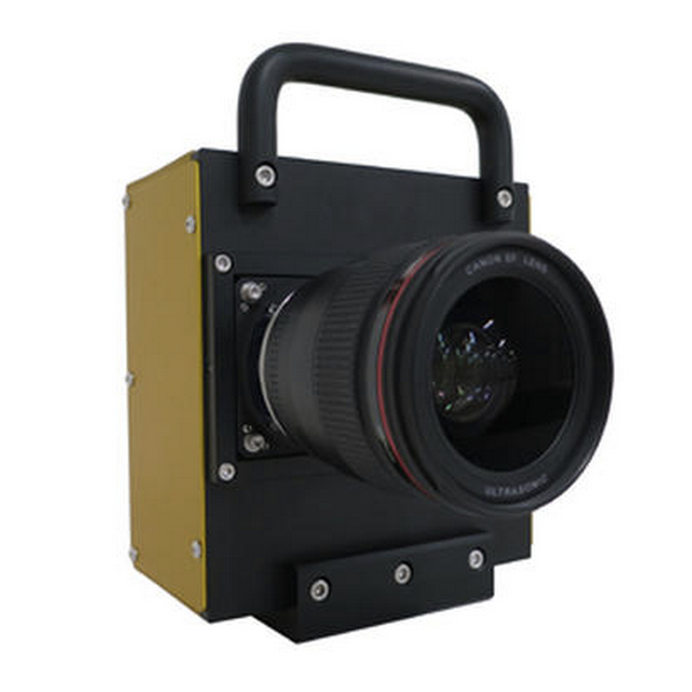
Canon’s 250-megapixel camera sensor 09/08/15
Can read letters 11 miles away!

Slide 40
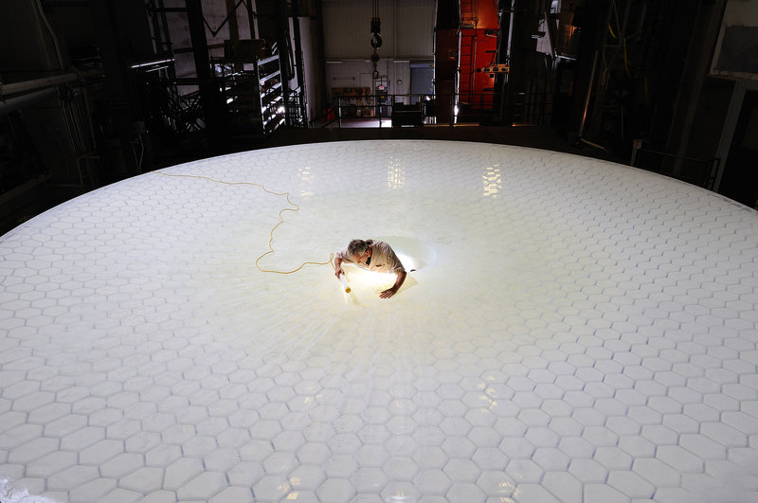
World’s Largest Digital Camera 2018
Biomimicry
Large Synoptic Survey Telescope
“The Largest Digital Camera in the World Takes Shape”
npr.org

Slide 41
Light Field Photography
Images are not two dimensional!

Slide 42
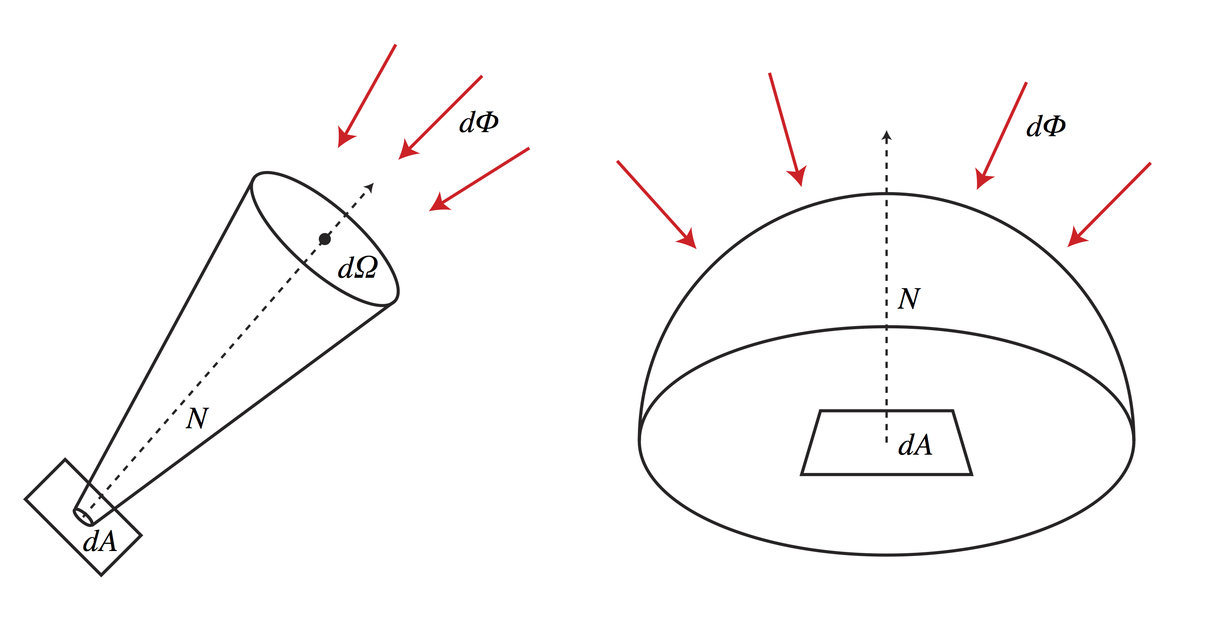
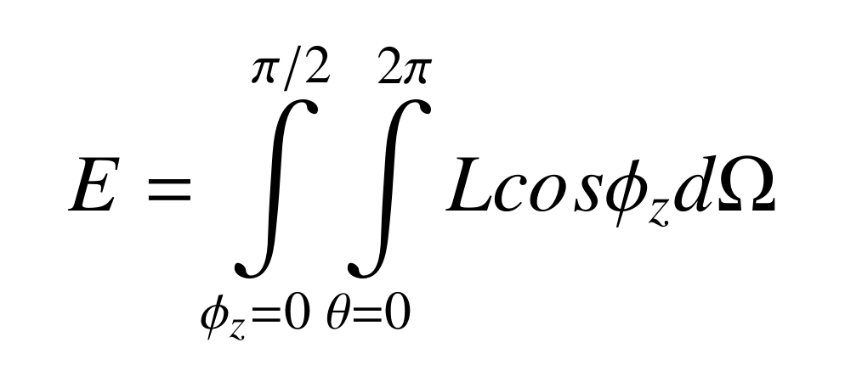
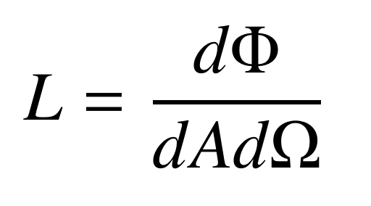
Quantifying Illumination
Irradiance
Radiance
Irradiance
Radiance is defined as the light energy coming
from a specific direction.

Slide 43
What is a Light Field?
Radiance is defined as the light energy coming from a specific direction.
A light field is defined as the radiance at a position (x, y), and a direction (θ, φ).
Thus, the light field is a 4-dimensional space.

Slide 44
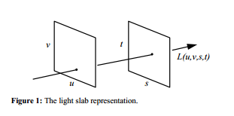
Light Field
A light field can be represented by four variables L(u,v,s,t)

Slide 45
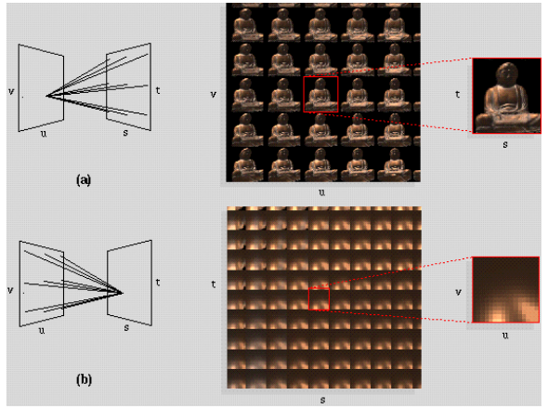
Light Field

Slide 46
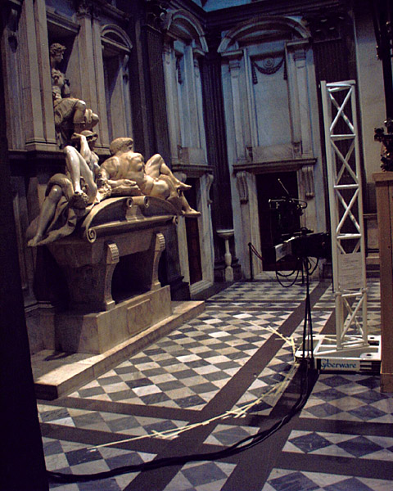

Slide 47
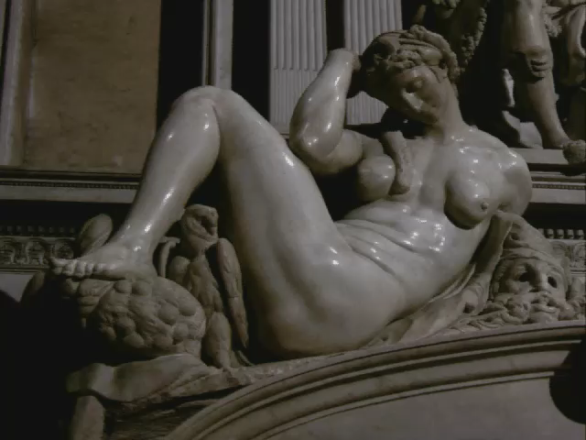

Slide 48
Multi-camera array and LF camera are duals

Slide 49
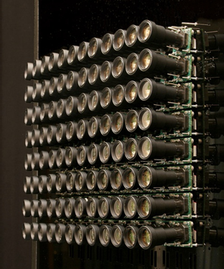
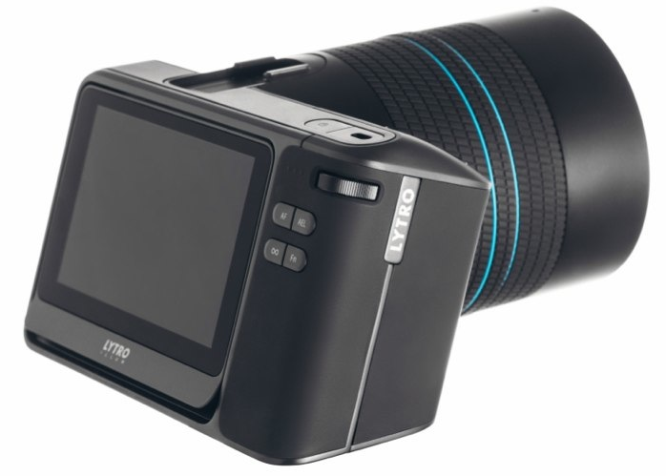
Key LF-camera advantage: a single lens
(more familiar, reduces complexity, simplifies calibration, …)

Slide 50
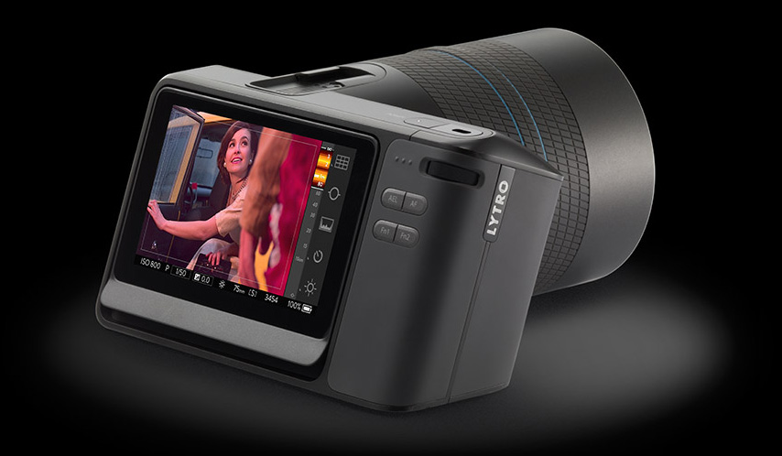
Lytro Camera 2015

Slide 51
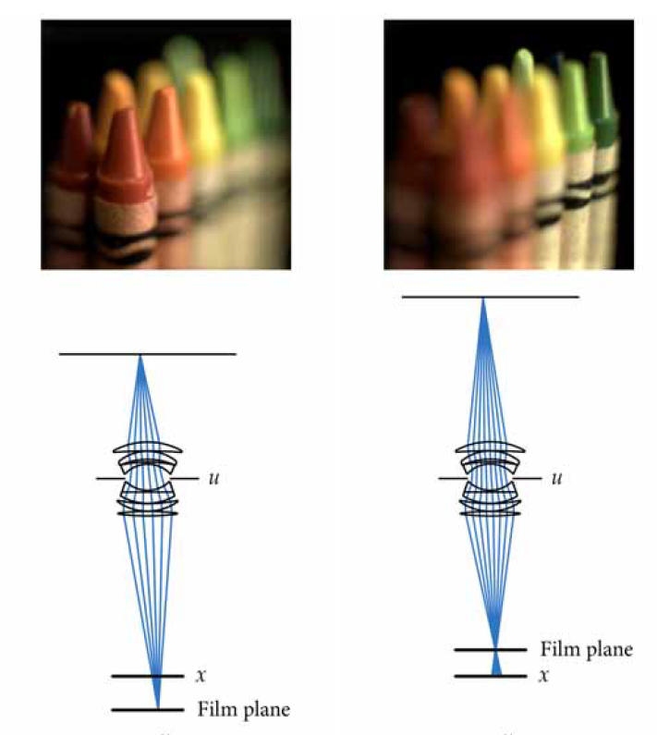
Lytro Camera 2015

Slide 52


Slide 53


Slide 54
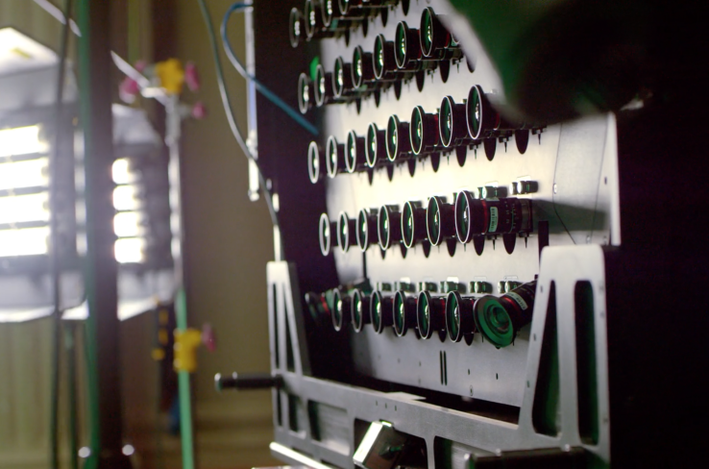
Lytro’s last light field camera 2017

Slide 55
End

Slide 56
Computer Graphics
Software & Hardware
NBAY 6120
Lecture 3
Donald P. Greenberg

Slide 57
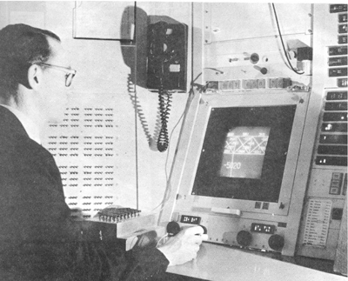
Ivan Sutherland 1963

Slide 58
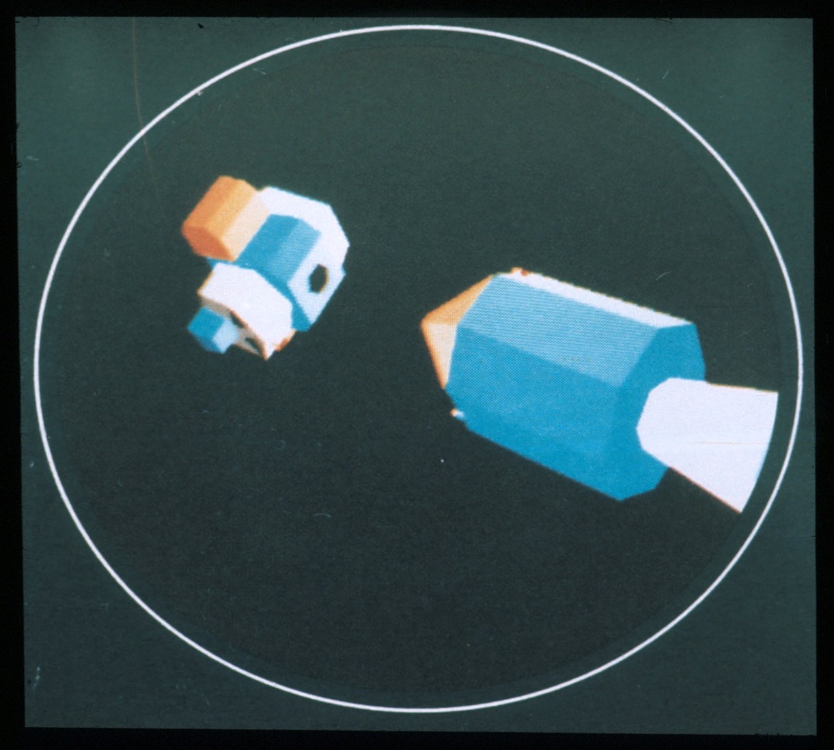
General Electric 1967
Program of Computer Graphics, Cornell University

Slide 59
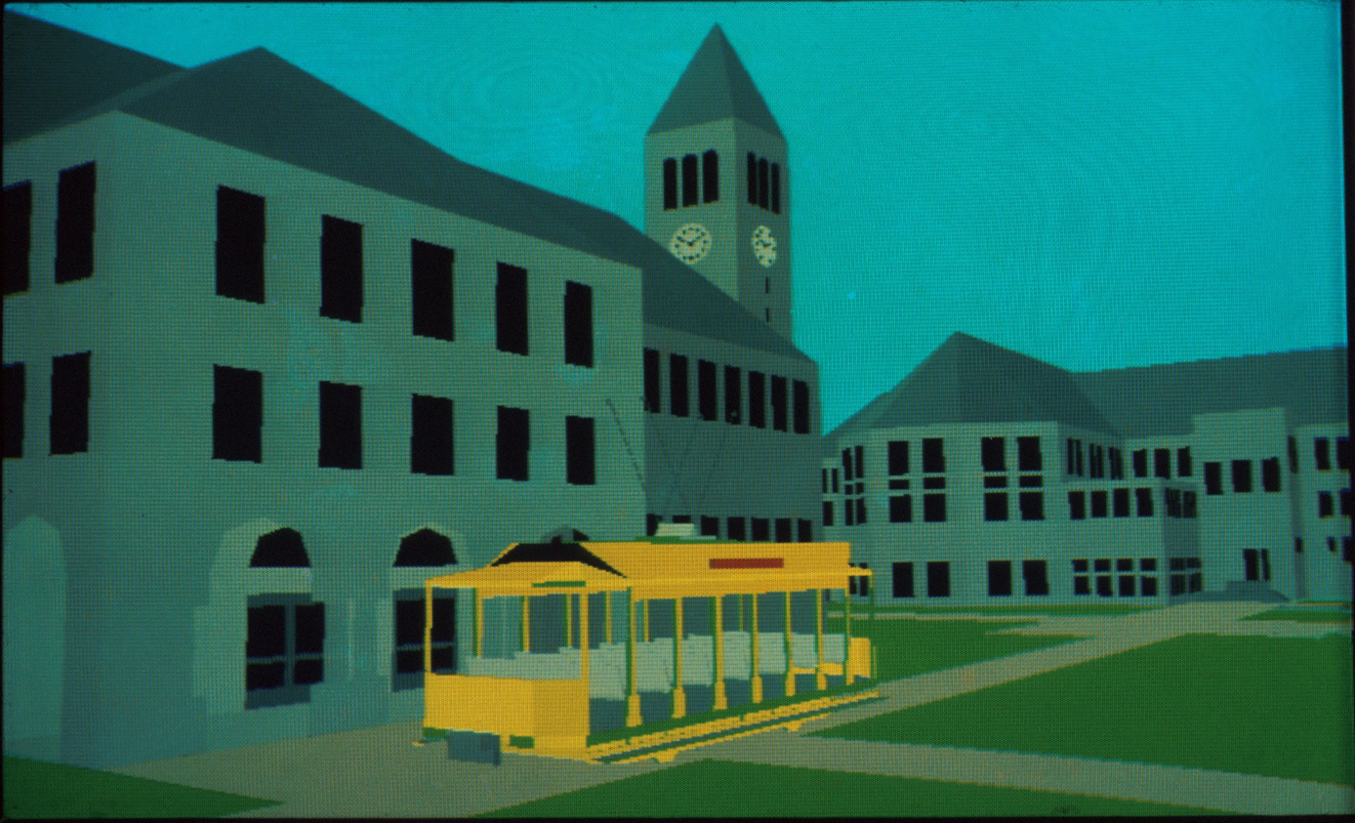
Cornell in Perspective Film 1972
Program of Computer Graphics, Cornell University

Slide 60
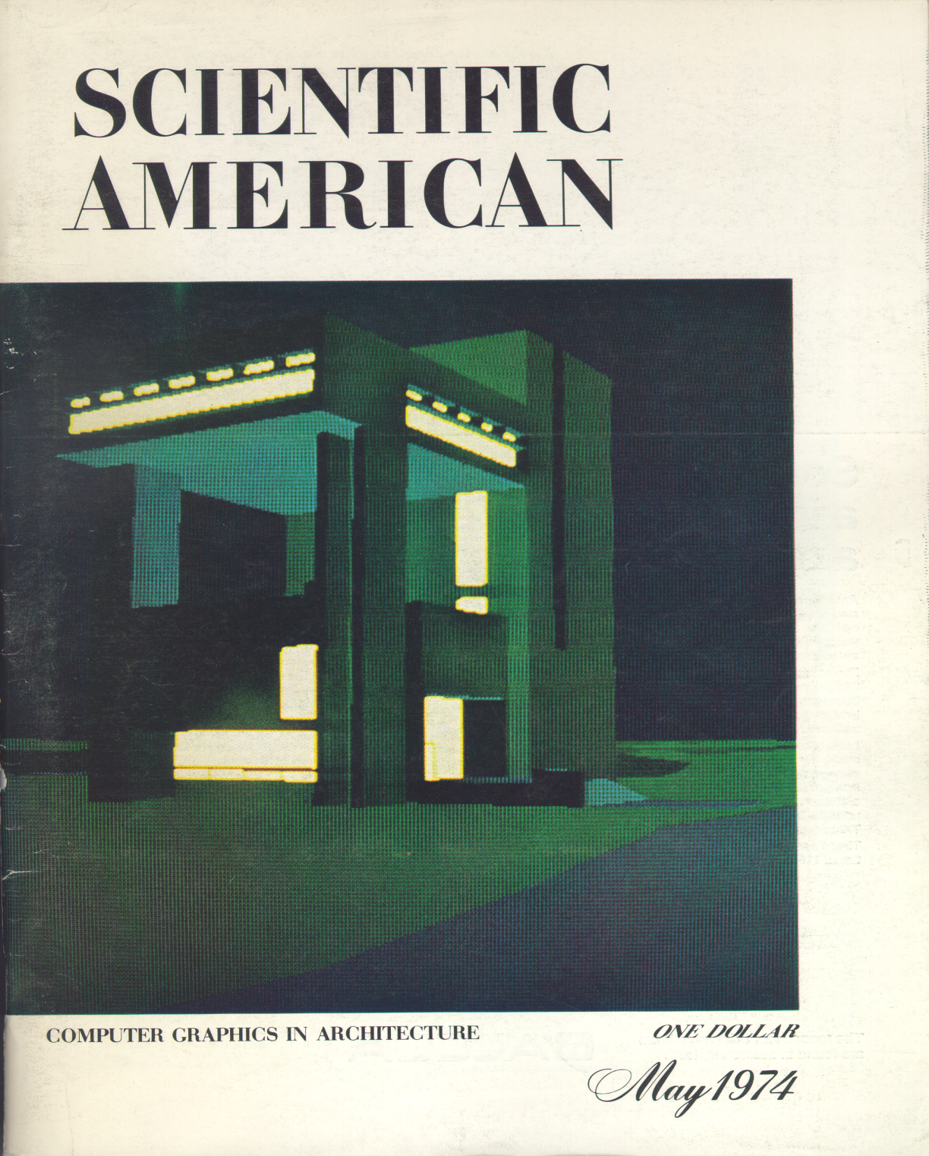

Slide 61

Gouraud Flat Polygon Shading 1972
Each polygon is shaded based on a single normal.
Gouraud Thesis

Slide 62

Gouraud Smooth Shading 1972
Each pixel is shaded by interpolating intensities computed in each of the polygon’s vertices.
Gouraud Thesis

Slide 63

Phong Shading 1974

Slide 64

Direct Illumination Pipeline

Slide 65

Model
Environment
  Geometry & topology
  Material Properties
    Color, reflectance, textures
    (Cost, strength, thermal properties)
Lighting
  Geometry & position
  Intensity, spectral distribution
  Direction, special distribution

Slide 66

Camera
Viewer position
Viewer direction
Field of View
  Wide angle
  Telephoto
Depth of focus
  Near
  Far

Slide 67

Perspective Transformation
Perspective Transformation
  Matrix multiplication (4 x 4)
Clipping objects outside the field of view
Culling back-facing surfaces

Slide 68


Slide 69

Brunelleschi’s Experiment

Slide 70

Hidden Line Algorithm

Slide 71

Hidden Line Algorithm

Slide 72

Seurat 1884-1886

Slide 73

Micrograph of TV Phosphors 1950’s

Slide 74

Raster Operations
Conversion from polygons to pixels
  Color computation
Hidden surface removal (z-buffer)

Slide 75

Image Storage
Typical frame buffer
  1280 x 1024 pixels
  3 channels (red, green, blue)
  1 byte/channel
Total memory
  3 3/4 megabytes - single buffer
  7 1/2 megabytes - double buffer

Slide 76

E & S Frame Buffer 1975

Slide 77

Display
Digital to analog conversion
  1280 x 1024 resolution
  60 frames/second
Total data rate
  1 ¼ million pixels
  x 3 bytes/pixel
  x 60 frames/second
  = 225 megabytes/second
  = 1.8 gigabits/second

Slide 78
Refresh vs. Update Rate
The “refresh rate” is the number of times per second the entire image is drawn
The “update rate” is the number of times per second the image is changed

Slide 79
Temporal Properties of NTSC
REFRESH
field 4
low refresh rate -> flicker
high refresh rate -> too much bandwidth
solution: interlacing
provides 60 Hz refresh rate with only 30 Hz update rate
field 3
field 2
field 1
frame 2
frame 1

Slide 80


Update Rate vs. Refresh Rate
Film: 24fps update rate, 3 blade shutter, 72Hz refresh rate
Video: 30fps update rate, 2:1 interlacing, 60 Hz refresh rate
interlacing: matches flicker limits of vision, minimizes bandwidth

Slide 81

Direct Illumination

Slide 82

Phong Model: Variations of Specular Exponent
Roy Hall

Slide 83
Reflection Descriptions
Images weren’t realistic
  Poor material representations
  Lack of global illumination
Need to measure how light reflects
Need to derive algorithms to compute global illumination

Slide 84

Light Measurement Laboratory
Notes:
Such a laboratory is not cheap, this one has about 1/2Meg of equipment, from corporate sponsors like HP and Kodak, and government grants
Purpose of the LML is to develop databases and provide reference measurements for the computer graphics community.
Next slide

Slide 85

Reflectance Three Approximate Components
Ideal diffuse (Lambertian)
Ideal
specular
Directional
diffuse

Slide 86

Cook-Torrance Renderings 1979

Slide 87

The Geometry of Scattering from a Layered Surface
acm Computer Graphics, Siggraph 1993 p. 166

Slide 88

Henrik Wann Jensen, Stephen R. Marschner, Marc Levoy, Pat Hanrahan. “A Practical Model for Subsurface Light Transport,” ACM Siggraph 2001, August 2001, Los Angeles, CA, pp. 511-518.

Slide 89

Schematic Model of the Image Process
acm Transactions on Graphics, Siggraph 2003 p. 773

Slide 90


Slide 91
Direct Lighting and Indirect Lighting
Direct
Direct
9
9
9
7
5
5
5
Indirect
9
9
9
7
5
5
5
9
9
9
7
5
5
5
9
9
9
7
5
5
5
9
7
14
9
7
5
5
9
7
14
9
7
5
5
9
3
1
7
9
7
7
9
3
1
7
9
7
7
7
3
1
7
9
9
9
7
3
1
7
9
9
9
6
3
1
7
9
9
9
6
3
1
7
9
9
9
6
6
6
9
9
9
9
6
6
6
9
9
9
9

Slide 92

Direct Lighting Only

Slide 93

Global Illumination

Slide 94
Global Illumination Algorithms
Ray Tracing
Radiosity

Slide 95


Slide 96

Ray Tracing Eric Haines 1985

Slide 97

Radiosity 1984

Slide 98

Radiosity Eric Chen 1986

Slide 99

Rendering Framework 1997

Slide 100

Surface Reflectance

Slide 101
Ray Tracing

Slide 102


Slide 103
Path Tracing
Path Tracing is similar to ray tracing except that many more rays are sent for each pixel.
Rays are sent out on a probabilistic basis depending on the reflectance (transmittance) distributions of each surface that is struck.
Computations can be accelerated by using “importance sampling”, where the ray directions are dependent on the magnitude of the potential effects.

Slide 104


Bi-directional Path Tracing
Photograph

Slide 105
Graphics Pipeline Hardware
“Moore's Law is for wimps.”

Slide 106
Why a Pipeline?
A pipeline allows multiple processes to occur in parallel.
Example: Automobile assembly line.
  Assume 4 stations, each taking 2 minutes to do its task. It takes 8 minutes to make a car, but the rate at which cars are made is one every 2 minutes.

Slide 107
Example: Automobile Pipeline
Automobile takes 8 minutes to make, but the assembly line makes a car every two minutes.
Build
frame
Add
engine
Add
windows
Paint
body
2 minutes 2 minutes 2 minutes 2 minutes

Slide 108
Example: Automobile Pipeline
Automobile takes 8 minutes to make, but the assembly line makes a car every two minutes.
Build
frame
Add
engine
Add
windows
Paint
body
2 minutes 2 minutes 2 minutes 2 minutes
Stage 1
A
B
C
D
E
Stage 2
A
B
C
D
Stage 3
A
B
C
Stage 4
A
B
0
2
4
6
8
10
Time (minutes)
® Donald P. Greenberg - Cornell Program of Computer Graphics

Slide 109


Slide 110

Graphics Hardware circa 1970
System used to generate Phong goblet

Slide 111

Graphics Hardware circa 1986
Added Z-Buffer
Added Double Frame Buffer
Rasterization and visible surface computations performed in hardware

Slide 112



Multipass Example: Light Maps
Two separate textures, one for the material’s composition, one for the lighting
X
=
J.L.Mitchell, M. Tatro, and I. Bullard

Slide 113

Castle’s Geometry
Agata & Andrzej Wojaczek, Advanced Graphics Applications Inc.

Slide 114

Reflection Example - Castle
Agata & Andrzej Wojaczek, Advanced Graphics Applications Inc.

Slide 115
Graphics Pipeline 1980s
M
L
P
S
D
V
M — Model
L — Lighting
P — Perspective/Clipping
S — Scan Conversion/Z-buffer
D — Display Storage
V — Video
® Donald P. Greenberg - Cornell Program of Computer Graphics

Slide 116

Graphics Hardware 2003
Early GPU’s performed lighting and clipping operations on locally stored model

Slide 117

Graphics Pipeline 2003 +
® Donald P. Greenberg - Cornell Program of Computer Graphics

Slide 118

Graphics Hardware 2009

Slide 119
Moore’s Law – GPU Transistor Counts
Processor | Transistor count | Date of introduction | Manufacturer | Process | Area
R520 | 321,000,000 | 2005 | AMD | 90 nm | 288 mm²
R580 | 384,000,000 | 2006 | AMD | 90 nm | 352 mm²
G80 | 681,000,000 | 2006 | NVIDIA | 90 nm | 480 mm²
R600 Pele | 700,000,000 | 2007 | AMD | 80 nm | 420 mm²
G92 | 754,000,000 | 2007 | NVIDIA | 65 nm | 324 mm²
RV790XT Spartan | 959,000,000 | 2008 | AMD | 55 nm | 282 mm²
GT200 Tesla | 1,400,000,000 | 2008 | NVIDIA | 65 nm | 576 mm²
Cypress RV870 | 2,154,000,000 | 2009 | AMD | 40 nm | 334 mm²
Cayman RV970 | 2,640,000,000 | 2010 | AMD | 40 nm | 389 mm²
GF100 Fermi | 3,200,000,000 | Mar 2010 | NVIDIA | 40 nm | 526 mm²
GF110 Fermi | 3,000,000,000 | Nov 2010 | NVIDIA | 40 nm | 520 mm²
GK104 Kepler | 3,540,000,000 | 2012 | NVIDIA | 28 nm | 294 mm²
Tahiti RV1070 | 4,312,711,873 | 2011 | AMD | 28 nm | 365 mm²
GK110 Kepler | 7,080,000,000 | 2012 | NVIDIA | 28 nm | 561 mm²
RV1090 Hawaii | 6,300,000,000 | 2013 | AMD | 28 nm | 438 mm²
GM204 Maxwell | 5,200,000,000 | 2014 | NVIDIA | 28 nm | 398 mm²
GM200 Maxwell | 8,100,000,000 | 2015 | NVIDIA | 28 nm | 601 mm²
Fiji | 8,900,000,000 | 2015 | AMD | 28 nm | 596 mm²
GP102 Pascal | 12,000,000,000 | 2016 | Nvidia | 12 nm | 471 mm²
Vega 10 | 12,500,000,000 | 2017 | AMD | 14 nm | 484 mm²
GP100 Pascal | 15,300,000,000 | 2016 | Nvidia | 16 nm | 610 mm²
GV100 Volta | 21,100,000,000 | 2017 | Nvidia | 12 nm | 815 mm²
http://en.wikipedia.org/wiki/Transistor_count

Slide 120
Instructions Per Clock-cycle per second (IPS) (Microprocessor CPU’S)

Slide 121

Instructions Per Clock-cycle per second (IPS) (Microprocessor CPU’S)
Microprocessor GPU’S
Processor / System | MIPS and Frequency | (IPS / clock cycles per second) | (IPS / clock cycles per second / cores) | Year*
*Nvidia Ge-Force RTX-2080T.I | 76,000,000 MIPs at 1.5 GHz | 50,666.7 | 11.6 | 2019
*Nvidia Quadro RTX-2080T.I | 78,000,000 MIPS at 1.6 GHz | 48750.0 | 11.2 | 2019
*Nvidia DGX | 500,000,000 MFLOPs at 1.46 GHz | 357142.9 | 17.4 | 2017

Slide 122
Integrated Graphics
All mobile microprocessor manufacturers (Intel, AMD, Qualcomm, etc.) have recently been integrating graphics hardware on to their chips.
Will this be a disruptive technology to Nvidia?

Slide 123

Intel – Integrated Graphics 2013

Slide 124
AMD – Integrated Graphics 2013

Slide 125

AMD – Integrated Graphics 2014
“Kaveri”
28 nm
47% GPU
47%
GPU

Slide 126

Intel’s Ice Lake 2019

Slide 127
End. . .

