Slide 1
Required Reading ( From Lecture 1)
Michael E. Porter. How Competitive Forces Shape Strategy, Harvard Business Review, March-April 1979, pp. 137-145.(Search http://erms.library.cornell.edu/
Joseph L. Bower and Clayton M. Christensen. Disruptive Technologies: Catching the Wave, Harvard Business Review, January-February 1995, pp. 43-53. (Search http://erms.library.cornell.edu/)
Peter J. Denning and Ted G. Lewis. “Exponential Laws of Computing Growth.” Communications of the ACM. January 2017. ACM.org.

Slide 2
Microprocessor Technology
&
Case Studies
NBAY 6120
March 03, 2020
Donald P. Greenberg
Lecture 2

Slide 3
Semi-Conductor Technology and Economics
Required Reading:
Craig R. Barrett. From Sand to Silicon: Manufacturing an Integrated Circuit, Scientific American, Special Issue, The Solid-State Century, January 1998, pp. 55-61. (Search: e-Journals/ Scientific American Archive Online/article (full text) http://www.library.cornell.edu/johnson/library/general/emba.html
G. Dan Hutcheson and Jerry D. Hutcheson. Technology & Economics in the Semiconductor Industry, Scientific American, January 1996.

Slide 4
Semi-Conductor Technology and Economics
Optional Reading:
Mack, Chris. "The Multiple Lives of Moore's Law." IEEE Spectrum Apr. 2015: 30-37. Cornell University Library. Web. http://ieeexplore.ieee.org/stamp/stamp.jsp?tp=&arnumber=7065415
Notes:
G. Dan Hutcheson and Jerry D. Hutcheson. “Technology & Economics in the Semiconductor Industry, “ Scientific American: The Solid State Century, pp. 66-73, January 1996.

Slide 5
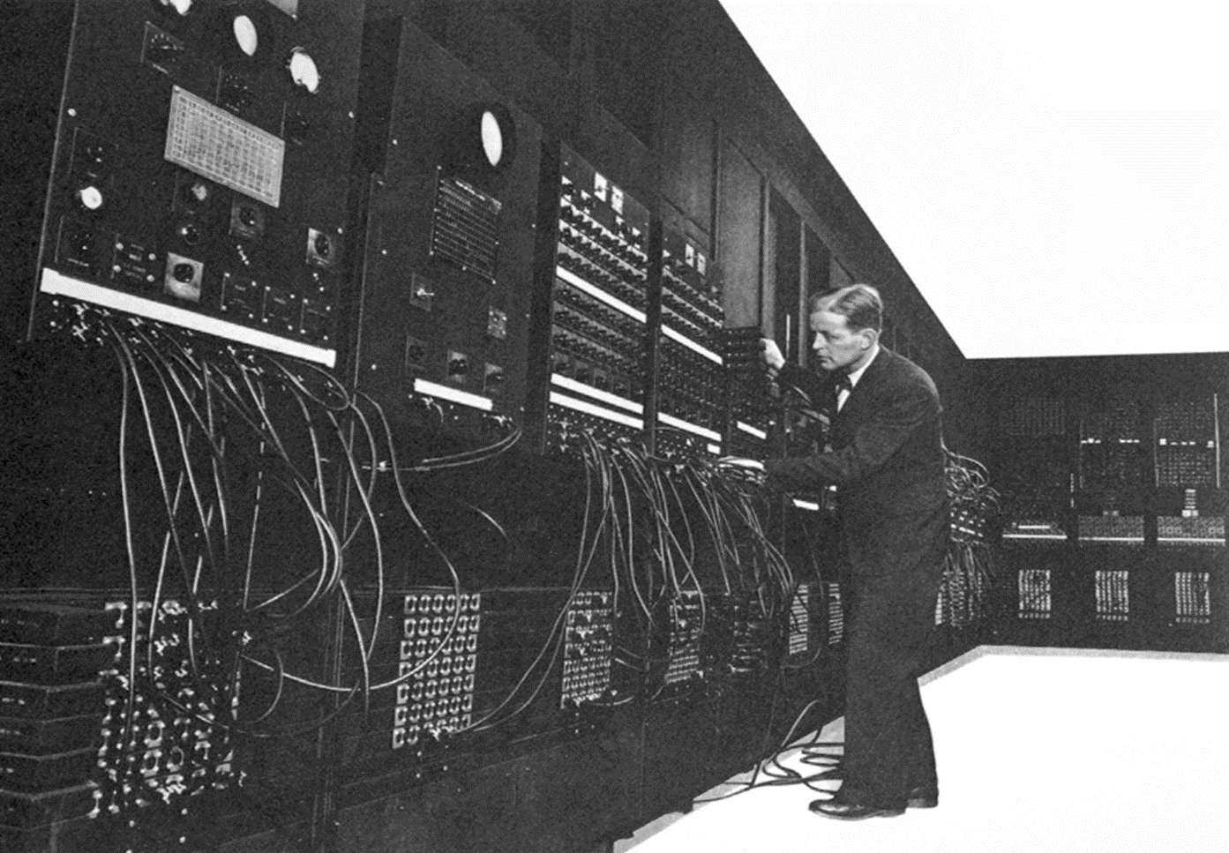
Eniac 1946

Slide 6
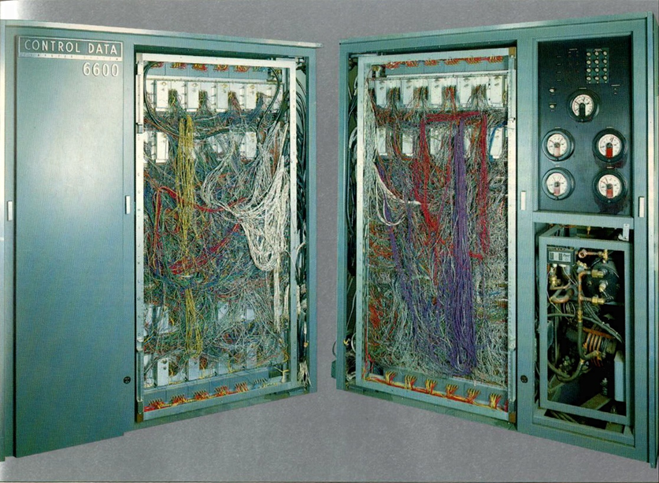
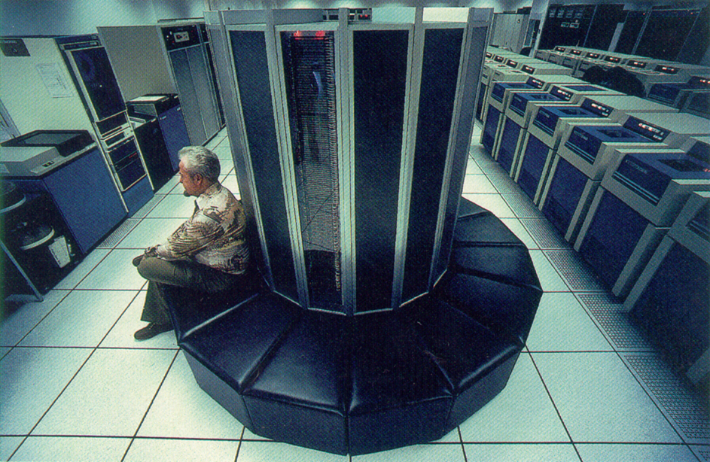
Super Computers
Control Data 1964
Cray 1990

Slide 7

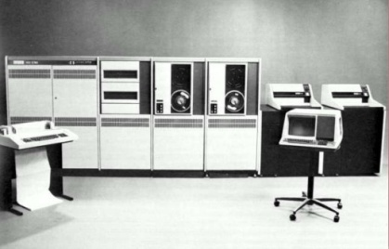
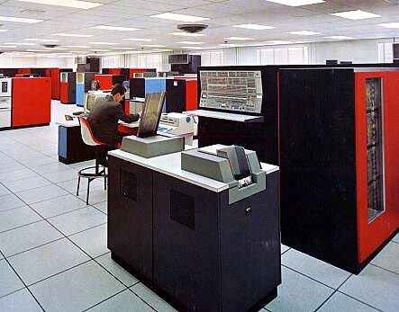
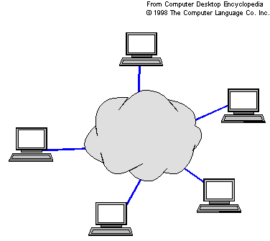
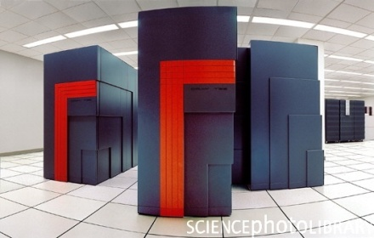
VAX-11/780 (1980)
IBM 360 Model 75 (1965)
Cloud Computing (2010)
The line shows “Moore’s Law”: Transistor count doubles every two years.
Cray T3E (1995)
http://en.wikipedia.org

Slide 8
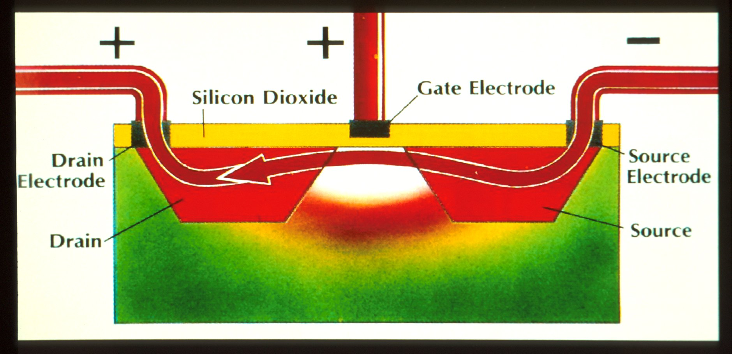
Transistor

Slide 9
Shockley & the Traitorous Eight
William Shockley - Receives the Nobel Prize in Physics with Bardeen and Brattain (1956) leaves Bell Laboratory and forms Fairchild Semiconductor
Julius Blank - founded Xicor
Jean Hoerni - invented the planar process founded Amelco → Teledyne
Jay Last - founded Amelco → Teledyne
Sheldon Roberts - founded Amelco → Teledyne

Slide 10
Shockley & the Traitorous Eight
Gordon Moore - founded Intel in 1968
Robert Noyce - founded Intel in 1968
Eugene Kleiner - founded Kleiner-Perkins
Victor Grinich - only a poor professor at UC Berkeley & Stanford

Slide 11
From Sand to Silicon – Manufacturing an Integrated Circuit
Scientific American: The Solid-State Century, Special Issue 1998

Slide 12
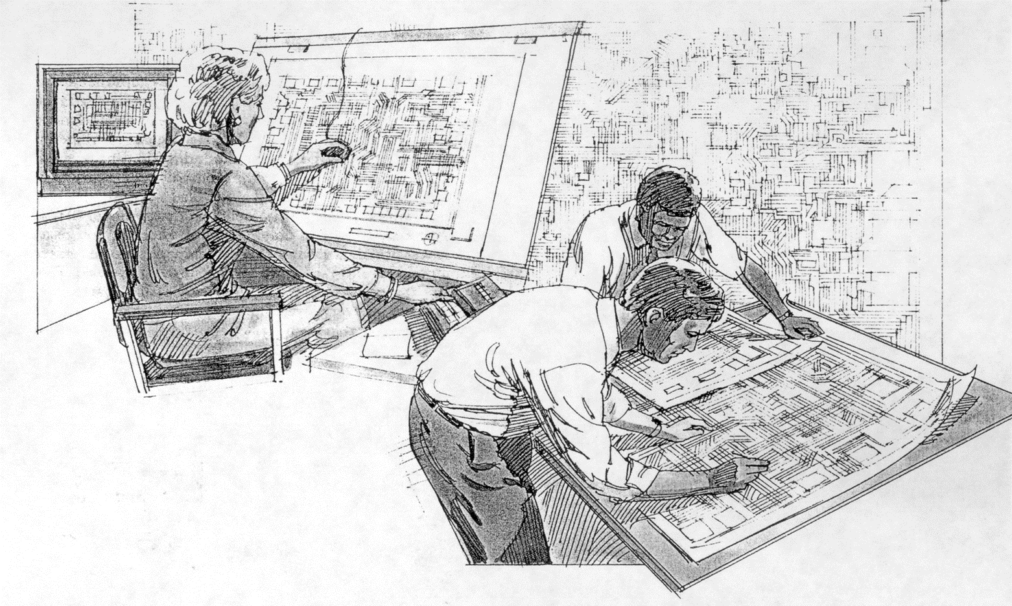
Chip Design

Slide 13
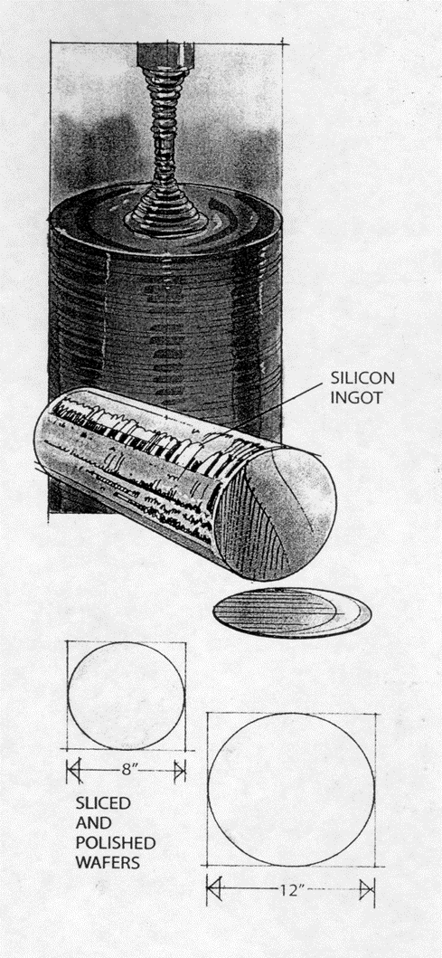
Silicon Crystal

Slide 14
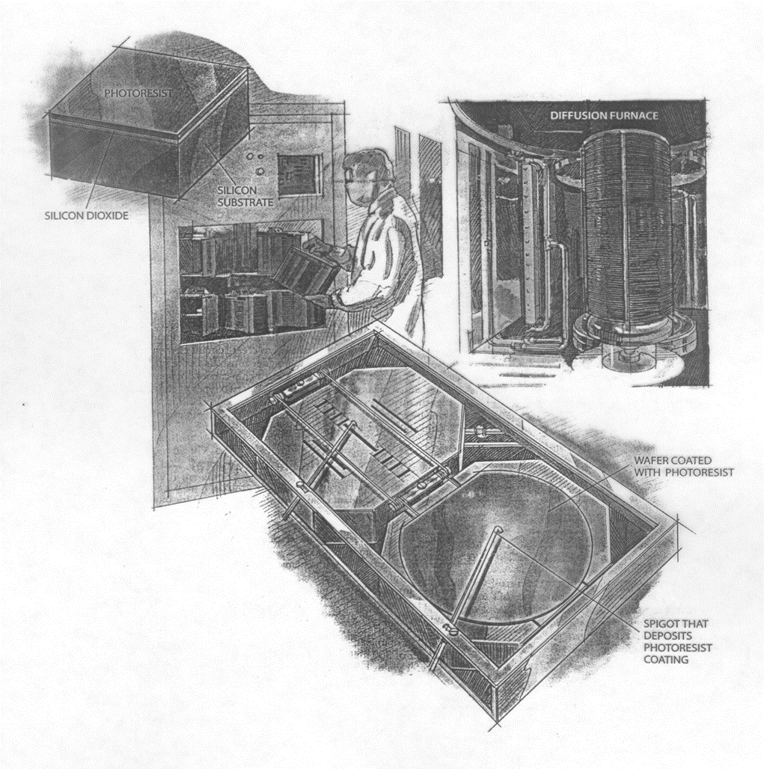
Layering

Slide 15
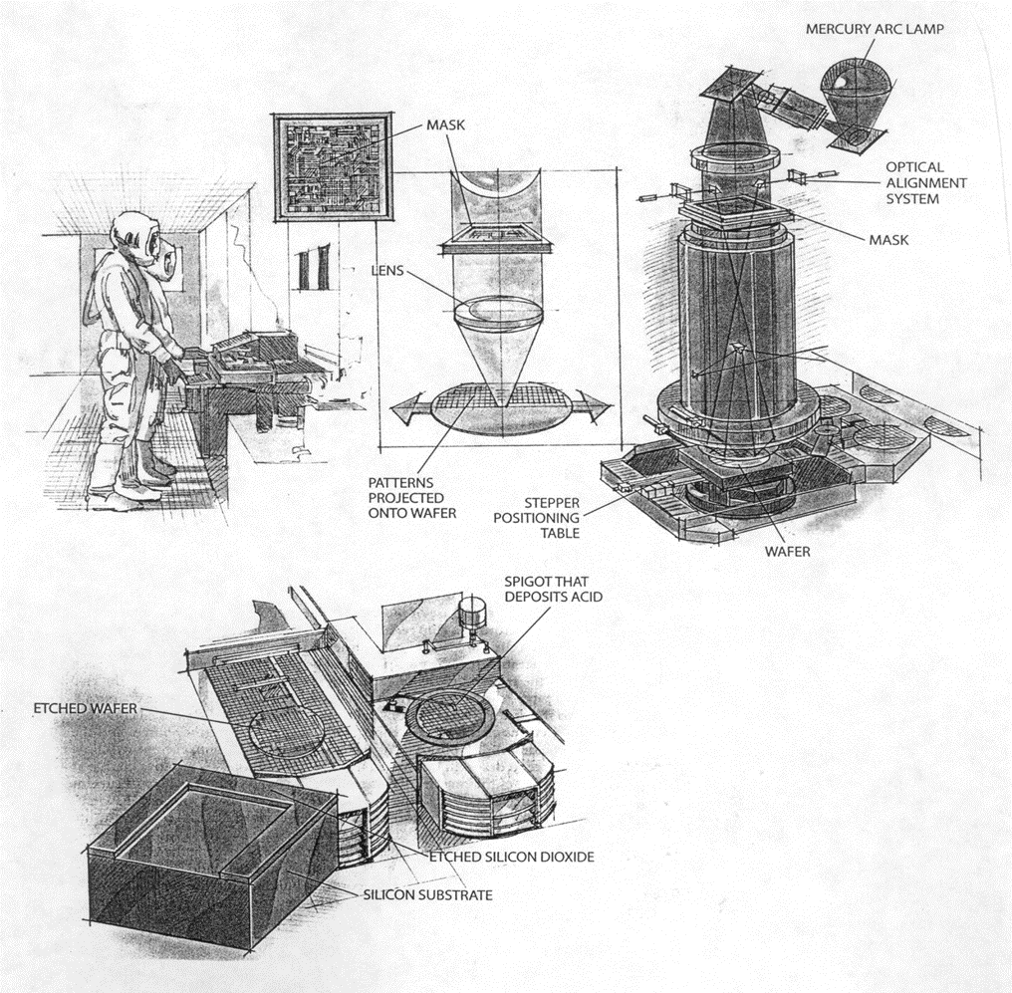
Masking & Etching

Slide 16
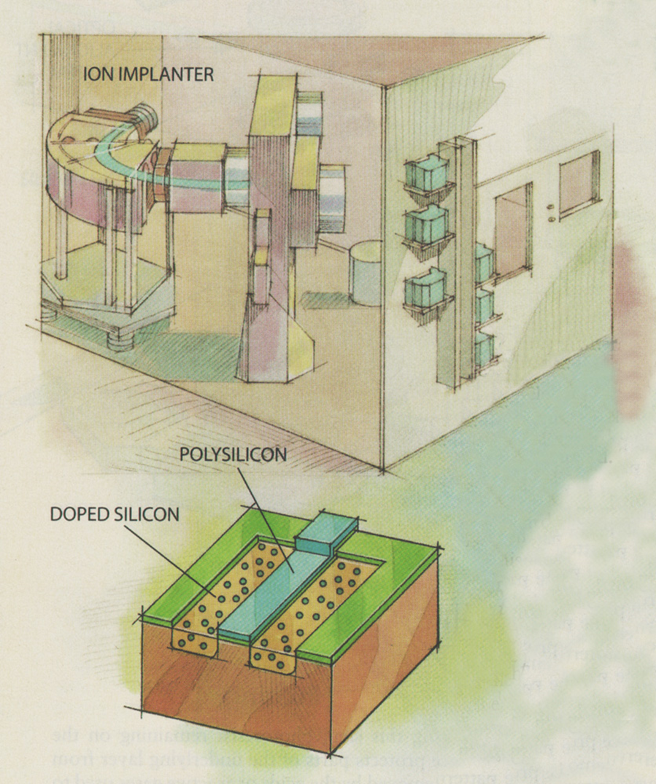
Doping

Slide 17
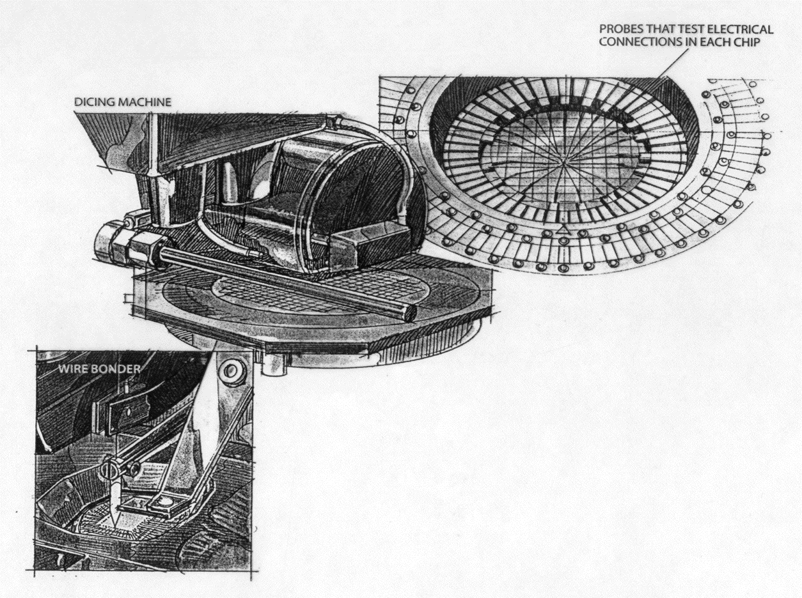
Interconnections & Dicing

Slide 18
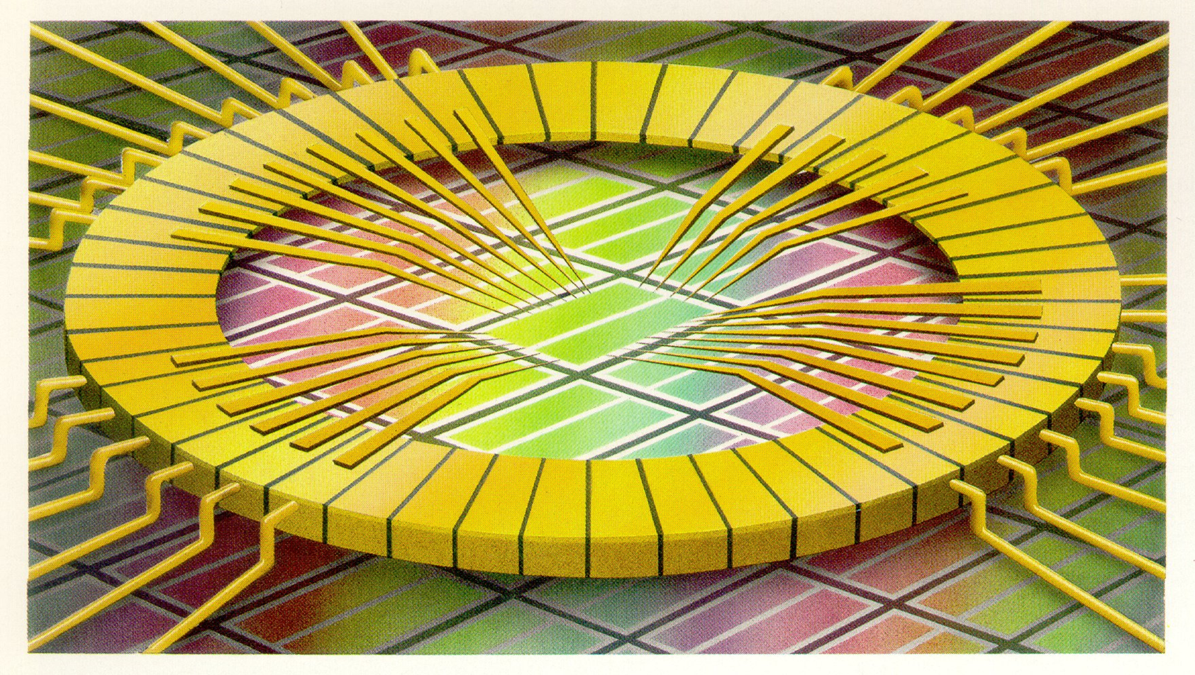
Probing Electrical Connections

Slide 19
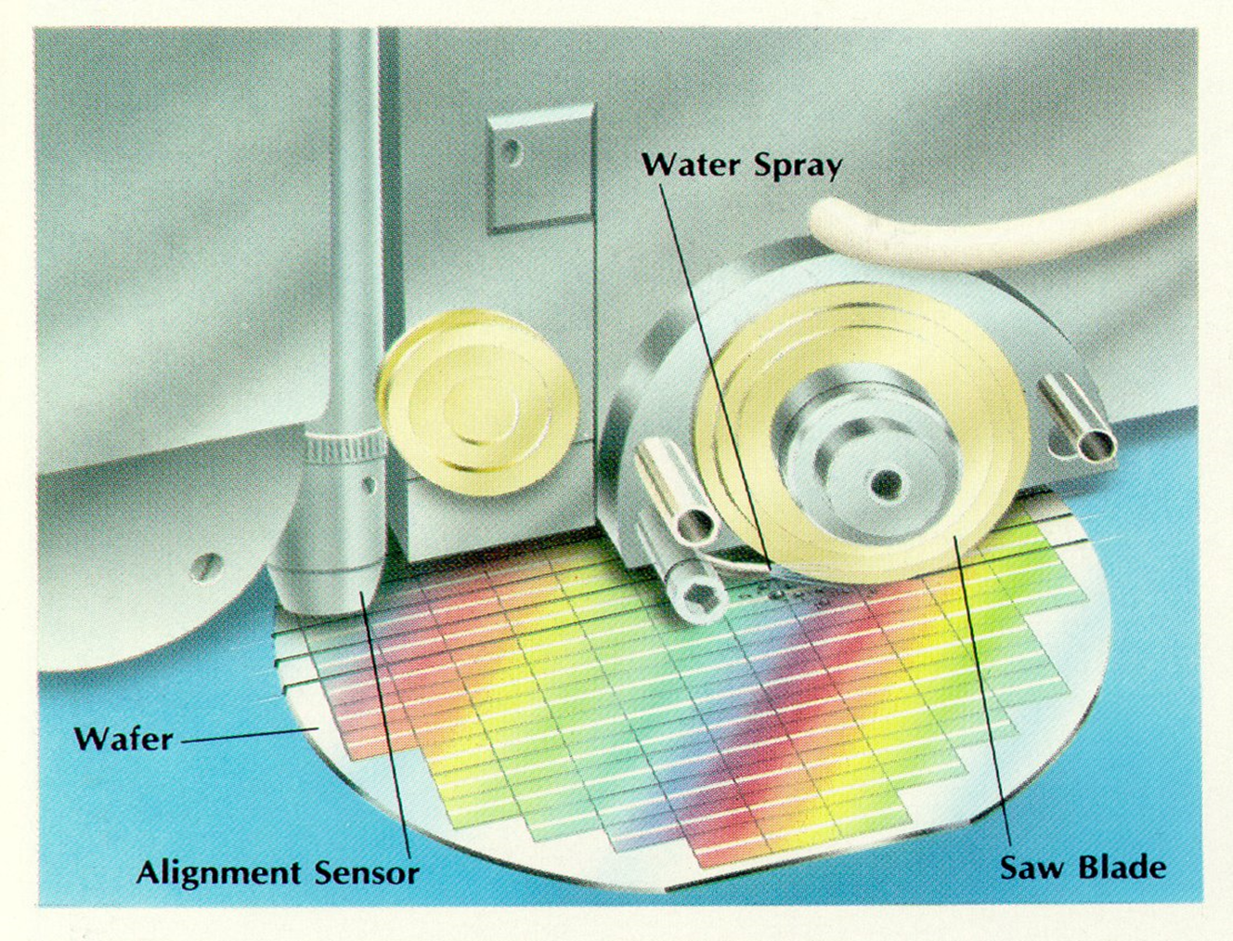
Dicing

Slide 20
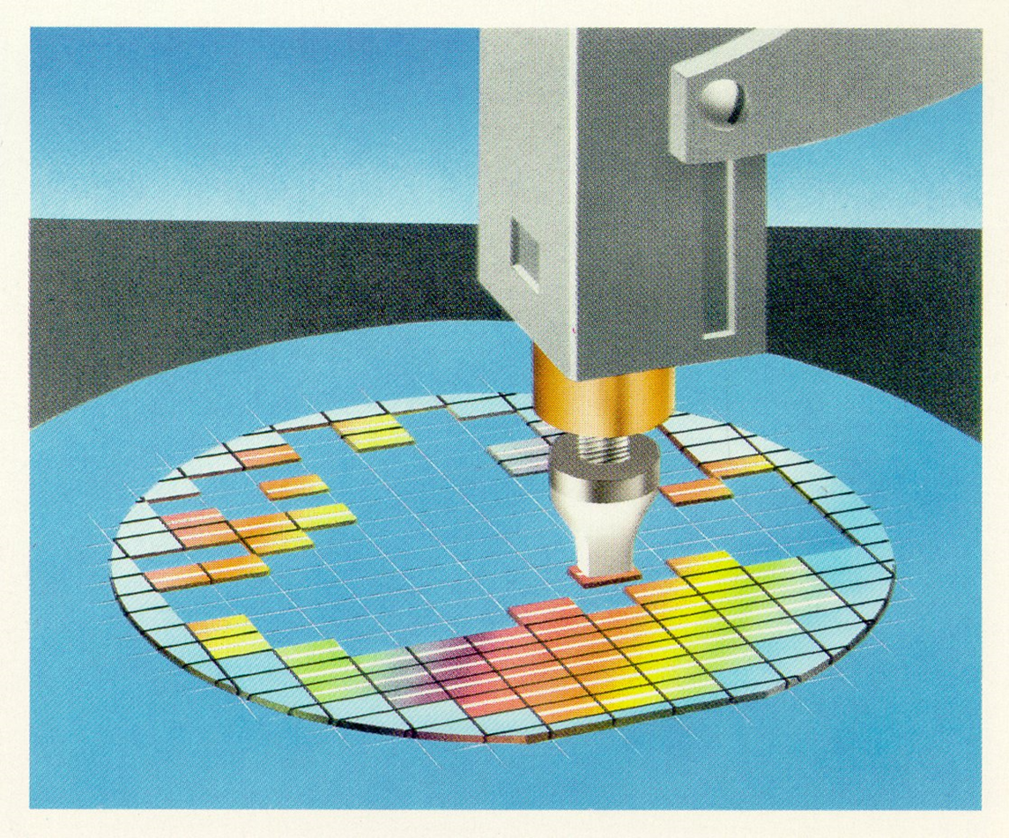
Chip Selection

Slide 21
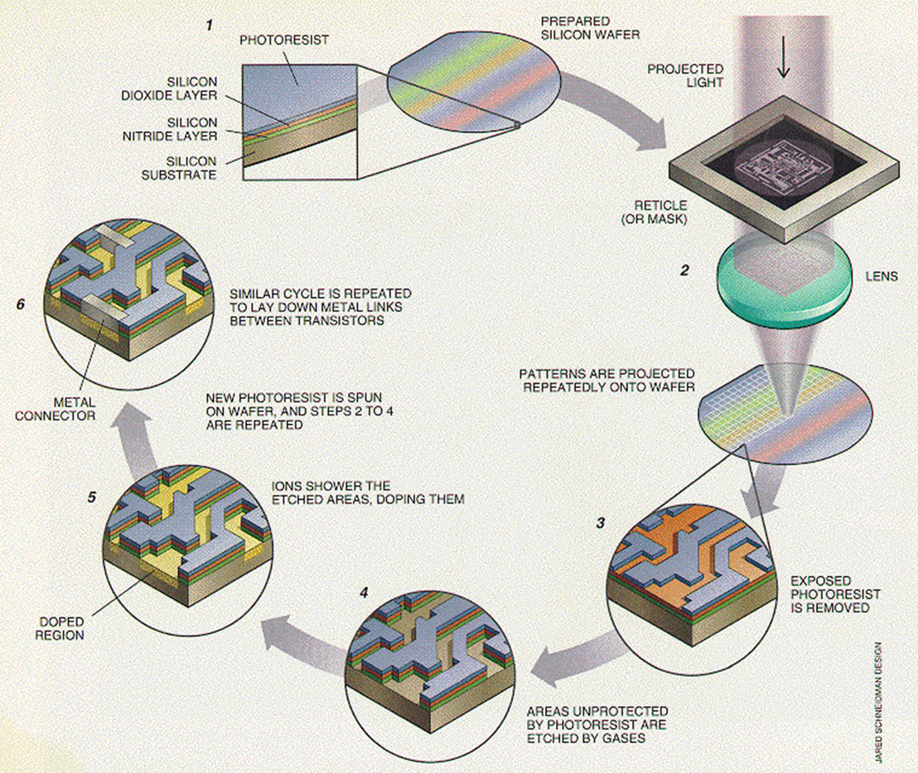
Chip Fabrication

Slide 22
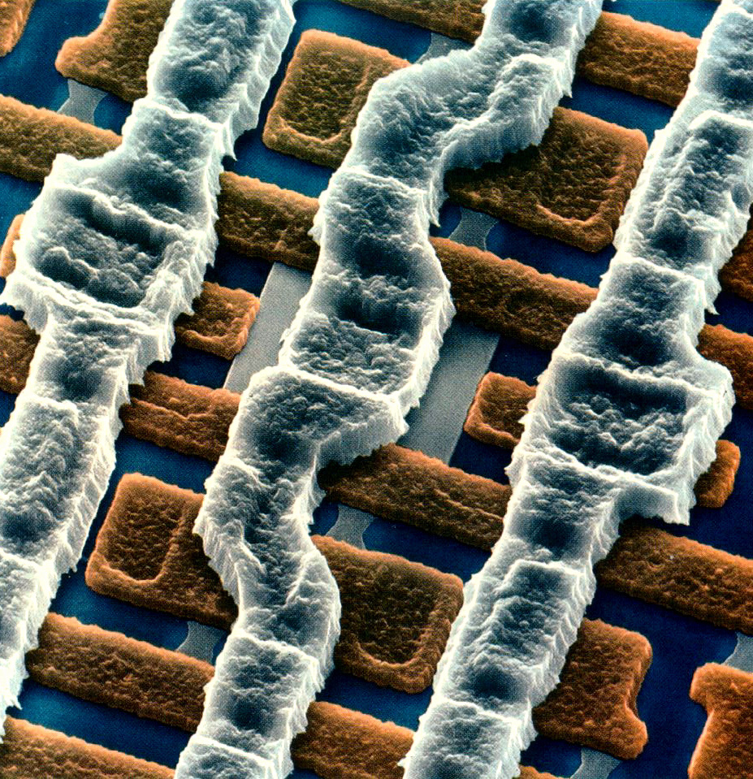

Slide 23
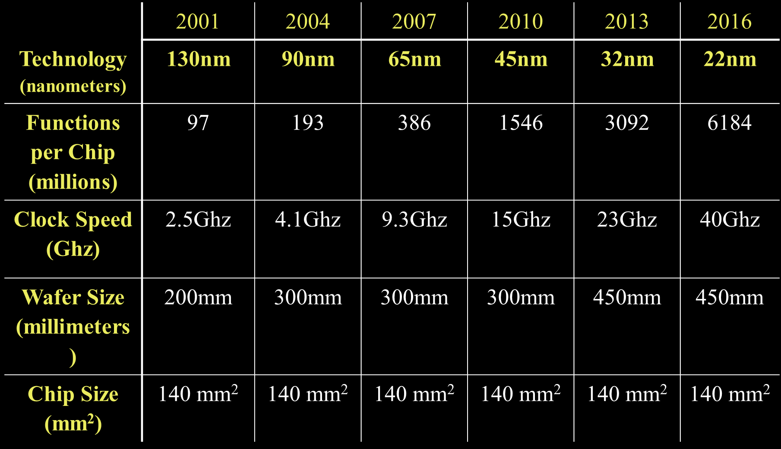
International Technology Roadmap for Semiconductors
Roughly 0.5 shrink every 3 years.
Intel released 22 nm chips in 2013

Slide 24
Moore’s Law – CPU Transistor Counts
Processor | Transistor count | Date of introduction | Manufacturer | Process | Area
Intel 4004 | 2,300 | 1971 | Intel | 10 µm
Intel 8008 | 3,500 | 1972 | Intel | 10 µm
Intel 8080 | 4,500 | 1974 | Intel | 6 μm
Intel 8088 | 29,000 | 1979 | Intel | 3 μm
Intel 80286 | 134,000 | 1982 | Intel | 1.5 µm
Intel 80386 | 275,000 | 1985 | Intel | 1.5 µm
Intel 80486 | 1,180,000 | 1989 | Intel | 1 µm
Pentium | 3,100,000 | 1993 | Intel | 0.8 µm
AMD K5 | 4,300,000 | 1996 | AMD | 0.5 µm
Pentium II | 7,500,000 | 1997 | Intel | 0.35 µm
AMD K6 | 8,800,000 | 1997 | AMD | 0.35 µm
Pentium III | 9,500,000 | 1999 | Intel | 0.25 µm
AMD K6-III | 21,300,000 | 1999 | AMD | 0.25 µm
AMD K7 | 22,000,000 | 1999 | AMD | 0.25 µm
Pentium 4 | 42,000,000 | 2000 | Intel | 180 nm
Atom | 47,000,000 | 2008 | Intel | 45 nm
Barton | 54,300,000 | 2003 | AMD | 130 nm
AMD K8 | 105,900,000 | 2003 | AMD | 130 nm
Itanium 2 | 220,000,000 | 2003 | Intel | 130 nm
http://en.wikipedia.org/wiki/Transistor_count

Slide 25
Moore’s Law – CPU Transistor Counts
Processor | Transistor count | Date of introduction | Manufacturer | Process | Area
Core 2 Duo | 291,000,000 | 2006 | Intel | 65 nm
AMD K10 | 463,000,000 | 2007 | AMD | 65 nm
AMD K10 | 758,000,000 | 2008 | AMD | 45 nm
Itanium 2 with 9MB cache | 592,000,000 | 2004 | Intel | 130 nm
Core i7 (Quad) | 731,000,000 | 2008 | Intel | 45 nm | 263 mm²
POWER6 | 789,000,000 | 2007 | IBM | 65 nm | 341 mm²
Six-Core Opteron 2400 | 904,000,000 | 2009 | AMD | 45 nm
Six-Core Core i7 | 1,170,000,000 | 2010 | Intel | 32 nm
Dual-Core Itanium 2 | 1,700,000,000 | 2006 | Intel | 90 nm | 596 mm²
Six-Core Xeon 7400 | 1,900,000,000 | 2008 | Intel | 45 nm
Quad-Core Itanium Tukwila | 2,000,000,000 | 2010 | Intel | 65 nm
Six-Core Core i7 (Sandy Bridge-E) | 2,270,000,000 | 2011 | Intel | 32 nm | 434 mm²
8-Core Xeon Nehalem-EX | 2,300,000,000 | 2010 | Intel | 45 nm | 684 mm²
10-Core Xeon Westmere-EX | 2,600,000,000 | 2011 | Intel | 32 nm | 512 mm²
Six-core zEC12 | 2,750,000,000 | 2012 | IBM | 32 nm | 597 mm²
8-Core Itanium Poulson | 3,100,000,000 | 2012 | Intel | 32 nm | 544 mm²
15-Core Xeon Ivy Bridge-EX | 4,310,000,000 | 2014 | Intel | 22nm | 541 mm²
62-Core Xeon Phi | 5,000,000,000 | 2012 | Intel | 22 nm | 350 mm²
Xbox One Main SoC | 5,000,000,000 | 2013 | Microsoft | 28 nm | 363 mm²
18-core Xeon Haswell-E5 | 5,560,000,000 | 2014 | Intel | 22 nm | 661mm²
IBM z13 Storage Controller | 7,100,000,000 | 2015 | IBM | 22 nm | 678 mm²
http://en.wikipedia.org/wiki/Transistor_count

Slide 26
Why are we continuing to strive for smaller and smaller technology?
More transistors/chip → increased functionality and performance
Higher speeds → partially depends on how close together the components are placed
Cheaper – more chips/wafer, greater yields

Slide 27
Yield Ratio

Slide 28
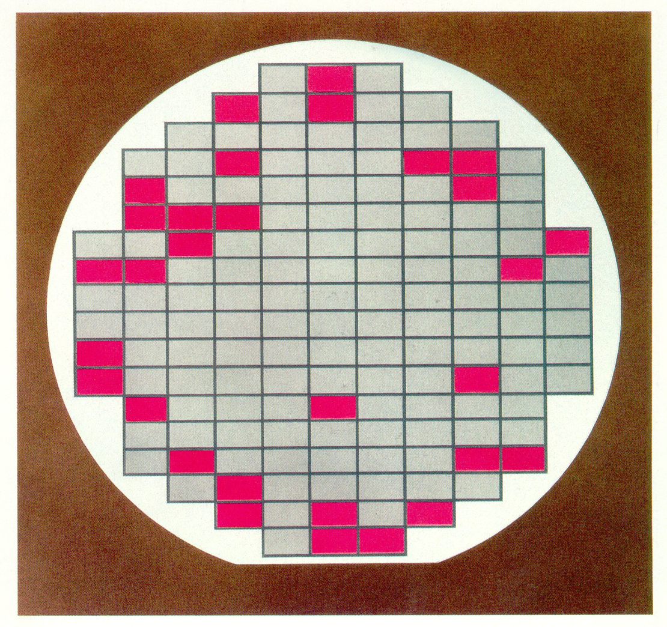
Yield per Wafer

Slide 29
Yield Ratio
Number of defects/unit area depends on the process
Total chips (n_{t}) for a given wafer size is also inversely proportional to the chip area

Slide 30
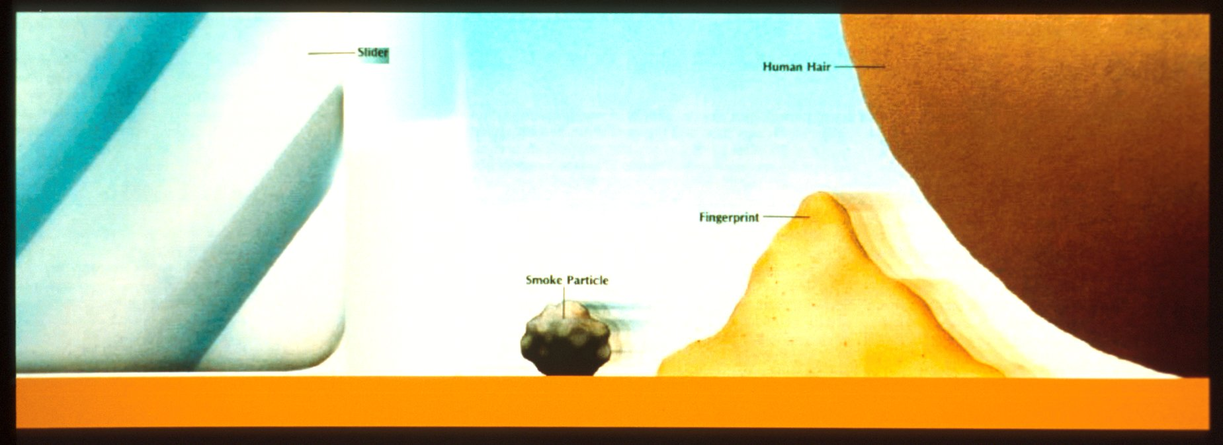
Size of Relative Contamination
Slider
Human Hair
Fingerprint
Smoke Particle
..

Slide 31
Example:

Slide 32
Can this Shrinking Technology Continue?

Slide 33
Factors Contributing to Advancing Microprocessor Performance
Shrinking Component Size
Increasing Speed
Reducing Circuit Resistance
New Materials

Slide 34
Factors Contributing to Advancing Microprocessor Performance
RISC vs. CISC
VLIW
Multi-level Cache
Parallelism & Pipelining

Slide 35
Factors Contributing to Advancing Microprocessor Performance
RISC vs. CISC
VLIW
Multi-level Cache
Parallelism & Pipelining
Multi-core Technology

Slide 36
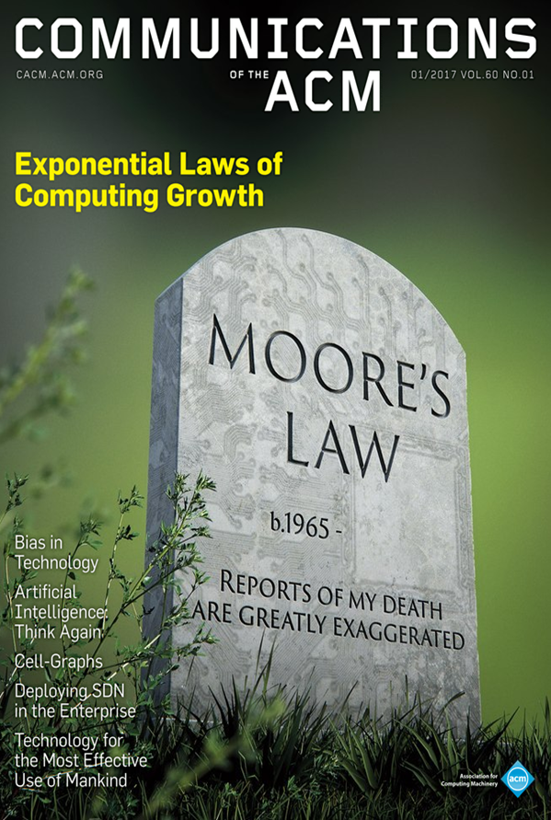
Exponential Laws of Computing Growth
Dennings and Lewis, Jan. 2016

Slide 37
International Technology Roadmap for Semiconductors
 | 2001 | 2004 | 2007 | 2010 | 2013 | 2016
Technology (nanometers) | 130nm | 90nm | 65nm | 45nm | 32nm | 22nm
Functions per Chip (millions) | 97 | 193 | 386 | 1546 | 3092 | 6184
Clock Speed (Ghz) | 2.5Ghz | 4.1Ghz | 9.3Ghz | 15Ghz | 23Ghz | 40Ghz
Wafer Size (millimeters) | 200mm | 300mm | 300mm | 300mm | 450mm | 450mm
Chip Size (mm²) | 140 mm² | 14 0 mm² | 140 mm² | 140 mm² | 140 mm² | 140 mm²
Roughly 0.5 shrink every 3 years 29% cost/reduction/function/yr.

Slide 38
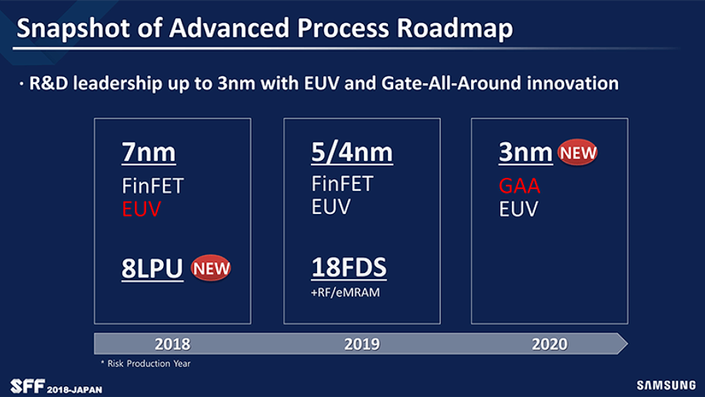
Advanced Process Roadmap

Slide 39
Moore’s Law – CPU Transistor Counts
Processor | Transistor count | Date of introduction | Manufacturer | Process | Area
Core 2 Duo | 291,000,000 | 2006 | Intel | 65 nm
AMD K10 | 463,000,000 | 2007 | AMD | 65 nm
AMD K10 | 758,000,000 | 2008 | AMD | 45 nm
Itanium 2 with 9MB cache | 592,000,000 | 2004 | Intel | 130 nm
Core i7 (Quad) | 731,000,000 | 2008 | Intel | 45 nm | 263 mm²
POWER6 | 789,000,000 | 2007 | IBM | 65 nm | 341 mm²
Six-Core Opteron 2400 | 904,000,000 | 2009 | AMD | 45 nm
Six-Core Core i7 | 1,170,000,000 | 2010 | Intel | 32 nm
Dual-Core Itanium 2 | 1,700,000,000 | 2006 | Intel | 90 nm | 596 mm²
Six-Core Xeon 7400 | 1,900,000,000 | 2008 | Intel | 45 nm
Quad-Core Itanium Tukwila | 2,000,000,000 | 2010 | Intel | 65 nm
Six-Core Core i7 (Sandy Bridge-E) | 2,270,000,000 | 2011 | Intel | 32 nm | 434 mm²
8-Core Xeon Nehalem-EX | 2,300,000,000 | 2010 | Intel | 45 nm | 684 mm²
10-Core Xeon Westmere-EX | 2,600,000,000 | 2011 | Intel | 32 nm | 512 mm²
Six-core zEC12 | 2,750,000,000 | 2012 | IBM | 32 nm | 597 mm²
8-Core Itanium Poulson | 3,100,000,000 | 2012 | Intel | 32 nm | 544 mm²
15-Core Xeon Ivy Bridge-EX | 4,310,000,000 | 2014 | Intel | 22nm | 541 mm²
62-Core Xeon Phi | 5,000,000,000 | 2012 | Intel | 22 nm | 350 mm²
Xbox One Main SoC | 5,000,000,000 | 2013 | Microsoft | 28 nm | 363 mm²
18-core Xeon Haswell-E5 | 5,560,000,000 | 2014 | Intel | 22 nm | 661mm²
IBM z14 Storage Controller | 9,700,000,000 | 2017 | IBM | 14 nm | 696mm²
32-core SPARC M7 | 10,000,000,000 | 2015 | Oracle | 20 nm
Centriq 2400 | 18,000,000,000 | 2017 | Qualcomm | 10 nm | 398 mm²
32-core AMD Epyc | 19,200,000,000 | 2017 | AMD | 14 nm | 4× 192 mm2
http://en.wikipedia.org/wiki/Transistor_count

Slide 40
International Technology Roadmap for Semiconductors
 | 2001 | 2004 | 2007 | 2010 | 2013 | 2016
Technology (nanometers) | 130nm | 90nm | 65nm | 45nm | 32nm | 22nm
Technology (nanometers) | 2014 | 2016 | 2018 | 2019 | 2021 | 2024
 | 14nm | 10nm | 7nm | 5nm | 3nm | 2nm

Slide 42
Semi-Conductor Technology and Economics
Required Reading:
G. Dan Hutcheson and Jerry D. Hutcheson. Technology & Economics in the Semiconductor Industry, Scientific American, January 1996.

Slide 43
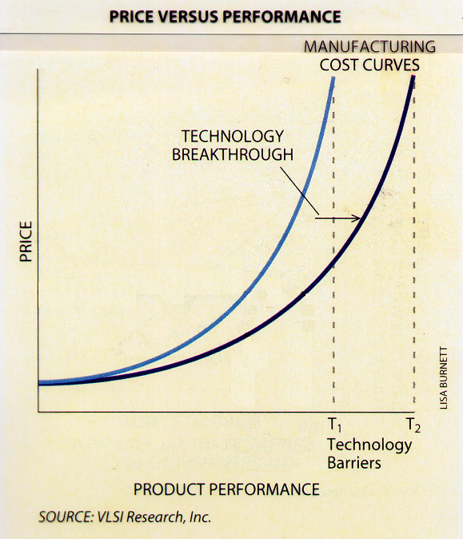

Slide 44
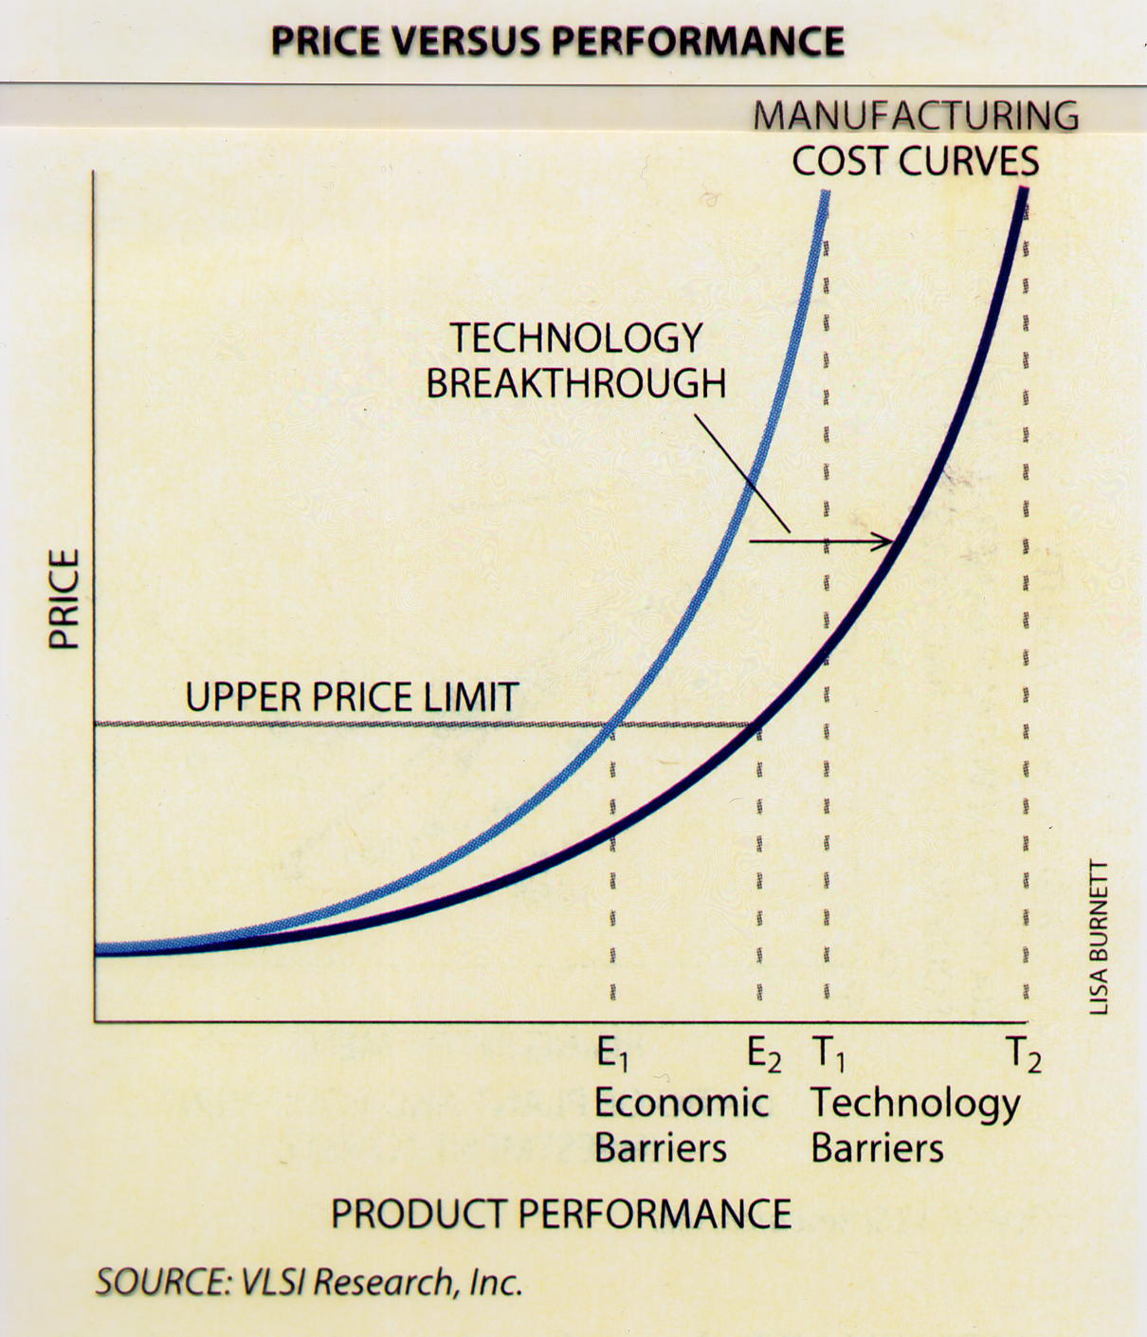
A
B
C
Notes:
G. Dan Hutcheson and Jerry D. Hutcheson. “Technology & Economics in the Semiconductor Industry, “ Scientific American: The Solid State Century, pp. 66-73, January 1996.

Slide 45
Return on Investment (ROI)
Assumptions:
Payback period (time)
Net Present Value
Value of future benefits in today’s money
Internal Rate of Return
Notes:
G. Dan Hutcheson and Jerry D. Hutcheson. “Technology & Economics in the Semiconductor Industry, “ Scientific American: The Solid State Century, pp. 66-73, January 1996.

Slide 46
How do you predict what the technology, manufacturing cost, market demand, market supply, and competition will be five years in the future?

Slide 47
Return on Investment (ROI) Model does not work well
Difficulties:
How long does the product last?
What is the price (revenue)/unit?
Exponential change
Non-linear pricing behavior
Competition (monopoly pricing)
Prediction of demand
Technical obstacles
Notes:
G. Dan Hutcheson and Jerry D. Hutcheson. “Technology & Economics in the Semiconductor Industry, “ Scientific American: The Solid State Century, pp. 66-73, January 1996.

Slide 48
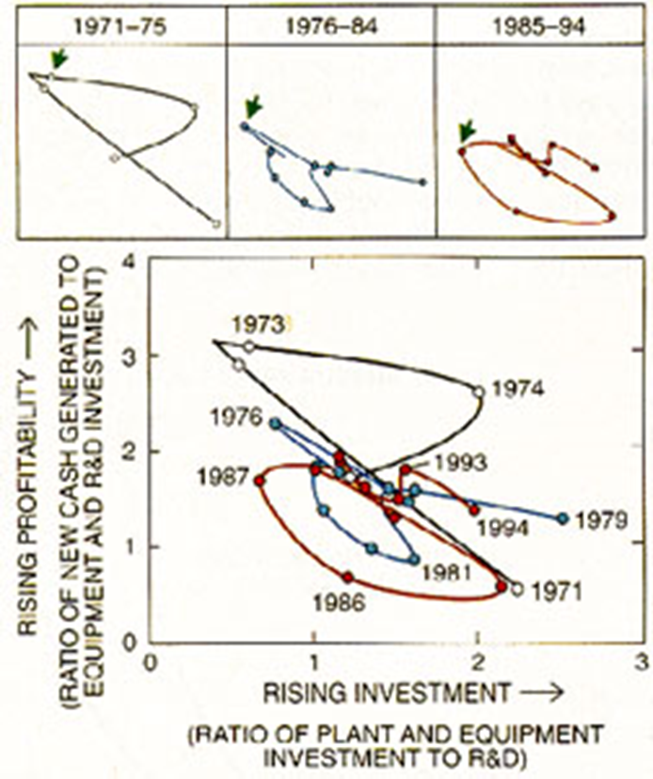
Profitability vs. Investment in the Computer Industry
Notes:
G. Dan Hutcheson and Jerry D. Hutcheson. “Technology & Economics in the Semiconductor Industry, “ Scientific American: The Solid State Century, pp. 66-73, January 1996.

Slide 49
Profitability vs. Investment in the Computer Industry
Rising Profitability
Rising Investment
cash
generated
during
year
Measured
by
ratio
=
investment
s
made
in
new
technolog
y
previous
year
wher
e
new
technolog
y
=
new
equipment
+
R
&
D
cash
=
gross
profit
(including
R
&
D)
Notes:
G. Dan Hutcheson and Jerry D. Hutcheson. “Technology & Economics in the Semiconductor Industry, “ Scientific American: The Solid State Century, pp. 66-73, January 1996.

Slide 50
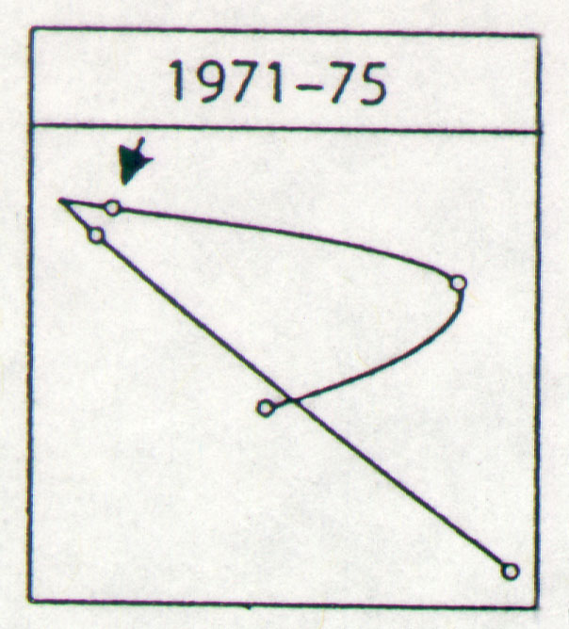
Profitability vs. Investment
1973
1972
1974
1975
1971

Slide 51
Profitability vs. Investment in the Computer Industry
It is obvious that with the shrinking technology, it is getting more expensive to move to the next generation process technology.
It is also obvious that the manufacturing cost as well as the sales price of processing chips is decreasing rapidly.

Slide 52
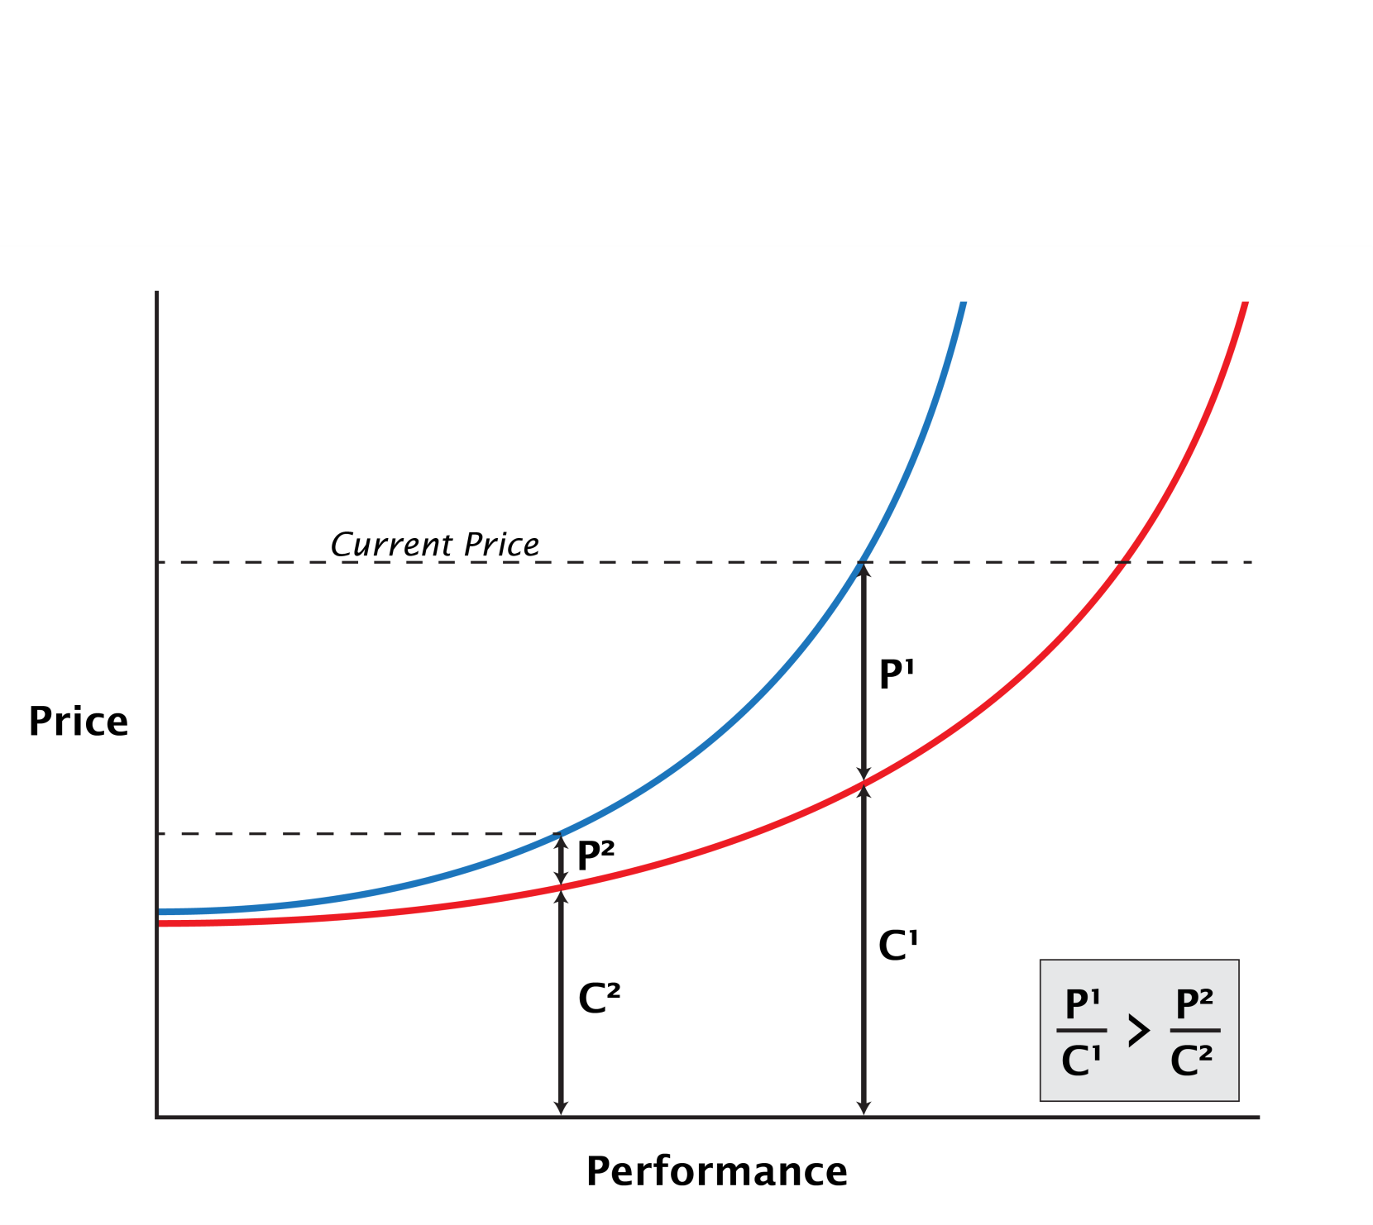
Diminishing Profitability

Slide 53
With these observations, what should the dominant chip manufacturers (Intel, IBM, TI, TSMC, Samsung, AMD, etc.) do?

Slide 54
Instructions Per Second (IPS)
IPS = No. of cores x (No. of cycles/Sec.) x (Instructions/cycle)
Example: Digital Equipment Corporation
VAX 11/780, 5Mhz
Cost $250,000 1977
IPS = 1x5x10⁶(cycles/sec)x0.2(Instructions/cycle)
=1x10⁶(Instructions)
⁖ The first 1.0 MIPS machine

Slide 55
Instructions Per Clock-cycle per second (IPS) (Microprocessor CPU’S)

Slide 56

Instructions Per Clock-cycle per second (IPS) (Microprocessor CPU’S)
Processor / System | MIPS and Frequency | (IPS / clock cycles per second) | (IPS / clock cycles per second / cores) | Year*
*Nvidia Ge-Force RTX-2080T.I | 76,000,000 MIPs at 1.5 GHz | 50,666.7 | 11.6 | 2019
*Nvidia Quadro RTX-2080T.I | 78,000,000 MIPS at 1.6 GHz | 48750.0 | 11.2 | 2019
*Nvidia DGX | 500,000,000 MFLOPs at 1.46 GHz | 357142.9 | 17.4 | 2017

Slide 57
Impact of Changing Customer Demand

Slide 58
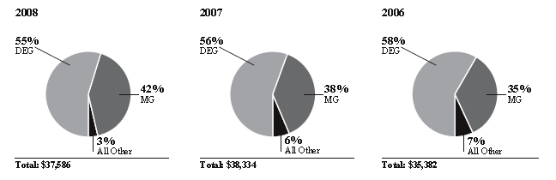
Intel 2008
In 2008 the average selling price for all products continued to decline
The revenues for the mobility group as contrasted to the digital enterprise group continued to increase
Percentage of Revenue
(Dollars in Millions)
Intel 2008 Annual Report and 10-K, http://www.intc.com/annuals.cfm

Slide 59
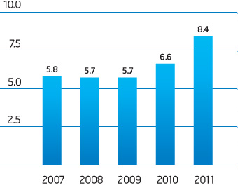
Intel Research and Development 2011

Slide 60
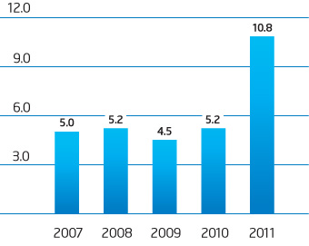
Intel Capital Additions to Property, Plant and Equipment 2011

Slide 61
Intel 2011
A new fab costs approximately $3-4B or more
Should Intel Continue to Invest In Creating New Fabrication Facilities?

Slide 62
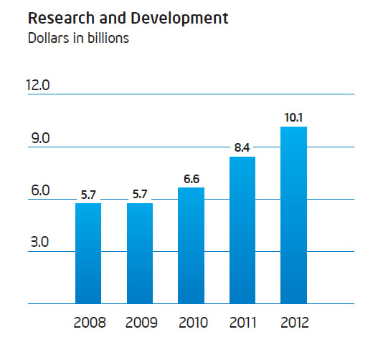
Intel Research & Development 2012

Slide 63
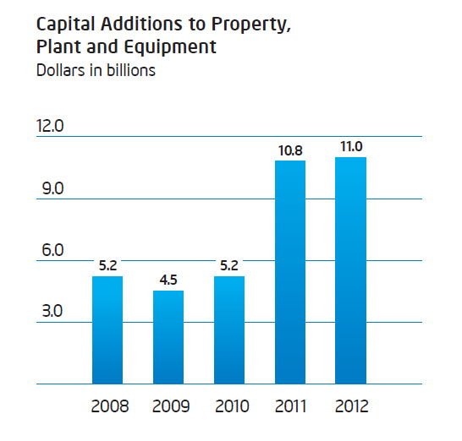
Intel 2012

Slide 64
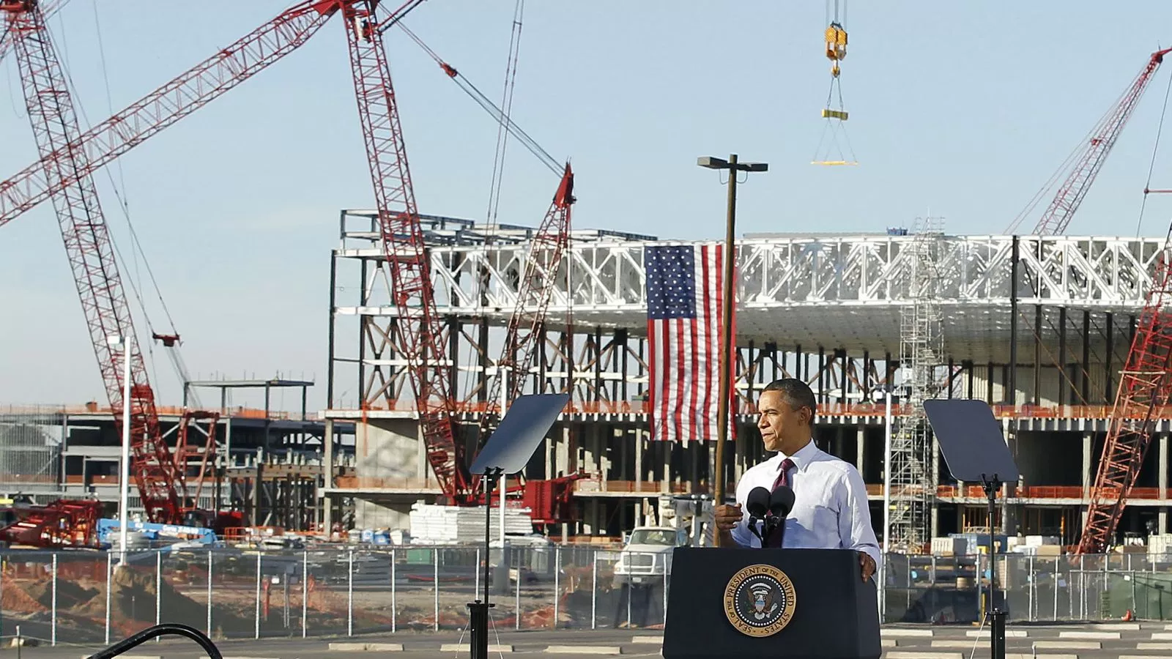
Obama at Intel 2012

Slide 65
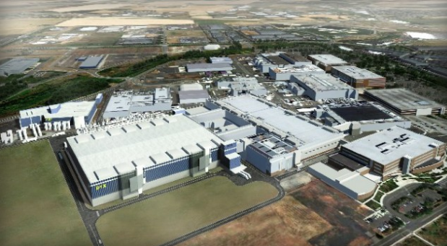
Intel cancels 14nm Fab 42 in AZ, due to increasing competition from ARM
January 2014, ExtremeTech.com

Slide 66
How did Intel maintain it’s revenue stream?
It Retrofitted two existing plants in Chandler Arizona
22nm >>> 14 nm (Fab 22 & Fab 32)

Slide 67
Is there another revenue stream?

Slide 68
Intel 2015
Intel again delays 10nm technology. It will depend on revenue increase from Windows 10 and its new Skylake processor.
The second generation of 14nm production technology had significant yield improvements.
At the same time, Intel moved to purchase Altera so it could shift from PC’s to mobile devices.

Slide 69
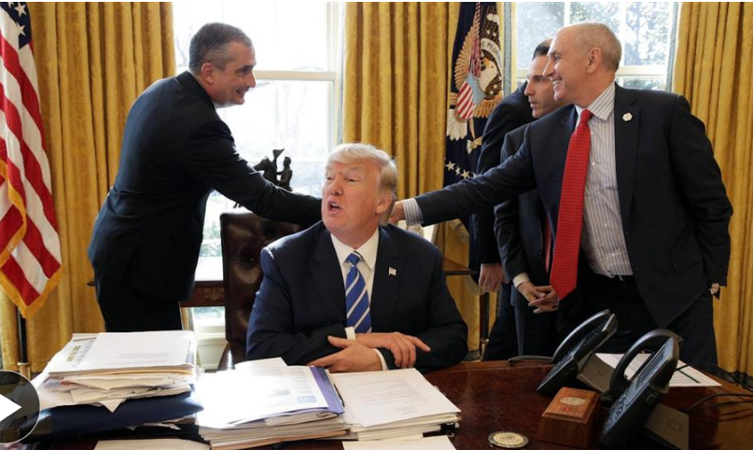
Intel’s $7B Investment
Wall Street Journal, Feb. 8th, 2017

Slide 70
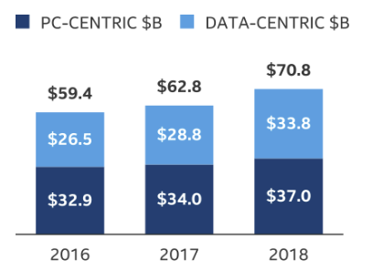
Intel 2018

Slide 71
Will the cost of new fabrication plants lead to oligopolies in this industry?

Slide 72
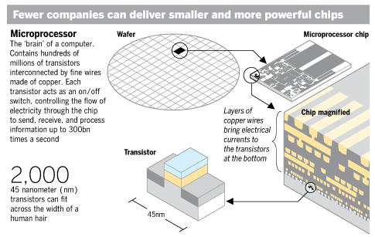
Fewer companies can deliver smaller and more powerful chips (July 20, 2009)
Chris Nuttall. “Moore’s Law hits economic limits,” FT.com, July 20, 2009 - http://www.ft.com/cms/s/0/01c8b5aa-754e-11de-9ed5-00144feabdc0.html

Slide 73
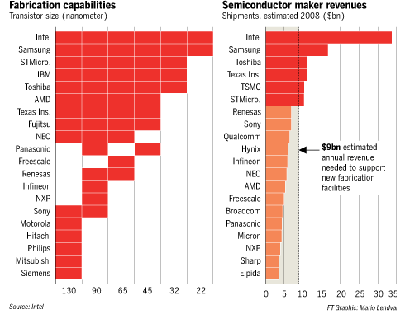
Fewer companies can deliver smaller and more powerful chips July 20, 2009
Chris Nuttall. “Moore’s Law hits economic limits,” FT.com, July 20, 2009 - http://www.ft.com/cms/s/0/01c8b5aa-754e-11de-9ed5-00144feabdc0.html

Slide 74
Cost of Current and Future FABs
TSMC invested $9.3 billion in its Fab15 300 mm wafer manufacturing facility in Taiwan.
Estimates are that future FABs might cost $20 billion

Slide 75
Foundry Model
Many companies (Integrated Device Manufacturers, IDMs) design and manufacture integrated circuits (efficiency through vertical integration)
Today, there are many companies that:
only design devices (fabless semiconductor companies),
as well as merchant foundries that only manufacture devices.
The foundry model is a business vision that seeks to optimize productivity.
In 1987, the world’s first dedicated merchant foundry opened its doors: Taiwan Semiconductor Manufacturing Company (TSMC)
source: https://en.wikipedia.org/wiki/Foundry_model

Slide 76
TSMC’s Customers
Manufacture’s chips for
Qualcomm
Nvidia
Advanced Micro Devices (AMD)
Broadcom, Altera
(even some for Intel & Texas Instruments)
Apple’s A5, A6 for iPad & iPhone
Apple’s new A8
source: https://en.wikipedia.org/wiki/TSMC

Slide 77
GlobalFoundries 2020
GlobalFoundries is an American Semi-Conductor Foundry in Santa Clara, CA, Vermont, Singapore, Germany, and owned by Advanced Technology Investment Company of the emirate of Abu Dhabi.
The firm manufactures chips for AMD, Broadcom, Qualcomm, and STMicroelectronics.
Wikipedia, GlobalFoundries

Slide 78
“Every economic era is based on a key abundance and a key scarcity.”
George Gilder,
Forbes ASAP, 1992

Slide 79
If processing is free what other options are available to create new revenue streams?

Slide 80
“Watts are more important then MIPS or FLOPS”
- George Gilder
http://www.wired.com/print/gadgets/wireless/magazine/17-03/mf_netbooks

Slide 81
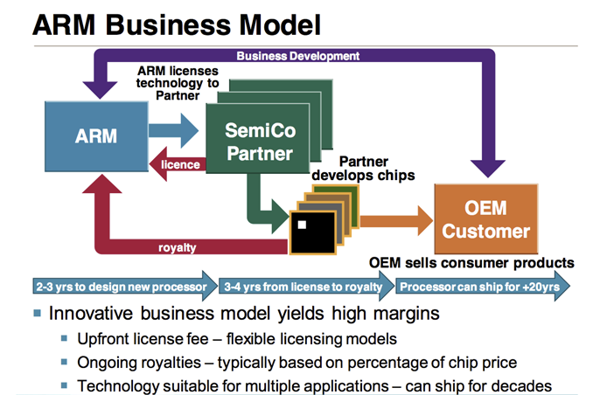
ARM Holdings - Business Model
Shimpi, Anand Lal. "The ARM Diaries, Part 1: How ARM's Business Model Works.“ Anand Tech. N.p., 28 June 2013. Web. 31 Aug. 2015.

Slide 82
ARM Holdings
Original name was Acorn Computers
In 1990 a new customer arrived, Apple: and company was renamed Advanced RISC Machines (ARM)

Slide 83
ARM Holdings 2014
By 2014, ARM dominated the smartphone market and had the following market share
95% smartphone market
10% mobile market
35% digital TV’s
23% PC’s
In 2014 ARM cores were licensed for 12 Billion chips

Slide 84
ARM’s Customers
Apple (iPhone 5, iPad, iPhone 5s, iPhone 6, etc.)
Samsung (Galaxy S4, S5, etc.)
Qualcomm (Snapdragon)

Slide 85
Marketing & Advertising Strategies in the Computer Industry
In a fast moving technology, how do you market your product?
How do you get brand name recognition?
When do you start advertising?

Slide 86
What is MMX?
First major extension to x86 instruction set since 1985
57 new instructions to accelerate:
2D & 3D graphics
Video
Speech synthesis and recognition

Slide 87
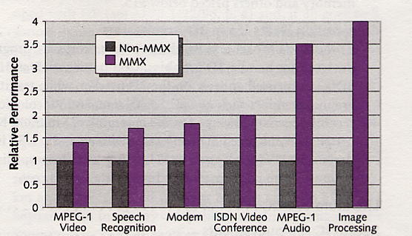

Slide 88
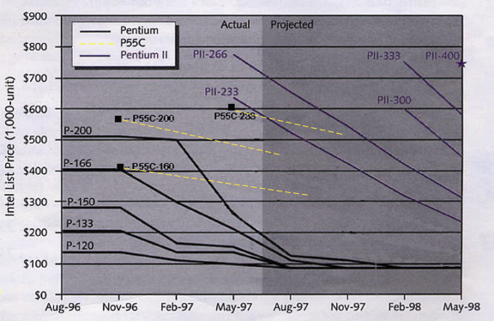

Slide 89
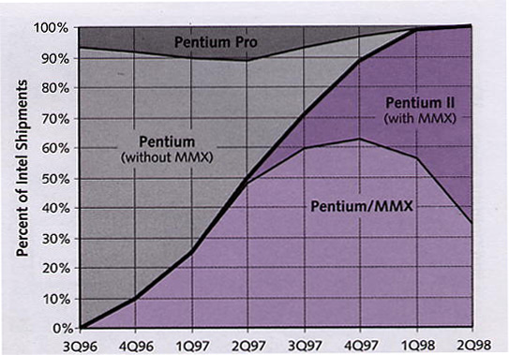

Slide 90
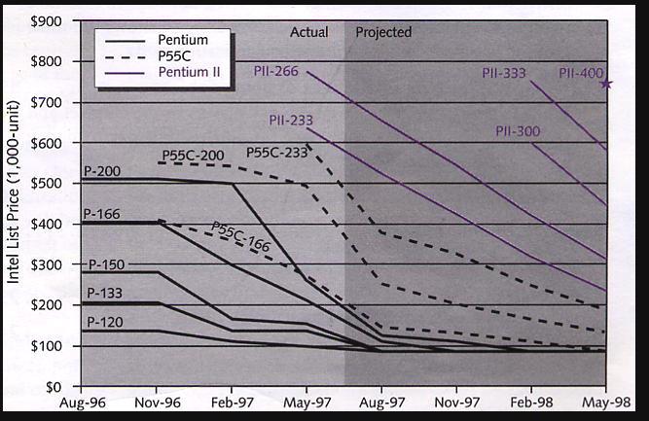

Slide 91
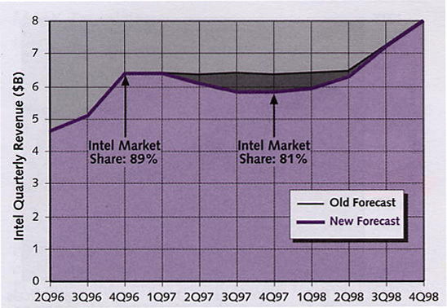

Slide 92
Four Commandments
Moore’s Law
Rock’s Law
Metcalfe’s Law
Wirth’s Law

Slide 93
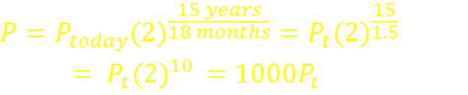
Moore’s Law
“Chip density doubles every 18 months.”
Processing Power (P) in 15 years:

Slide 94
Moore’s Law (continued)
Original paper noted that the cost per electronic component was inversely proportional to the number of components/chip
In 1988 Erich Bloch (then head of IBM’s research division), later Chairman of NSF Board, & sponsor for Cornell’s Theory Center
“Moore’s law won’t work at feature sizes less than a quarter of a micron (250 nanometers)”
Moore, underestimated the staying power of photolithography, “No exponential trend lasts forever, but forever can be postponed”

Slide 95
Rock’s* Law
“The cost of semiconductor tools will double every four years”
Actually this was not true and current cost is $3 – 4B (slightly more than in the1990’s)
What actually happened was:
1980’s. . .increase in yield
1990’s. . .increase in throughput
(from 20 wafers/hr. →50 wafers/hr.)
Now, reduced size with 193μm stepper and larger wafers (300mm)
* Rock was an initial investor in Intel

Slide 96
Metcalfe’s* Law
“The value of a network grows as the square of the number of users”
1980 - later in “There Oughta be a Law,” NY Times 1996
Unlike the previous laws, this can’t be quantified because value (what economists call utility) can’t be measured.
However, note the impact of search engines, and the business model of Google, Yahoo, etc.
* Inventor of the Internet standard

Slide 97
Wirth’s* Law
“Software is slowing faster than hardware is accelerating”
IEEE Computer 1995
“Were it not for a thousand times faster hardware, modern software would be utter unusable”
Most of the features that bloated the programs were superfluous for most of the users most of the time
* Niklaus Wirth, Professor of ETH, Zurich and inventor of Pascal

Slide 98
END. . .
Notes:
G. Dan Hutcheson and Jerry D. Hutcheson. “Technology & Economics in the Semiconductor Industry, “ Scientific American: The Solid State Century, pp. 66-73, January 1996.

